Slide 1


Set 2 Sounds
ir
Notes:
Lets practise our set 2 sounds, today;’s sound is ir

Slide 2
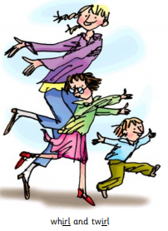
Notes:
What are these people doing? Yes, theyre dancing, they are doing a whirl and twirl

Slide 3
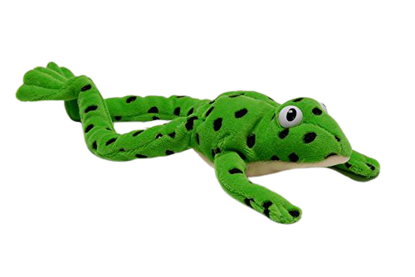
Notes:
Lets fred talk! Wh-ir-l, whirl, t-w-ir-l, twirl, b-ir-d, bird

Slide 4
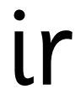
Notes:
This is our new sound ir. It has 2 letters but 1 sound, it’s a special friend

Slide 5
Notes:
Lets practice ir. My turn first…..

Slide 6
Notes:
Now can you practice ir when the pictures move on the screen?

Slide 7
girl
_
.
.
whirl
_
_
.
twirl
_
.
.
.
Notes:
Lets read some green words! First lets use fred talk then read the word

Slide 8


Notes:
Let’s practice writing our sound - ir

Slide 9
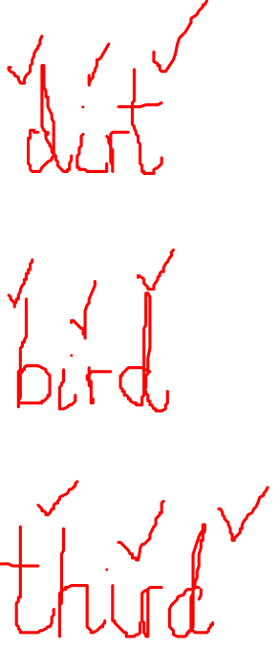
Notes:
Let’s practice writing words with the ir sound in them dirt, bird, third

