Slide 1
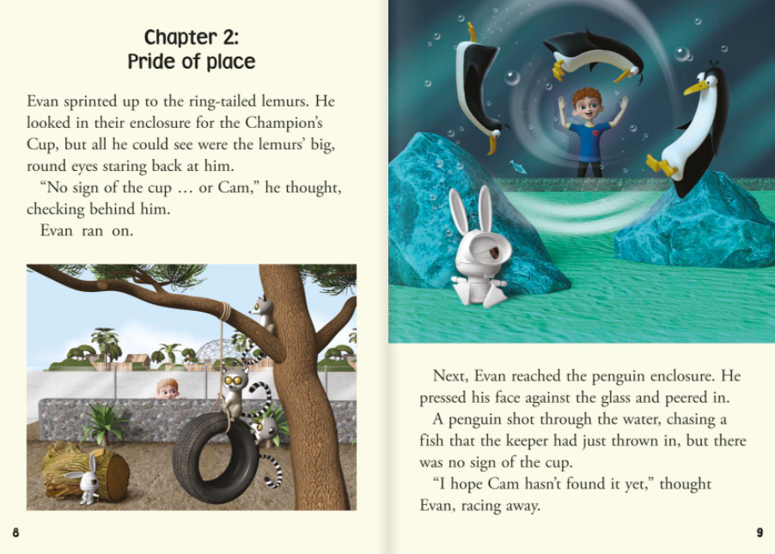
1. Why does Evan hope Cam hasn’t found the cup yet?

Slide 2
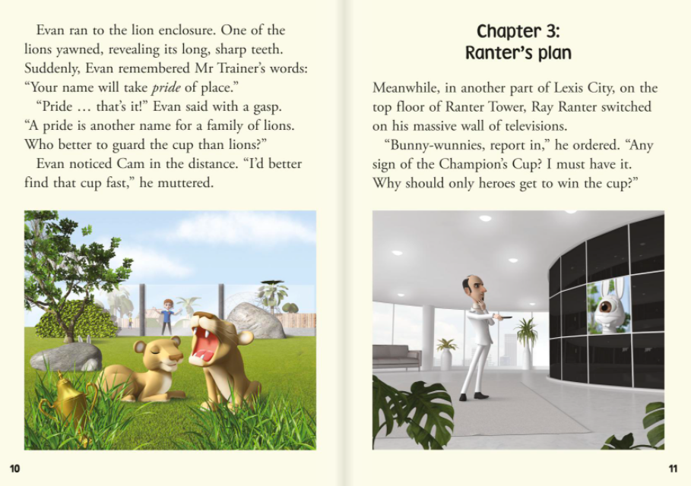
2. Why does Evan think the cup might be hidden with the lions?

Slide 3
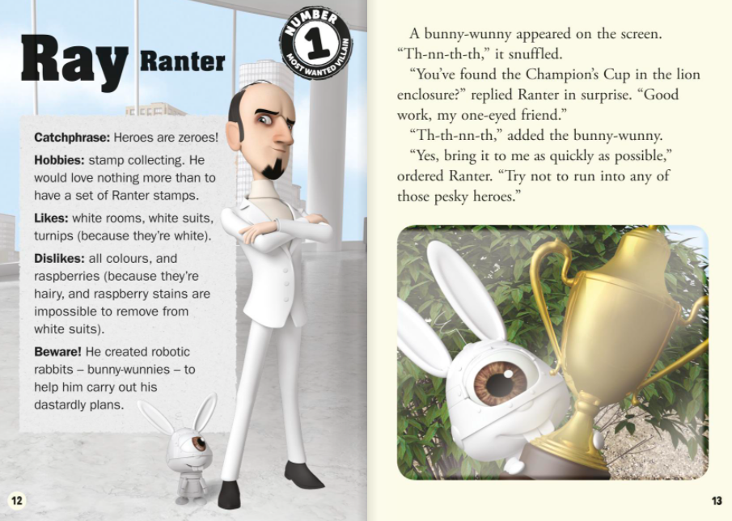
3. Why does Ray Ranter dislike raspberries?

Slide 4
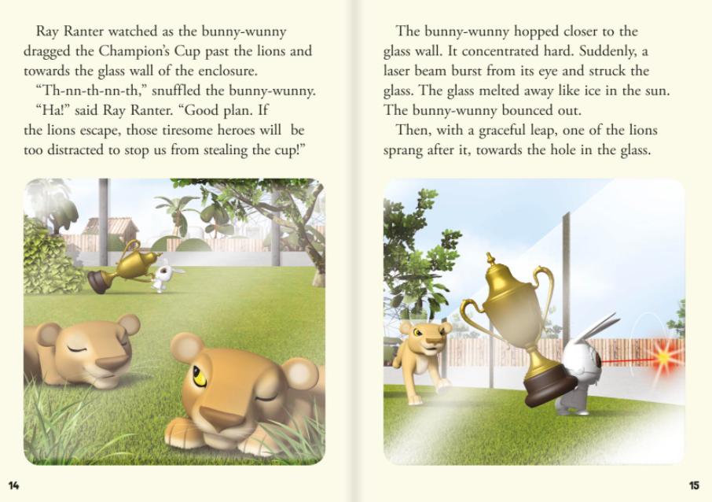
4. Now that the bunny-wunny has made a hole in the glass, what do you think might happen next?

