Slide 1
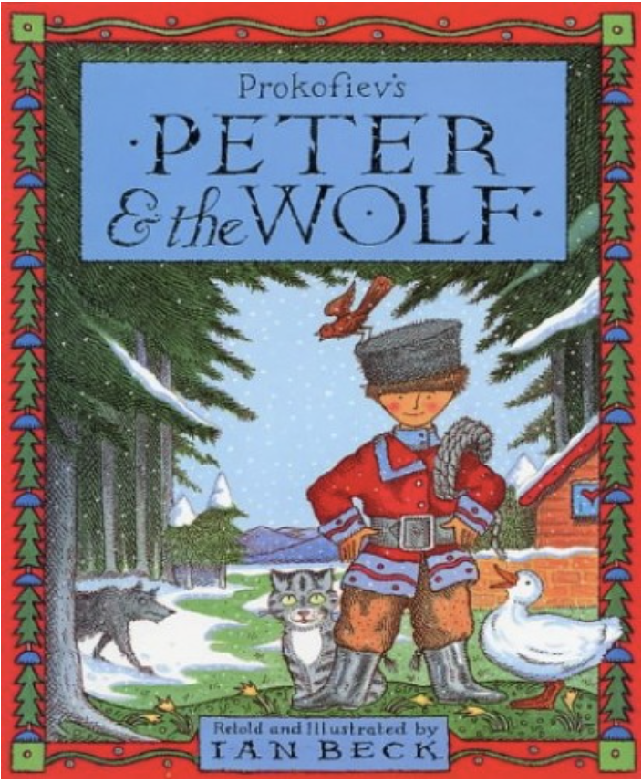
Notes:
Yesterday, we made predictions (guesses) about what Peter and the Wolf could be about. Peter and the Wolf is a traditional tale which is based on a piece of music composed by Sergei Prokofiev. It has been retold many times. Today we are going to look at the start of the story and see if your predictions were correct.

Slide 2
Listen to the first part of the story and see if you can answer the questions at the end.

Slide 3
Notes:
First – Peter and the Wolf music
Then - Peter and the Wolf is a piece of music composed by Sergei Prokofiev in 1936, it has since been narrated, retold and illustrated by different authors. We will look at Ian Beck’s.

Slide 4
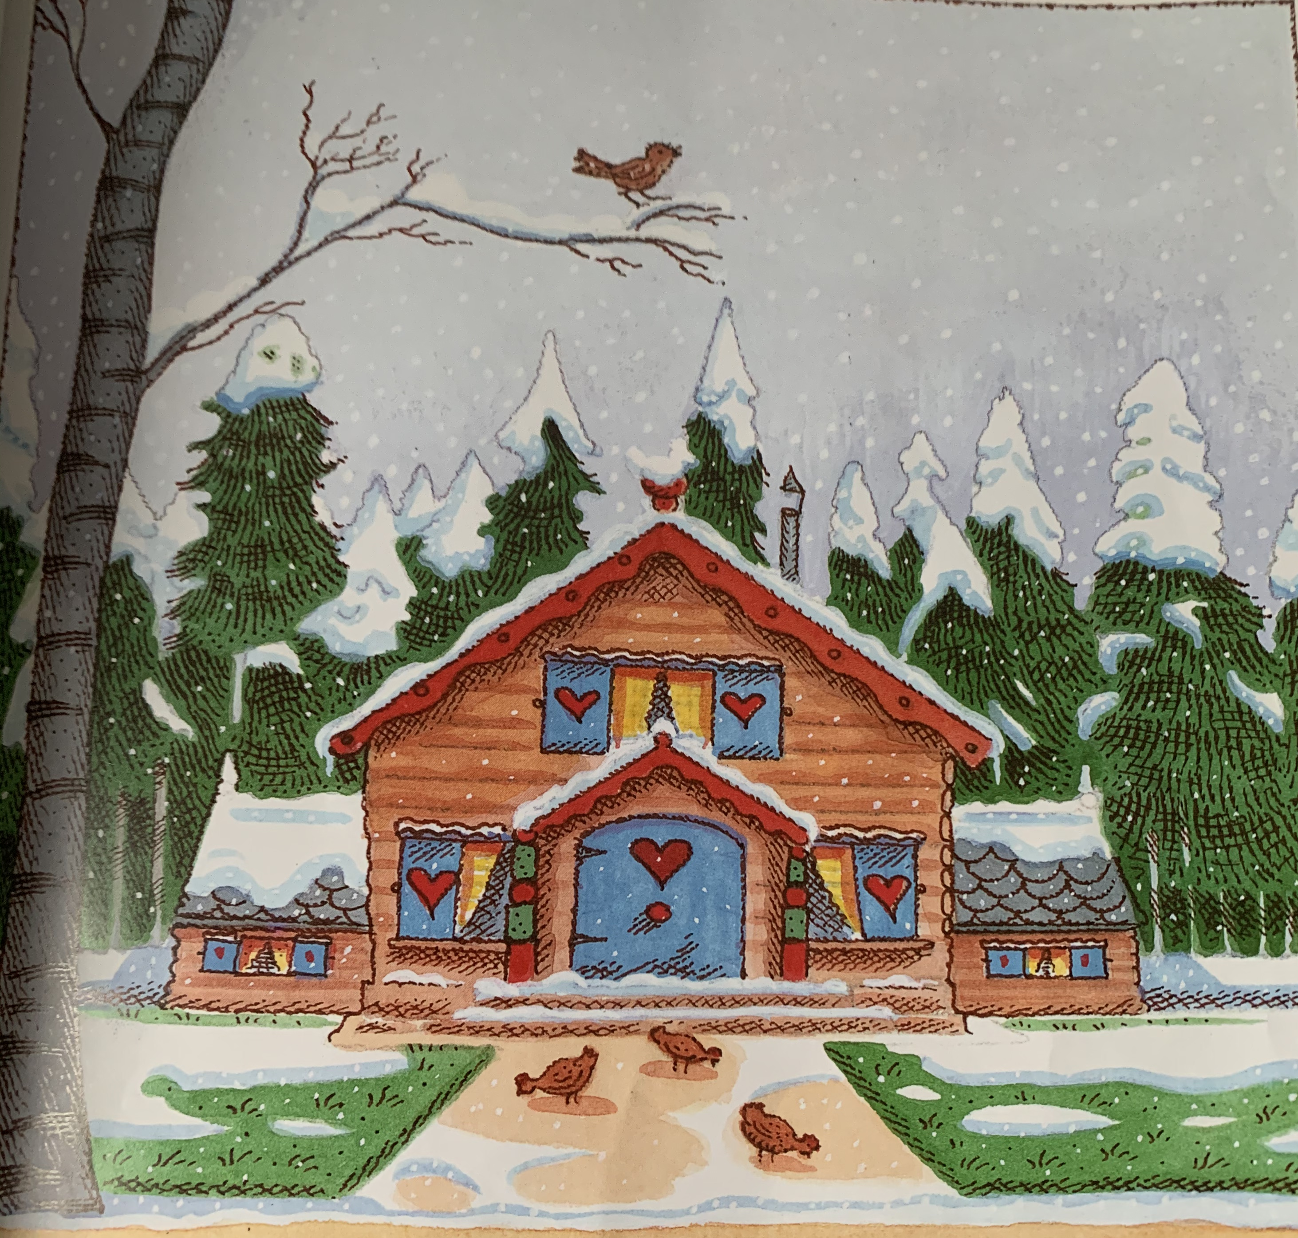
Notes:
Peter lived with his Grandfather in a little wooden house at the edge of a great dark forest. Around their house was a garden, beyond the garden was a meadow.

Slide 5
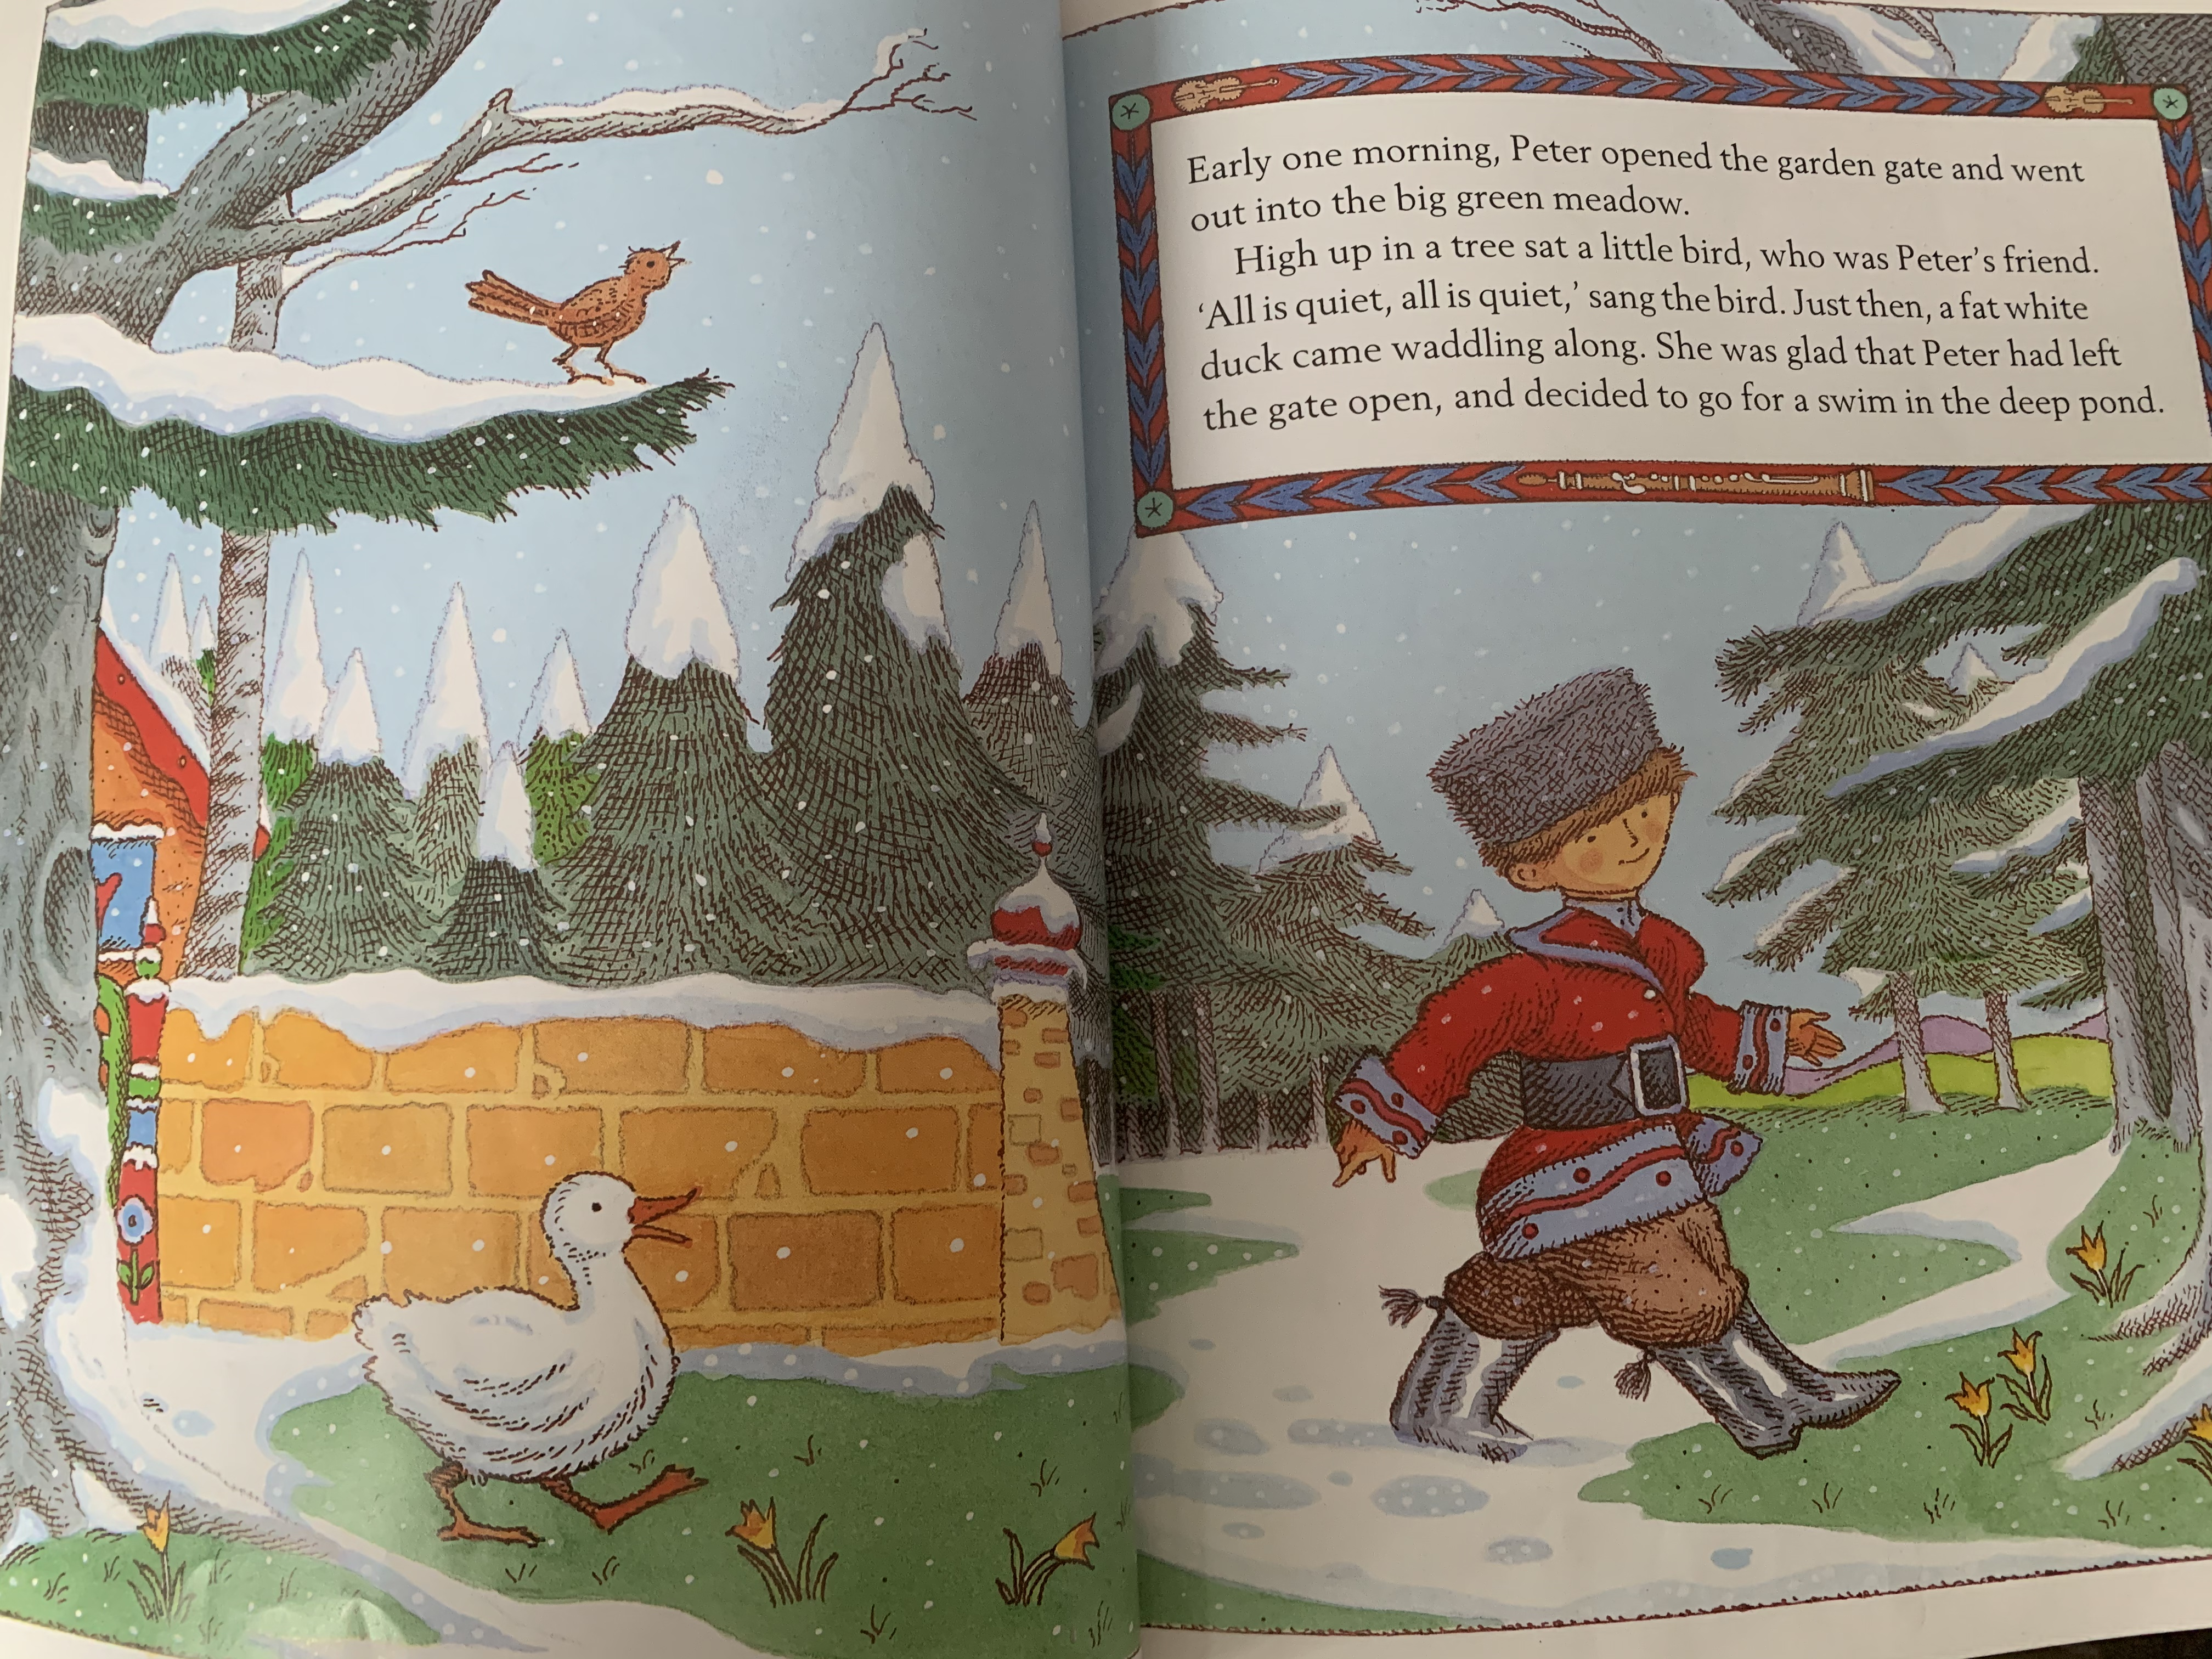
Notes:
Early one morning, Peter opened the garden gate and went out into the big green meadow. High up in the tree sat a little bird who was Peter’s friend. “All is quiet, all is quiet,” sang the bird. Just then a fat white duck came waddling along. She was glad that Peter had left the gate open and decided to go for a swim in the deep pond.

Slide 6
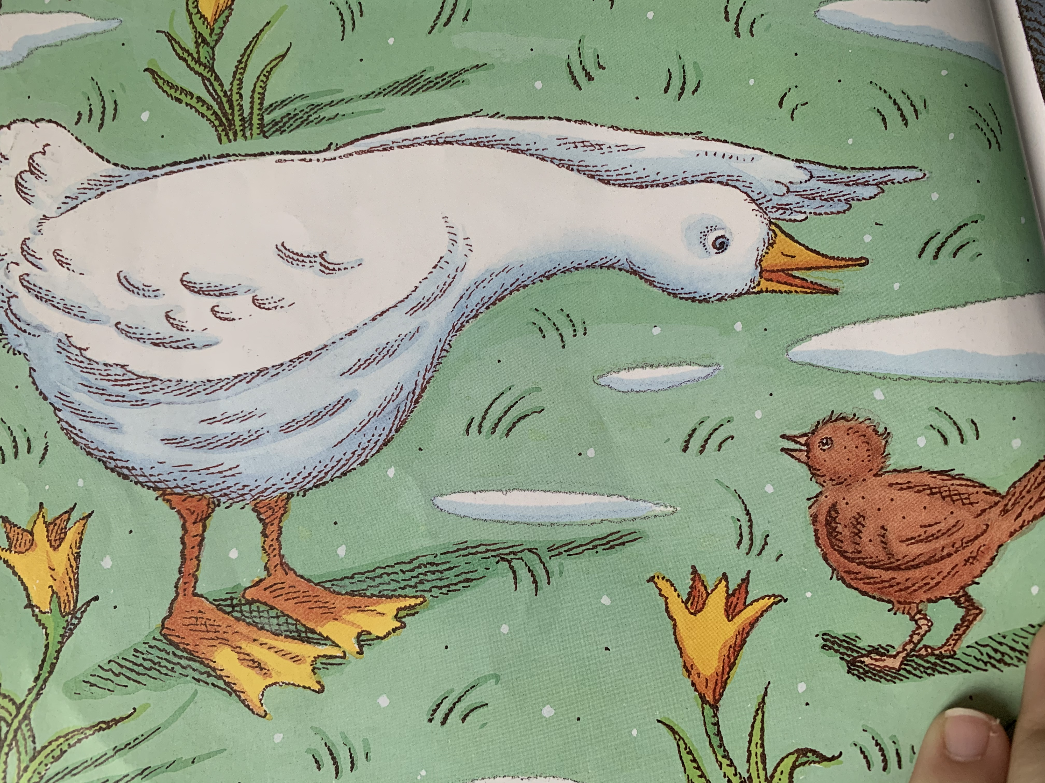
Notes:
Seeing the duck, the little bird flew down from the tree and settled next to her on the grass. He looked her up and down. “What kind of bird are you if you can’t fly?” He said.

Slide 7
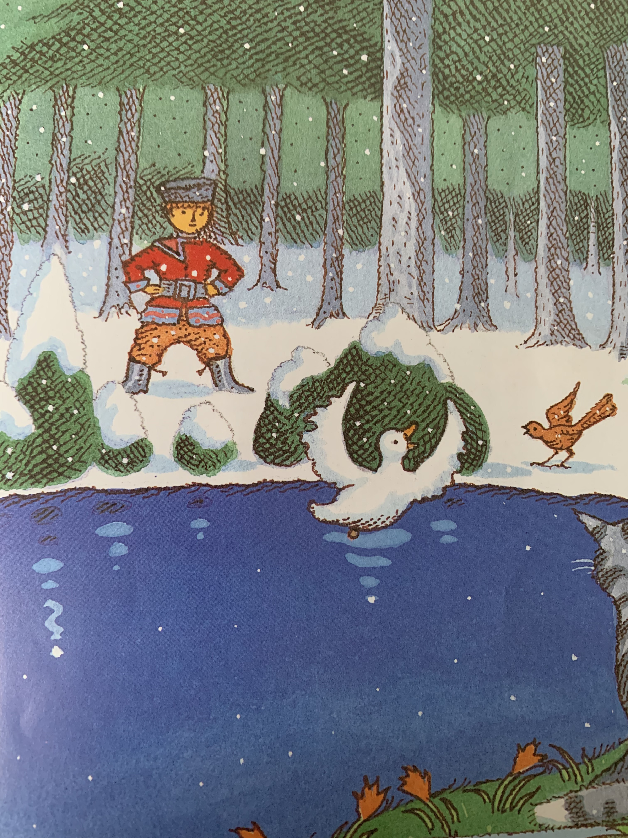
Notes:
The duck just shook her feathers and said, “What kind of bird are you, if you can’t swim?” She dived into the water. Peter watched them as they argued and argued. The duck quacking in the pond and the little bird hopping around the edge.

Slide 8
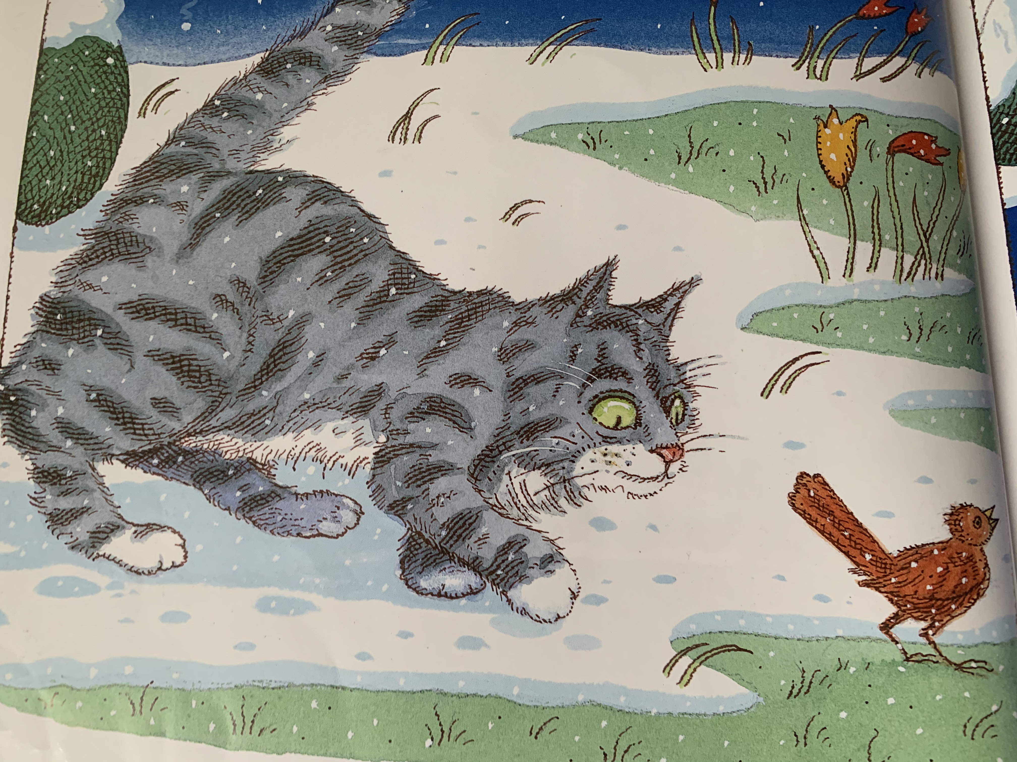
Notes:
Suddenly, something caught Peter’s eye. It was a cat, creeping slowly towards them. The cat was thinking, “While the little bird is so busy arguing with that duck, I’ll just grab him!” Stealthily she crept nearer and nearer on her soft velvet paws.

Slide 9
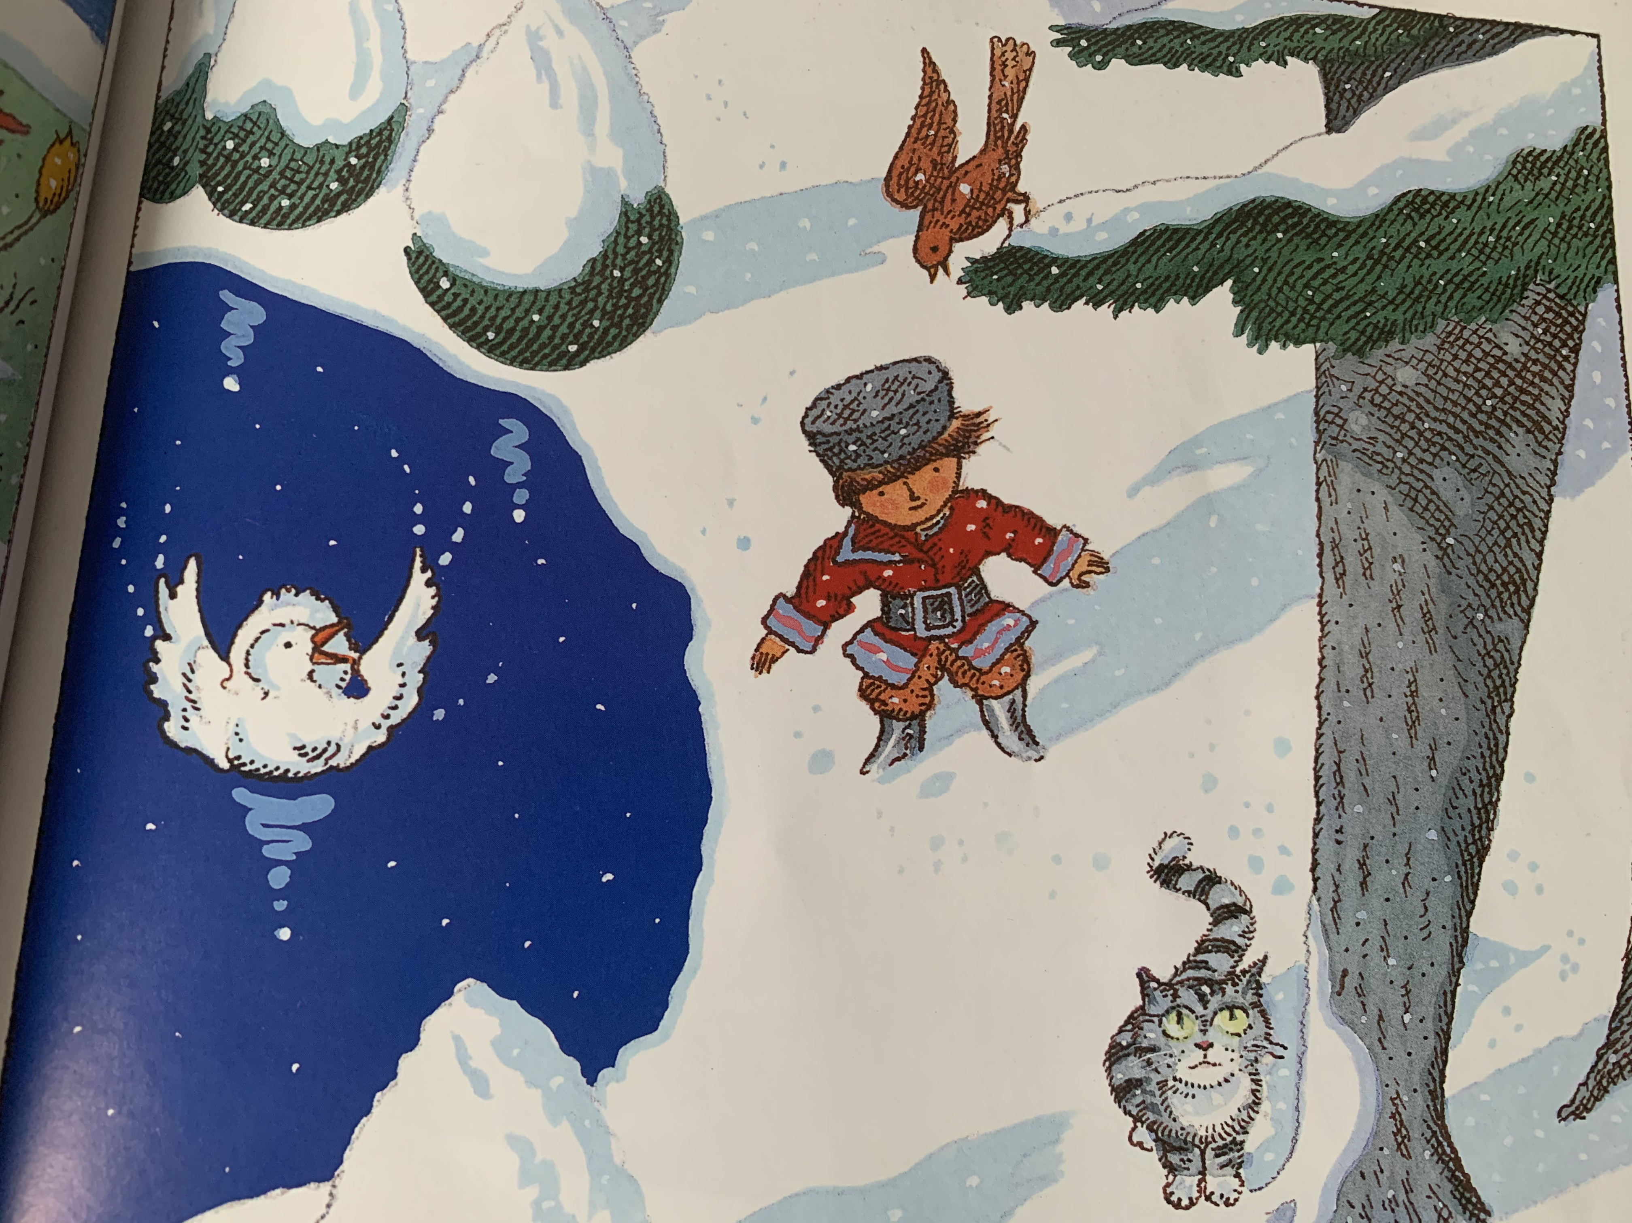
Notes:
“Look out!” Shouted Peter and the bird flew high into the tree while the duck quacked and flapped in the middle of the pond. The cat walked round and round the tree and thought, “Is it worth climbing up so high? By the time I get near the bird, he will have flown away!”

Slide 10
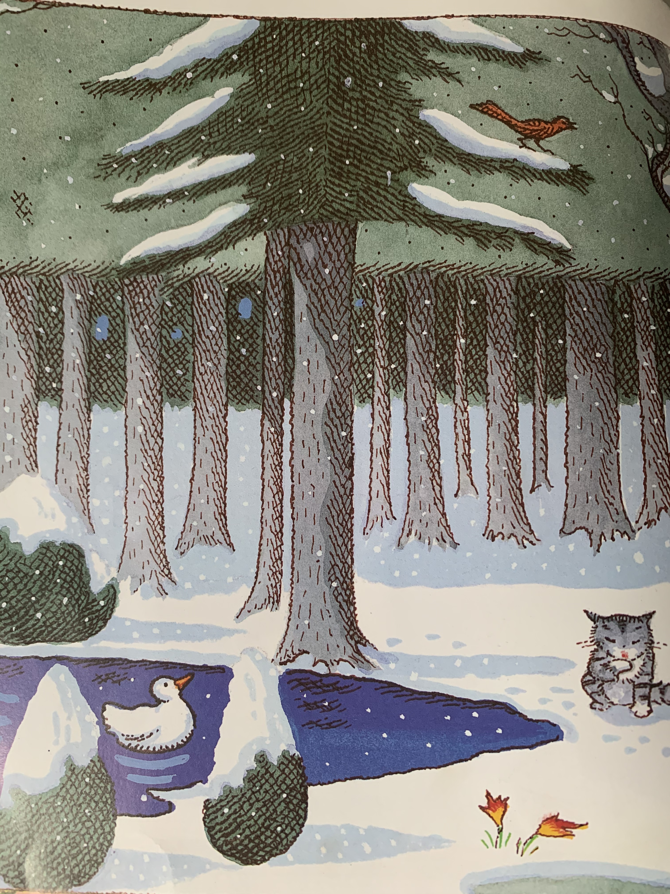
Notes:
Just then Grandfather came out of the house, he was angry that Peter had gone out into the meadow. “It’s a dangerous place this, suppose a wolf would come out of the great dark forest, what would you do then?!”

Slide 11
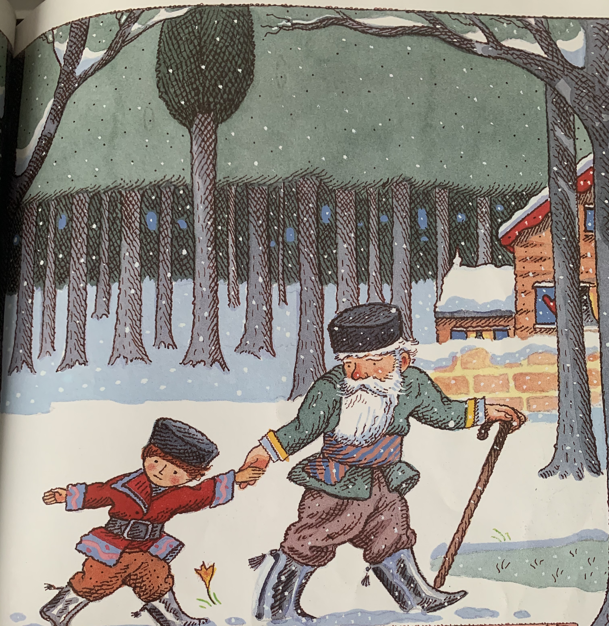
Notes:
Peter paid no attention to his Grandfather’s words. Boys like him aren’t afraid of wolves. Grandfather took Peter by the hand, led him home and locked the garden gate.

Slide 12
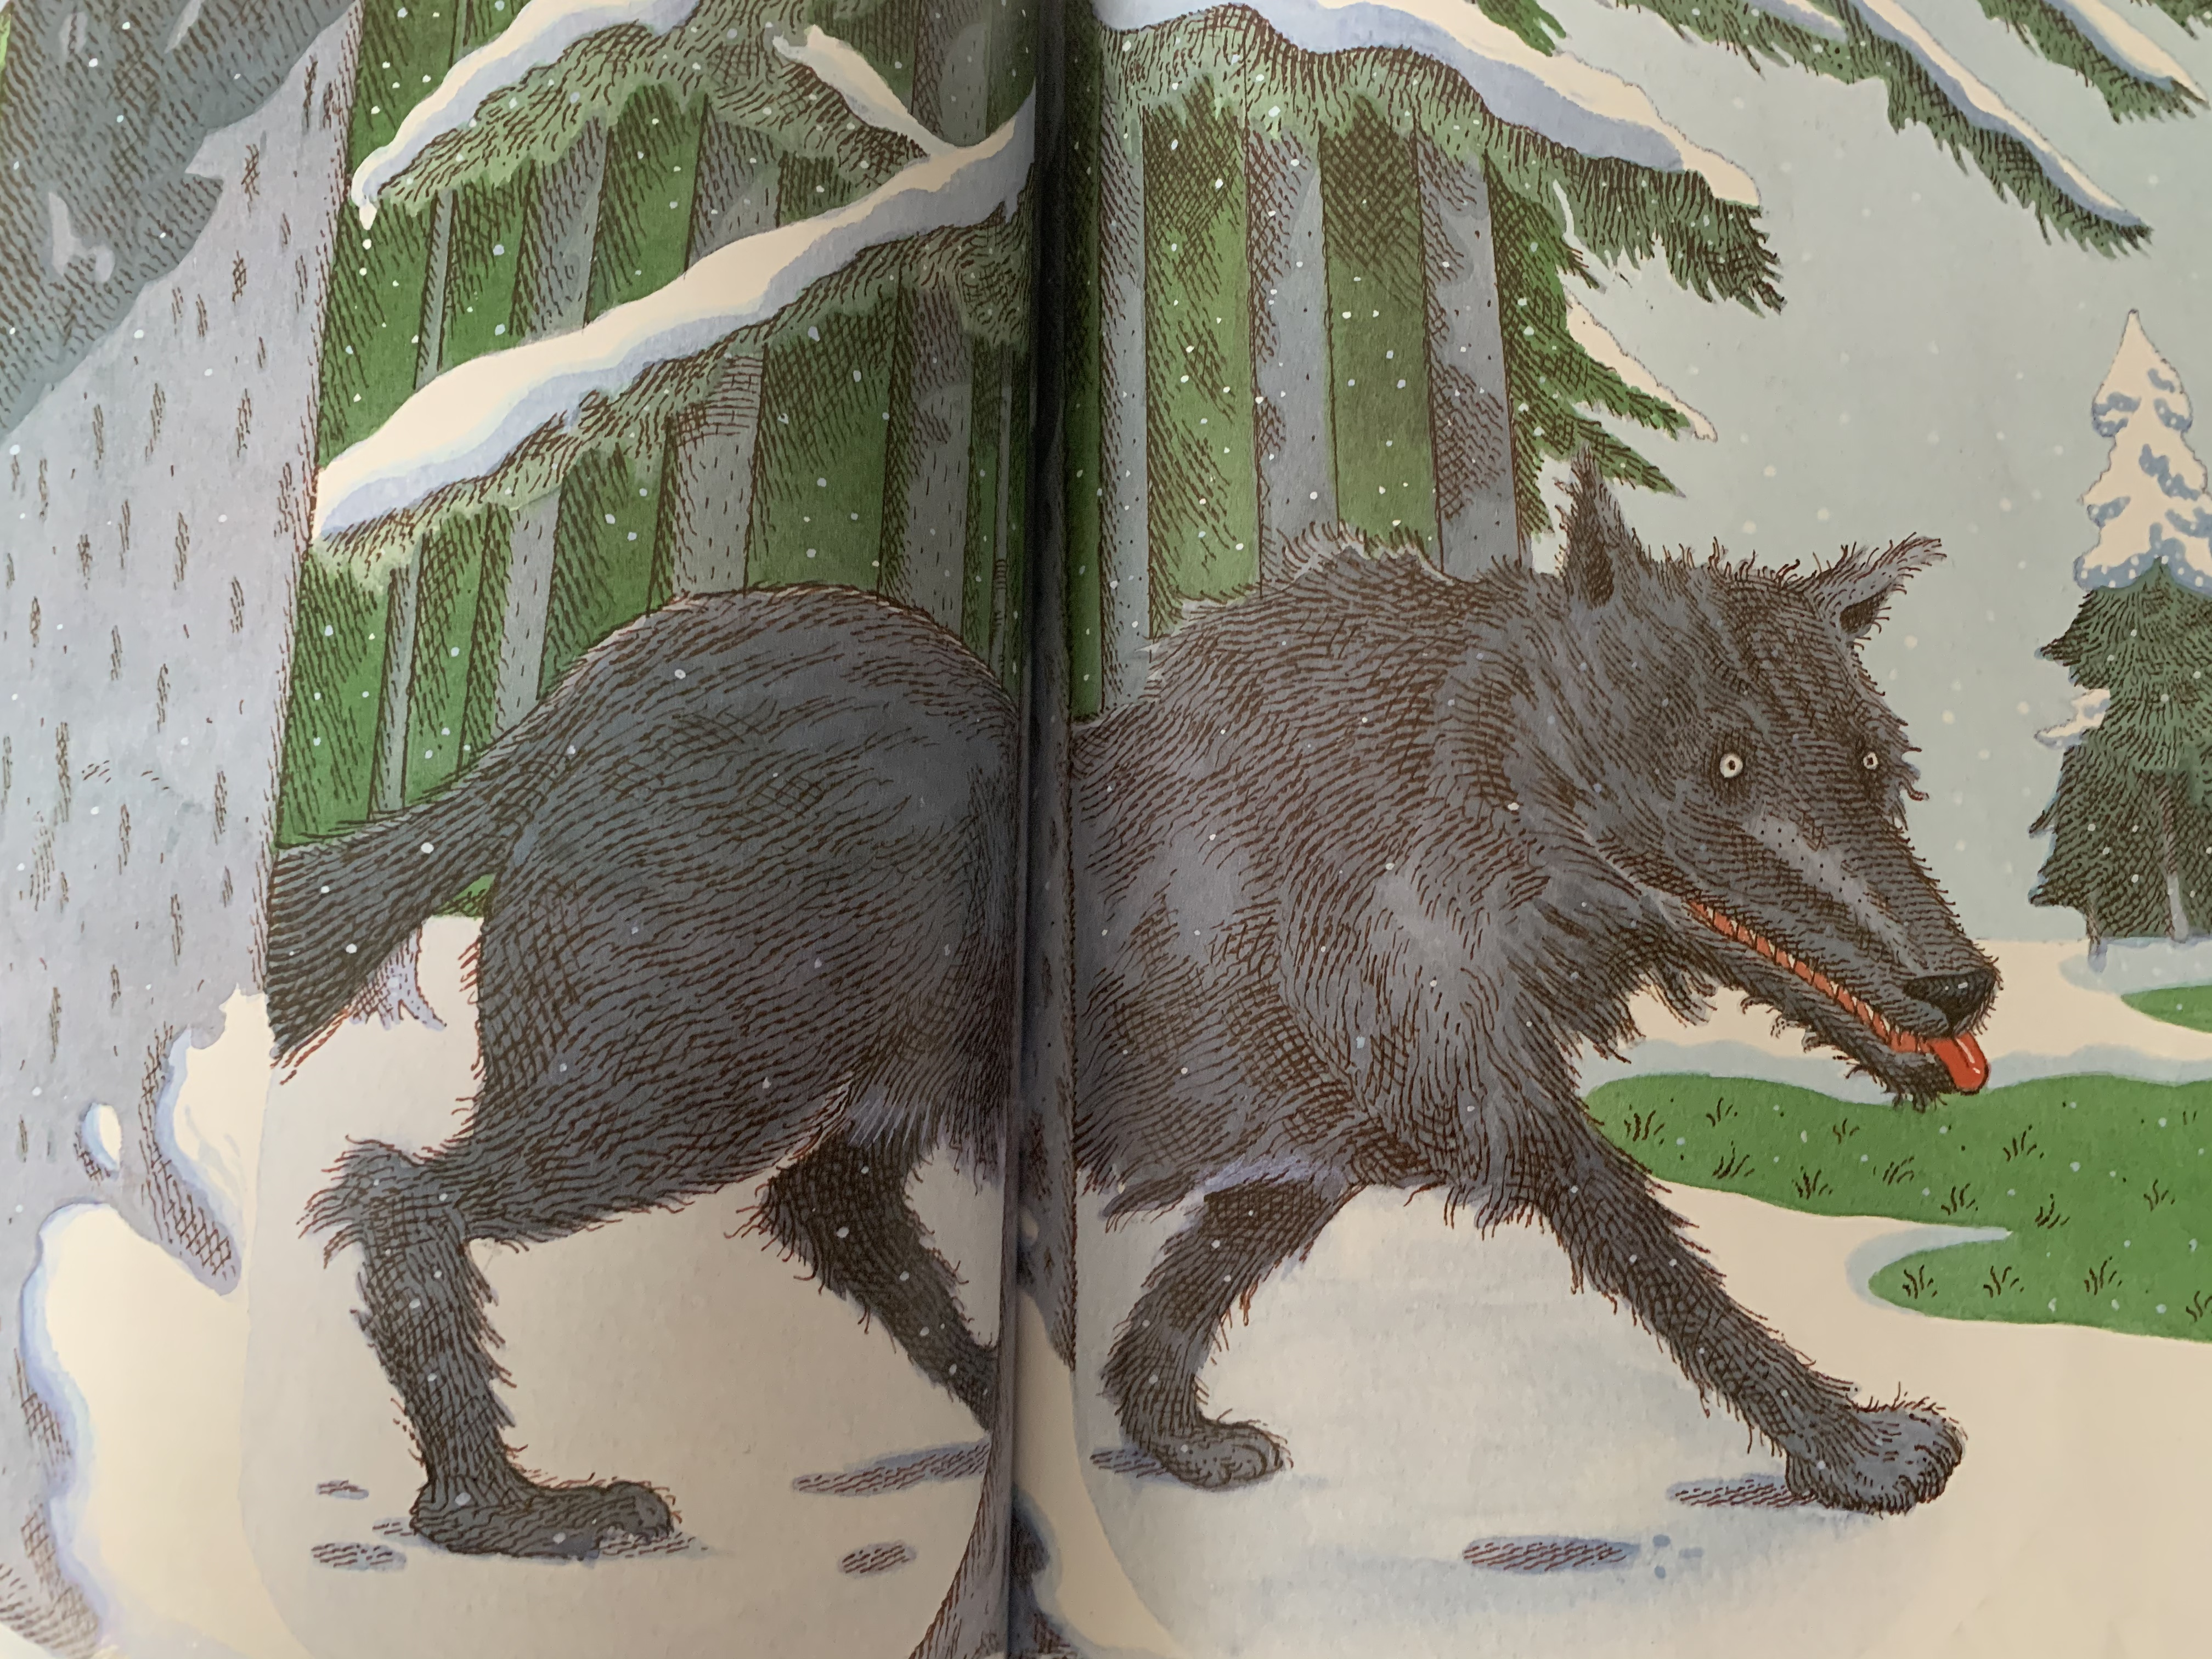
Notes:
No sooner had Peter gone, then a big grey wolf came out of the forest.

Slide 13
Can you describe Peter?
Which animal does Peter meet first?
Are duck and bird friends? Why?
Who tries to eat bird?
Why is Grandfather angry at Peter?
What might happen next?
Notes:
Can you describe Peter?
Which animal does Peter meet first?
Are duck and bird friends? Why?
Who tries to eat bird?
Why is Grandfather angry at Peter?
What might happen next?

Slide 14
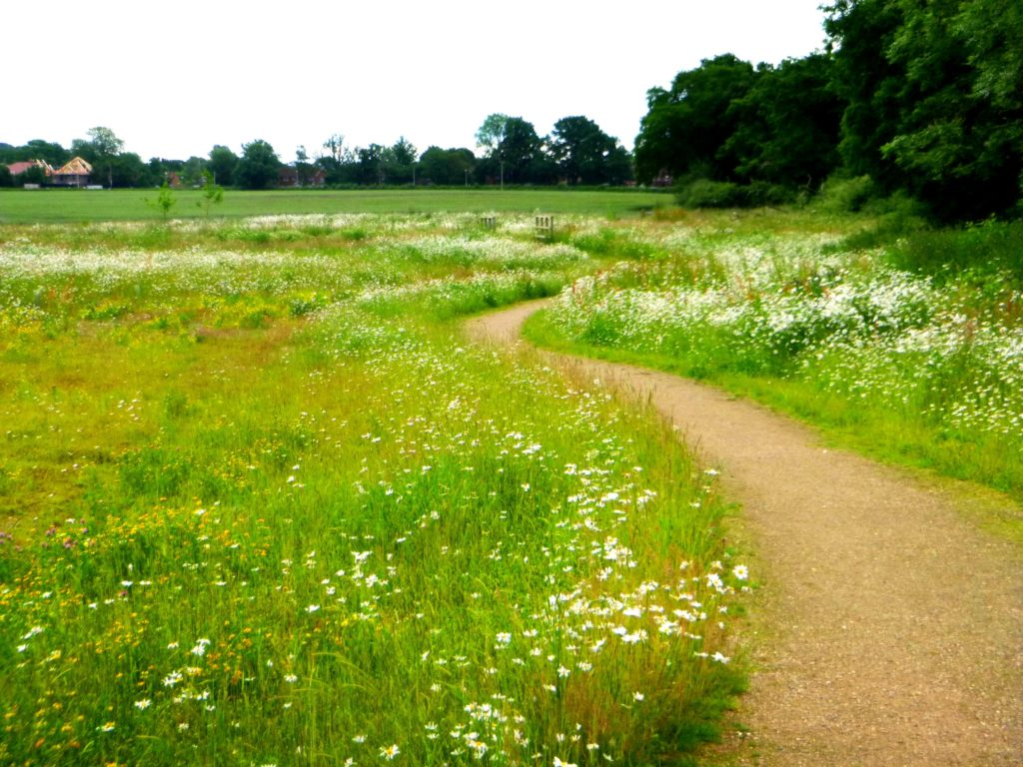
Glossary:
meadow – a meadow is an open field or grassland
Grandfather – the father of a mother or father. There are lots of different names for them for example, Grandad, Grandpa, Granda, Pop.
beyond – at the side or further away of something
stealthily – to do something slowly and carefully to try not to get caught

Slide 15
Commentary:
Slide 1: Yesterday, we made predictions (guesses) about what Peter and the Wolf could be about. Peter and the Wolf is a traditional tale which is based on a piece of music composed by Sergei Prokofiev. It has been retold many times. Today we are going to look at the start of the story and see if your predictions were correct.
See the word document for the commentary with each picture
Slide 13: Can you describe Peter? Which animal does Peter meet first? Are duck and bird friends? Why? Who tries to eat bird? Why is Grandfather angry at Peter? What might happen next?
Glossary: A glossary is the page that tells you the meaning of words. Meadow, Grandfather, beyond and stealthily

