Slide 1

Learning intention: To identify the eight points of a compass.

Slide 2
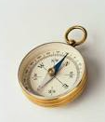
A Compass
A compassis a tool for finding direction. A simple compass is a magnetic needle mounted on a pivot, or short pin. The needle, which can spin freely, always points north. The pivot is attached to a compass card. The compass card is marked with the directions.

Slide 3
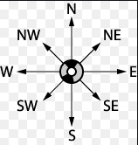
Eight points compass.
A compass that has eight points uses North, East, South and West as well as four ordinal directions, North East, South East, South West, North West.

Slide 4
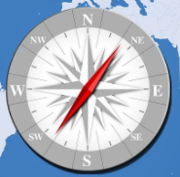
North, East, South and West.
A compass can be used to find which direction north is. Compasses show four directions - north, east, south and west. These are called the four cardinal points on a compass.
On a compass
North – N
East- E
South- S
West - W

Slide 5
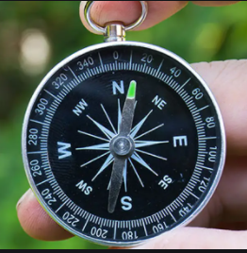
North East, South East, South West, North West.
These are also known as ordinal directions. Using these will help you be more specific with the direction you are giving on a compass.
They come between the four main points on a compass and are called:
Northeast (NE)
South east (SE)
South west (SW)
North west (NW)

Slide 6
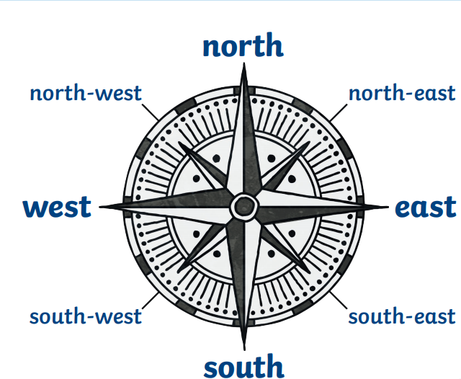
The directions on a compass are placed like this.

