Slide 1
Keeping Healthy
Can you remember what our bodies need to be healthy?
Notes:
Can you remember what our bodies need to be healthy?

Slide 2
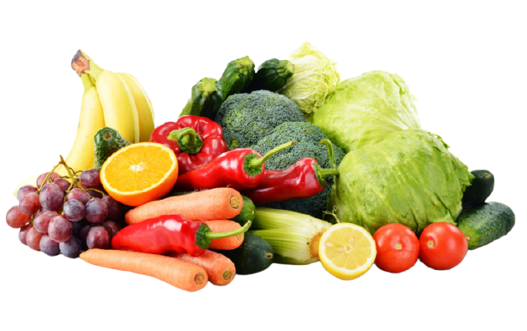
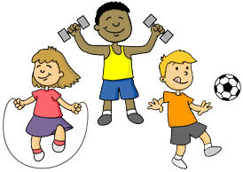
Notes:
Sleep, water, exercise and food keep our bodies healthy. Let’s talk about them some more.

Slide 3
Sleep
Children need about 8-10 hours of sleep a night.
Sleep is important for our bodies to rest and recover.
Some people need more sleep than others.
Notes:
Children need about 8-10 hours of sleep a night.
Sleep is important for our bodies to rest and recover.
Some people need more sleep than others.

Slide 4
Water
Drinking water is good for our bodies.
Our bodies have lots of water in them, so we need to keep water going in.
Water helps us cool down when we are too hot.
This is why we have water bottles at school.

Slide 5
Exercise
Doing 5-10 minutes of exercise a day is good for our bodies, especially our hearts.
We have playtimes so that you can exercise too.
Notes:
Doing 5-10 minutes of exercise a day is good for our bodies, especially our hearts.
We have playtimes so that you can exercise.

Slide 6
Food
There are lots of different types of foods.
It is important to eat a balanced diet to give our bodies the vitamins and minerals it needs to keep healthy.
What are your favourite foods?
Notes:
There are lots of different types of foods.
It is important to eat a balanced diet to give our bodies the vitamins and minerals it needs to keep healthy.
What are your favourite foods?

Slide 7
Have a go at the worksheet:?
Notes:
We have talked about some of the things that keep our bodies healthy. Can you draw them on your sheet? If you want a challenge – can you think of any more?

Slide 8
Commentary:
Slide 1: Can you remember what our bodies need to be healthy?
Slide 2: Sleep, water, exercise and food keep our bodies healthy. Let’s talk about them some more.
Slide 3: Children need about 8-10 hours of sleep a night. Sleep is important for our bodies to rest and recover.
Slide 4: Drinking water is good for our bodies. Our bodies have lots of water in them, so we need to keep water going in. Water helps us cool down when we are too hot. This is why we have water bottles at school.
Slide 5: Doing 5-10 minutes of exercise a day is good for our bodies, especially our hearts. We have playtimes so that you can exercise.
Slide 6: There are lots of different types of foods. It is important to eat a balanced diet to give our bodies the vitamins and minerals it needs to keep healthy. What are your favourite foods?
Slide 7: We have talked about some of the things that keep our bodies healthy. Can you draw them on your sheet? If you want a challenge – can you think of any more?

