Slide 1
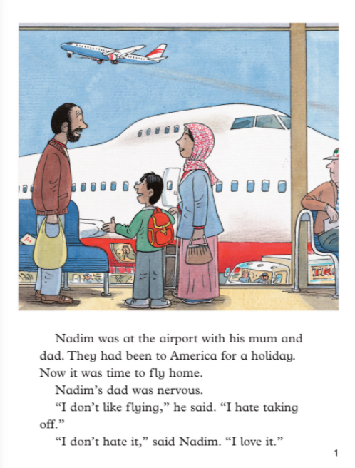
1. Where had Nadim’s family been on holiday?
2. Why was Nadim’s dad feeling nervous?

Slide 2
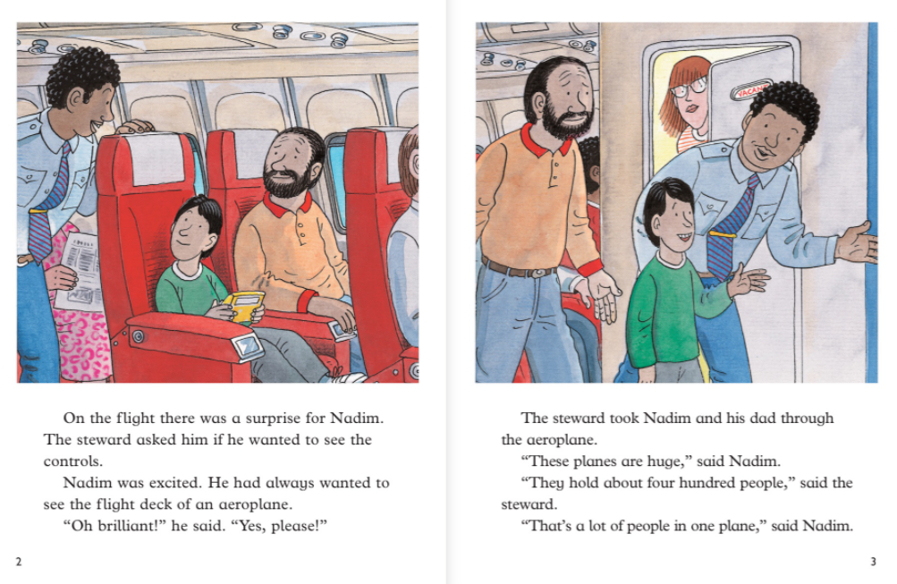
3. How many people can fit on one plane?

Slide 3
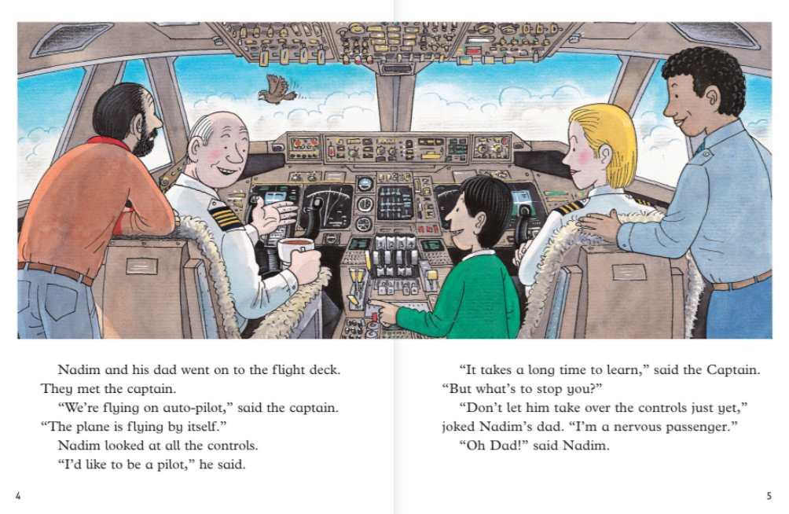
4. What job does Nadim want to do when he grows up?

Slide 4
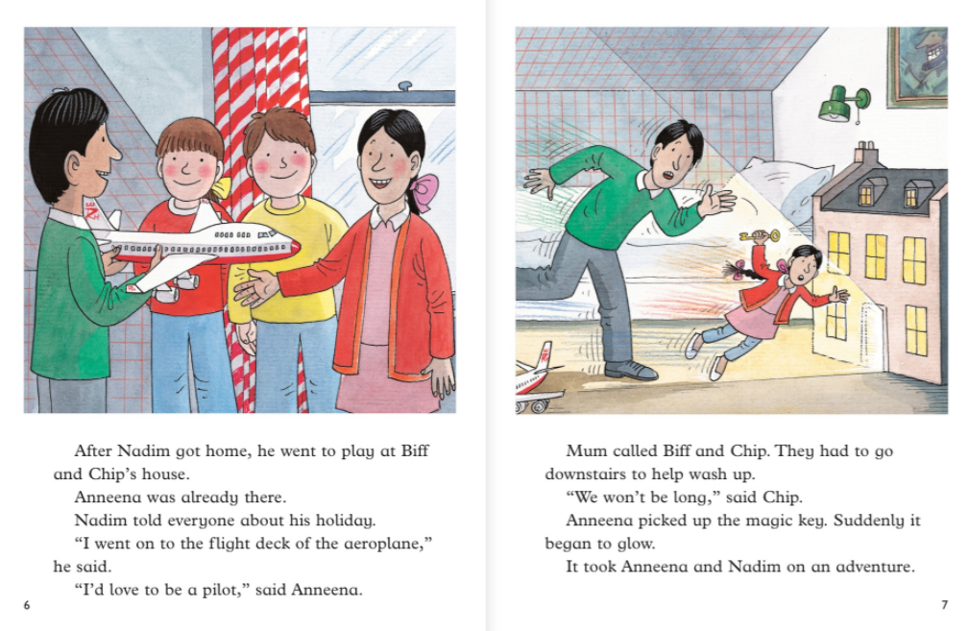
5. Who else wants to be a pilot?

Slide 5
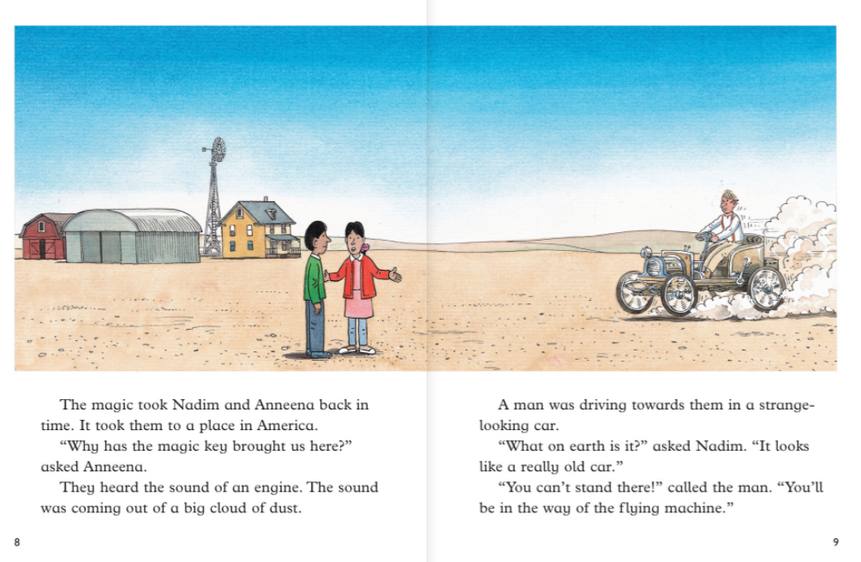
6. Where did the magic key take them?
7. Why did the man want them to move?

