Slide 1



Slide 2
f ff | l ll le | m mm | n nn kn | r rr | s ss se | v ve | z zz s | sh | th | ng nk
b bb | c k ck | d dd | g gg | h | j | p pp | qu | t tt | w wh | x | y | ch tch
Speed Sounds

Slide 3
a at | e hen | i in | o on | u up | ay day | ee y see | igh high | ow blow
oo zoo | oo look | ar car | or for | air fair | ir whirl | ou shout | oy boy
Speed Sounds

Slide 4
do | you | want
to | be | me
I | the | your

Slide 5
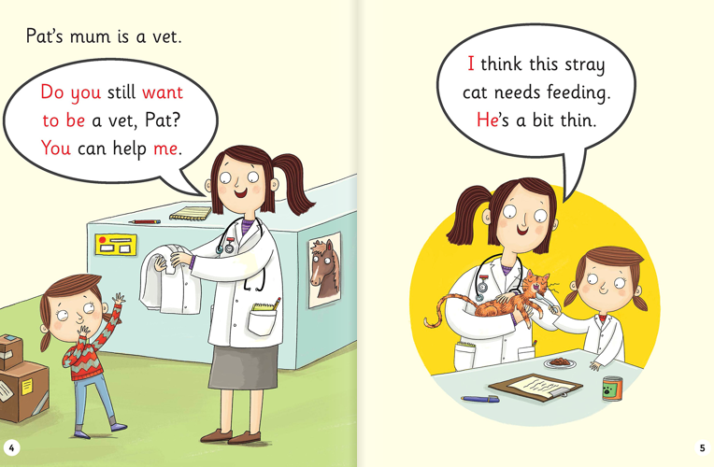

Slide 6
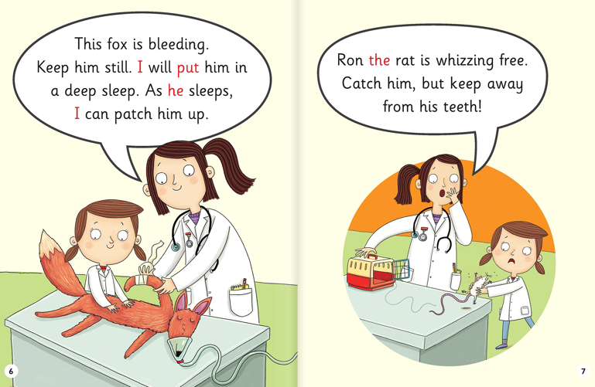

Slide 7
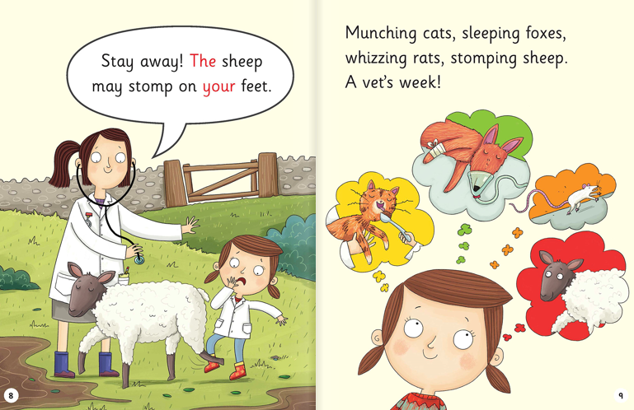

Slide 8
What is Pat’s mum’s job?
Why do you think the cat is too thin?
What is wrong with the fox?
What is the name of the rat?
Why should Pat stay away from the sheep?

