Slide 1
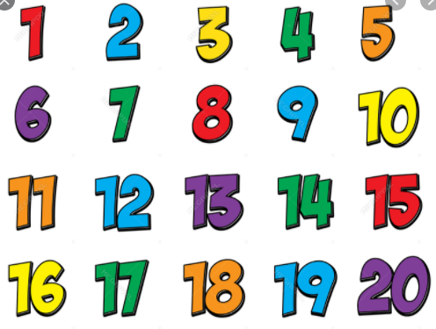
Learning Intention Addition and subtraction Numbers to 20

Slide 2
A number bond to 20 is a pair of numbers or two sets of objects that make 20.
To find the number bond for 4 you can try this.
Use 20 objects such as coins to help.
4 + _____= 20
Start with 20
Take away 4 to give you 16.
4 + 16 = 20
So the number bond to 20 for 4, is 16

Slide 3
Example 2. 7 + ____ = 20
7+ _____= 20
Start with 20
Take away 7
How many are left
7 + 13 = 20
So the number bond to 20 for 7, is 13

Slide 4
Can you find the number bonds to 20 for the questions on the sheet, Alternative Maths 2.

Slide 5
Number bonds to 10
Click to find your answers

Slide 6
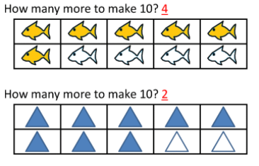
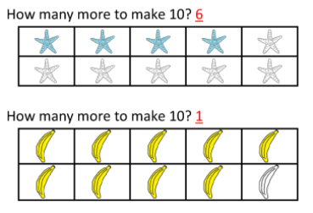
Well done if you were right.

Slide 7
Number bonds to 20
Number bonds to 20 are pairs of numbers that add to 20.
Like 17 + 3 = 20 or 6 + 14 = 20

Slide 8
Can you find the number bonds to 20 for the questions on the sheet, Alternative Maths 2.

