Slide 1
To use descriptive language to improve my writing
Adding adjectives

Slide 2
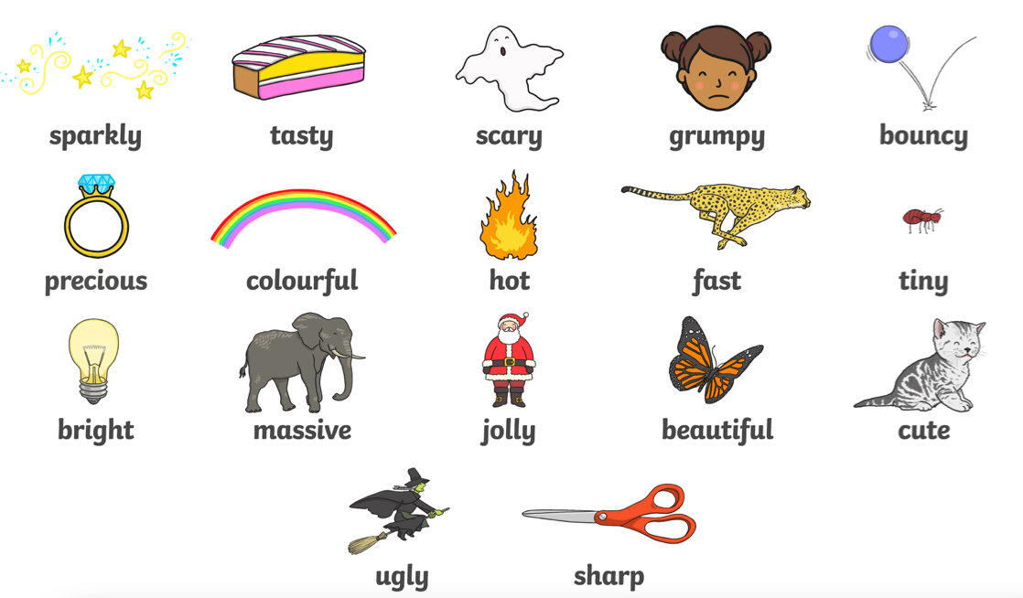
Adjectives
We have looked a lot at adjectives this week. Adjectives are those words that describe nouns and tell you more about them.

Slide 3
Today’s task
Today you are going to be given a picture with two things to describe.
You should use an adjective for each noun.
We are going to look at an example on the next page.

Slide 4
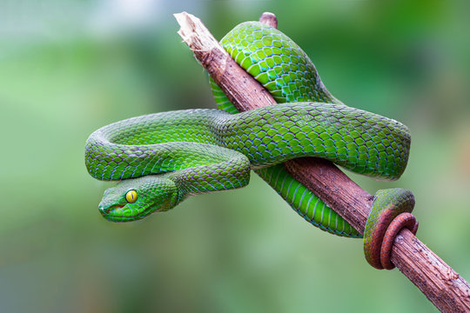
Example
Snake branch
I will now have to make a sentence and describe these nouns.
There is a scary snake on a brown branch.
I have added the adjectives scary and brown before each noun.

