Slide 1
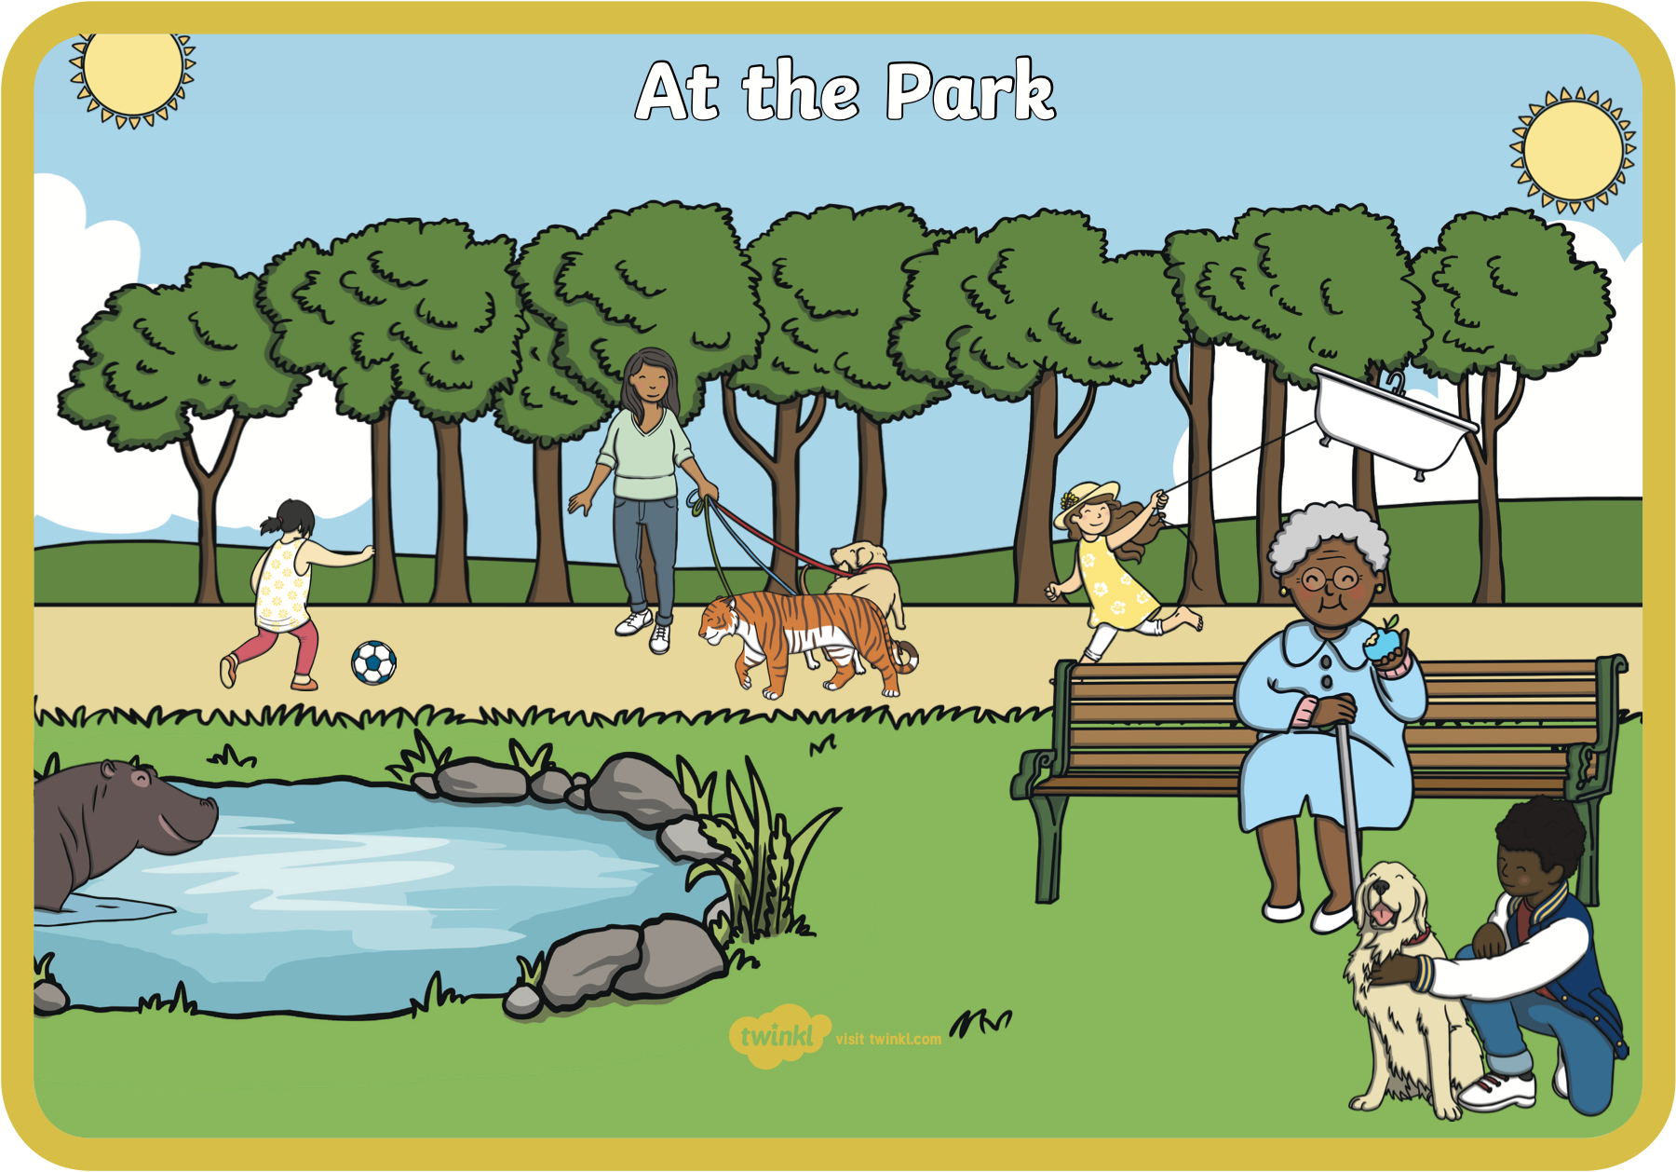

Warm up! What’s wrong in this picture of the park?
Notes:
It’s time to warm up and get ready to learn. What is wrong in this picture of the park? Explain what you can see out loud to yourself, a toy or a grown up! This doesn’t look like a regular park, does it?

Slide 2
Rhyming words
What are they?
Notes:
Today, our work is going to be about rhyming words and strings. Remember when we are trying to find rhymes, we need to focus on the END of each word or sentence. For example, nice, rice, mice, the –ice sound or cat, hat, mat, the -at sound or snake, cake, lake, the –ae sound. Can you think of any rhymes?

Slide 3
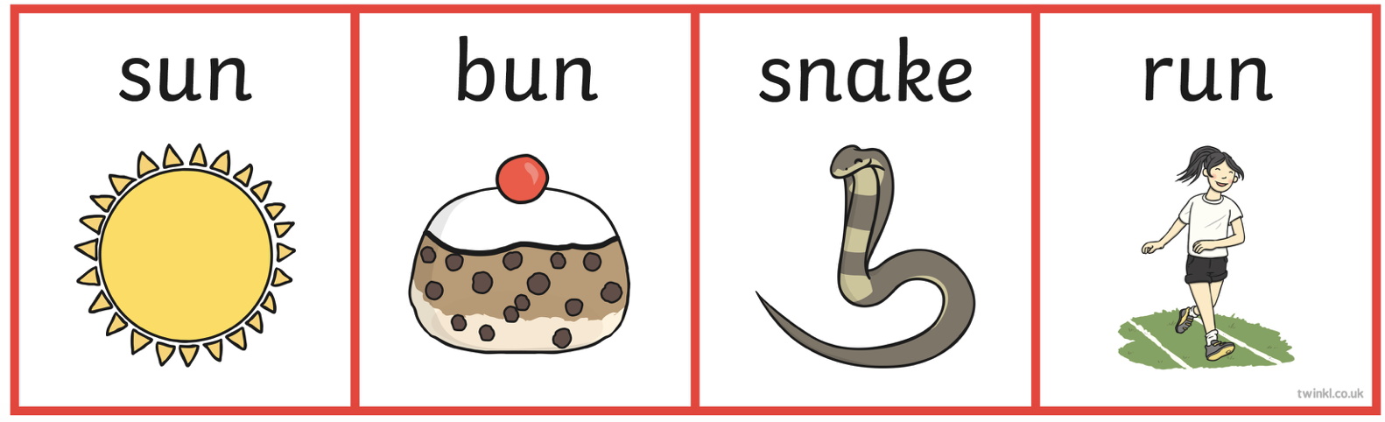
Which is the odd one out that doesn’t rhyme?
Notes:
Let’s have a closer look! There is an odd word out here that doesn’t rhyme with the others. Remember to look at the end of each word. Let’s say them aloud to see if we can find the odd one out. Sun, bun, snake, run. Sun and bun… they rhyme and end with an ‘un’ sound. What about run? Yes! Run has the ‘un’ sound too. Wait a minute… s-n-a-k-e… is there the same sound at the end? No! Snake is the odd word out.

Slide 4
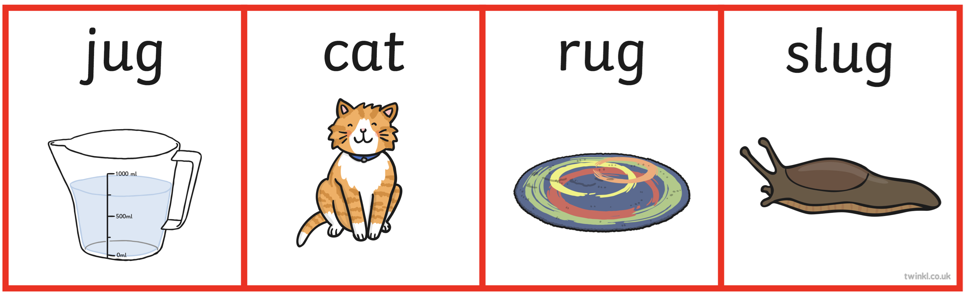
Let’s do another, which is the odd one out?
Notes:
Ok, let’s do another. Let’s fred talk the words… j-u-g jug, c-a-t cat, r-u-g rug, s-l-u-g slug. It seems to me that the ending sound that rhymes is ‘ug’. Which word is the odd one out? Jug, cat, rug, slug. That’s right it is cat!

Slide 5

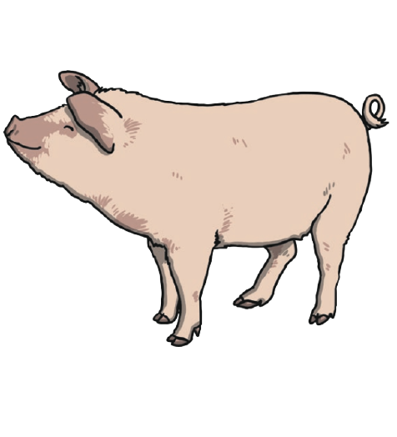
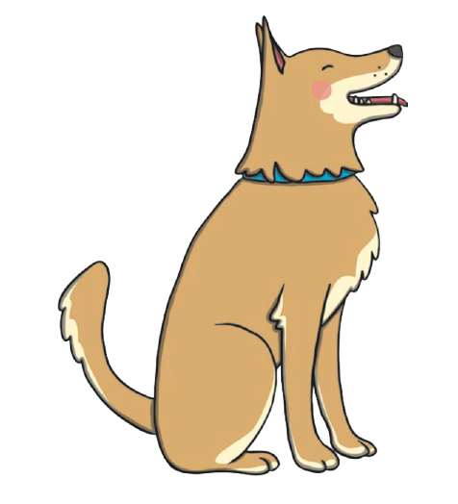

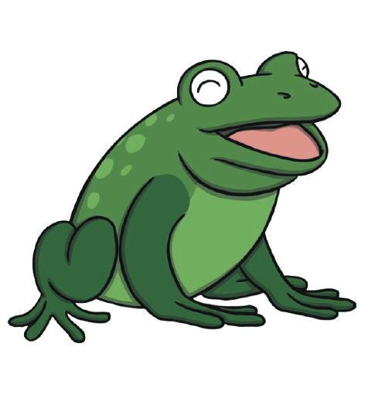
Finish the rhyming string:
Notes:
A rhyming string is a line of words that rhyme with each other. Here are some examples… dog, log and… let’s look at the picture box to help us! What do we have? P-e-n pen. P-i-g pig or f-r-o-g frog. What do you think? Is it dog, log, pen? Dog, log, pig? Dog, log frog? Yes! Dog, log, frog. Well done.

Slide 6
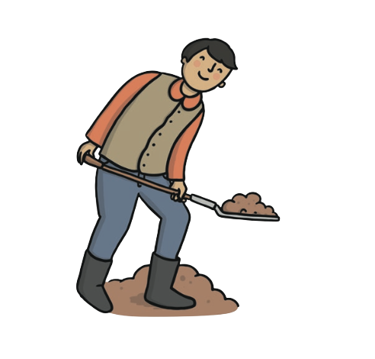

Finish the rhyming string:
Notes:
Next, we have wig, dig and… which one will finish our rhyming string? P-e-n pen? P-i-g pig? F-r-o-g frog? Wig, dig, pen? Wig, dig, pig? Wig, dig, frog? Yes you’re right… wig, dig, pig!

Slide 7
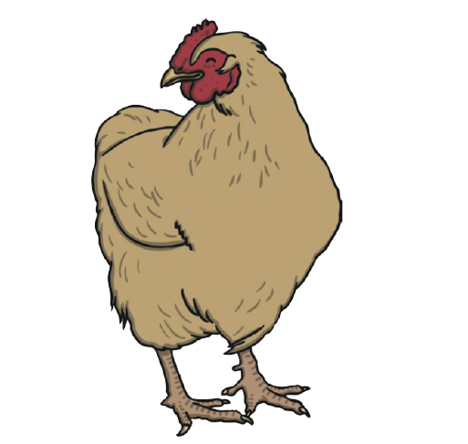

Finish the rhyming string:
Notes:
Final one! Is it ten, hen, pen? Ten, hen, pig? Ten, hen, frog?

Slide 8
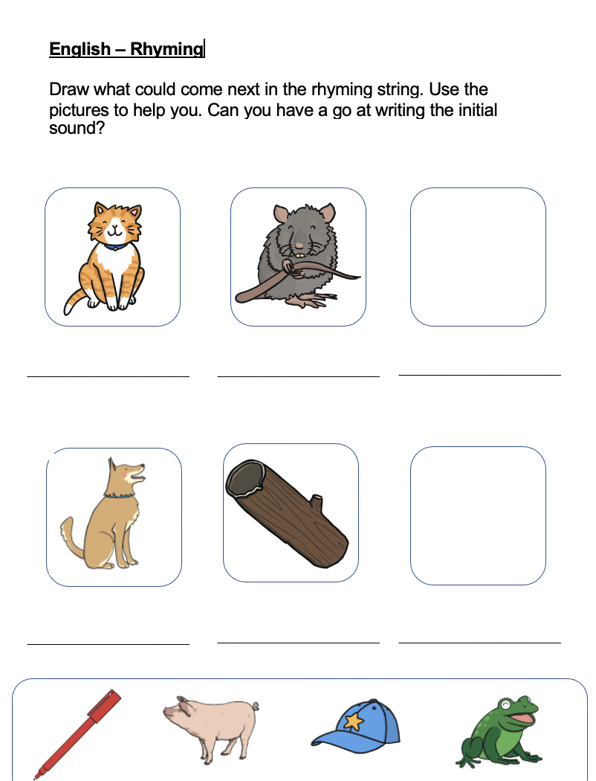
Notes:
Now it’s your turn to have a go at finishing the rhyming strings. Draw the missing picture, if you need help, look at the picture box at the bottom. Challenge time: Why don’t you have a go at writing the initial sound, for example, for cat you would write what sound? Yes! C, c c cat.

Slide 10
Commentary:
Slide 1: It’s time to warm up and get ready to learn. What is wrong in this picture of the park? Explain what you can see out loud to yourself, a toy or a grown up! This doesn’t look like a regular park, does it?
Slide 2: Today, our work is going to be about rhyming words and strings. Remember when we are trying to find rhymes, we need to focus on the END of each word or sentence. For example, nice, rice, mice, the –ice sound or cat, hat, mat, the -at sound or snake, cake, lake, the –ae sound. Can you think of any rhymes?
Slide 3: Let’s have a closer look! There is an odd word out here that doesn’t rhyme with the others. Remember to look at the end of each word. Let’s say them aloud to see if we can find the odd one out. Sun, bun, snake, run. Sun and bun… they rhyme and end with an ‘un’ sound. What about run? Yes! Run has the ‘un’ sound too. Wait a minute… s-n-a-k-e… is there the same sound at the end? No! Snake is the odd word out.

Slide 11
Slide 4: Ok, let’s do another. Let’s fred talk the words… j-u-g jug, c-a-t cat, r-u-g rug, s-l-u-g slug. It seems to me that the ending sound that rhymes is ‘ug’. Which word is the odd one out? Jug, cat, rug, slug. That’s right it is cat!
Slide 5: A rhyming string is a line of words that rhyme with each other. Here are some examples… dog, log and… let’s look at the picture box to help us! What do we have? P-e-n pen. P-i-g pig or f-r-o-g frog. What do you think? Is it dog, log, pen? Dog, log, pig? Dog, log frog? Yes! Dog, log, frog. Well done
Slide 6: Next, we have wig, dig and… which one will finish our rhyming string? P-e-n pen? P-i-g pig? F-r-o-g frog? Wig, dig, pen? Wig, dig, pig? Wig, dig, frog? Yes you’re right… wig, dig, pig!
Slide 7: Final one! Is it ten, hen, pen? Ten, hen, pig? Ten, hen, frog?
Slide 8: Now it’s your turn to have a go at finishing the rhyming strings. Draw the missing picture, if you need help, look at the picture box at the bottom. Challenge time: Why don’t you have a go at writing the initial sound, for example, for cat you would write what sound? Yes! C, c c cat.

