Slide 1

Half and Halving

Slide 2
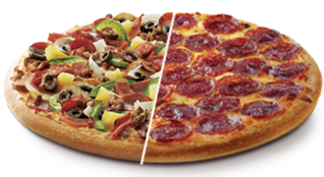
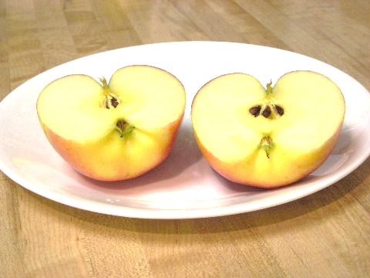
When we halve something we cut it or divide it into two equal parts

Slide 3
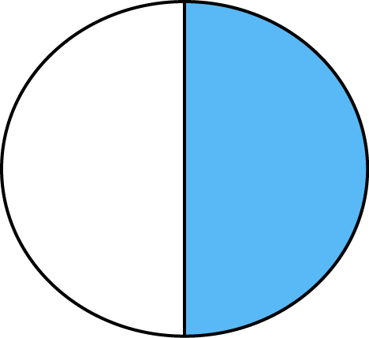
1 of the 2 halves is blue. So we can write……..
1
2 of the circle is blue.

Slide 4
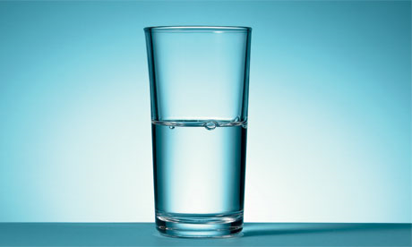
This glass is …..
1 full and
2
1 empty!
2
Two halves make a whole glass!

Slide 5
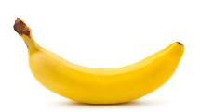

We can find half of numbers……
If I eat half of these bananas how many will I have left?
3, because half of 6 is 3

Slide 6
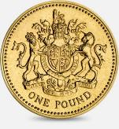

Tom has this much money. If he gives Ethan
half, how much money does Ethan have?
Ethan has £4 because half of 8 is 4

Slide 7
I want to colour in half of this pattern.
How many rectangles do I need to colour in?
5 because half of 10 is 5

Slide 8
Now find the sheet ‘Half true or false (alternative maths) and complete the task.

