Slide 1
Capital Cities of Europe
We are going to investigate what a capital city is
Which capital belongs with which country
Research your choice of capital

Slide 2
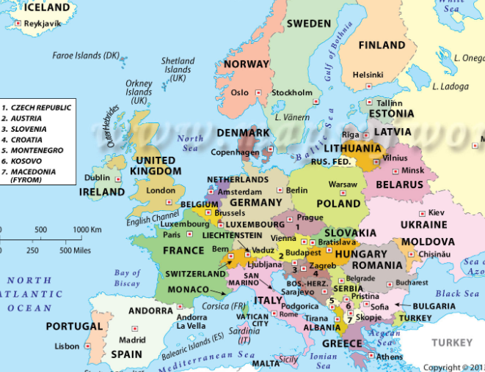
Look at this map of Europe.
Can you see the countries that we have talked about?
Find Germany, Italy, Switzerland, Greece and Portugal.
Can you see in each country there is one city marked. For Example in Germany it is Berlin.
These are the capital cities of each country.

Slide 3
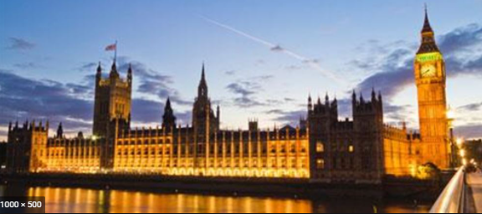
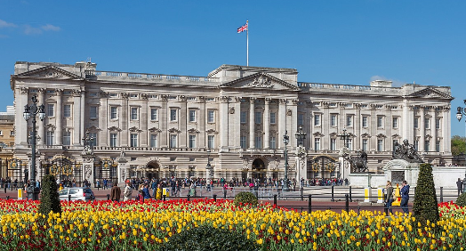
What is a Capital City?
A capital is a city or town of a country, set down in that countries law, that is the main city in that country. It is where the government of that country usually meets. The countries leaders and officials also usually work in the capital. For example in London is where you will find the Houses of Parliament which is where our Government meets. You will also find our head of State the Queen lives in Buckingham Palace, which is in London.

Slide 4
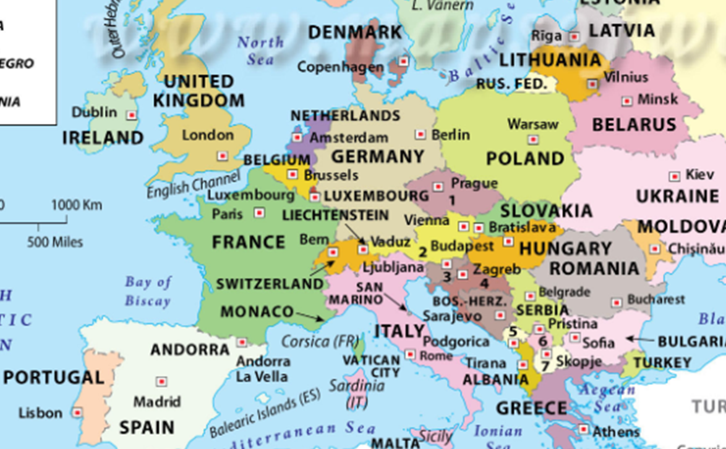
Task 1
Use the map to find which capital city belongs in which country.
Which countries are these cities in.
Berlin-
Copenhagen -
Paris -
Rome -
Minsk -
Madrid -
London -
Warsaw -
Ireland -
Which of these countries belongs with the cities listed below.
Poland United Kingdom Germany
Spain Italy Denmark
France Ireland Belarus

