Slide 1

Learning intention:
To identify and describe properties of 3D shapes, including the number of edges, vertices and faces.

Slide 2
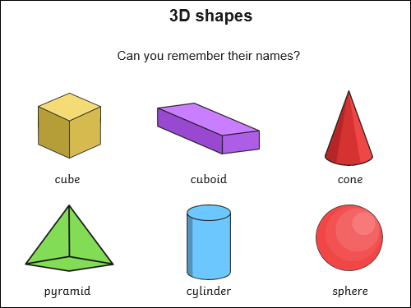

Slide 3
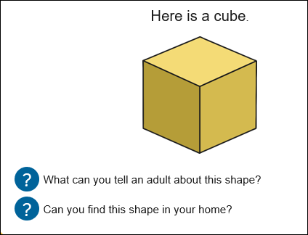

Slide 4
You might say things like:
It has squares on it.
We would say it has square faces.
It is yellow.
Cubes can also be different colours and sizes.
It has corners.
On 3D shapes we call these vertices.

Slide 5
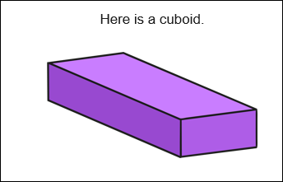
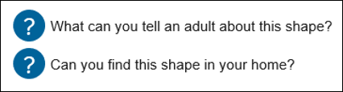

Slide 6
You might say things like:
It has rectangles on it.
We would say it has rectangle faces.
It is purple.
Cuboids can also be different colours and sizes.
It has corners.
On 3D shapes we call these vertices.
What is different between a cube and a cuboid?

Slide 7
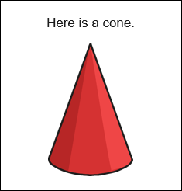

Slide 8
You might say things like:
It has a point
One a cone we would call it a vertice or vertex.
It is red.
Cones can also be different colours and sizes.
This shape has no corners.
This shape would roll.

Slide 9
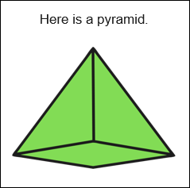

Slide 10
You might say things like:
It has triangle on it.
We would say it has triangle faces.
It is green.
Pyramids can also be different colours and sizes.
It has corners.
On 3D shapes we call these vertices.
Can you count how many vertices the pyramid has?

Slide 11
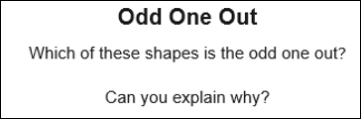
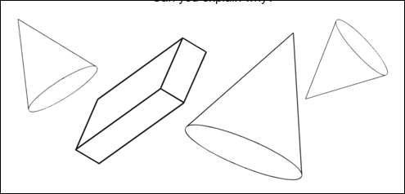

Slide 12
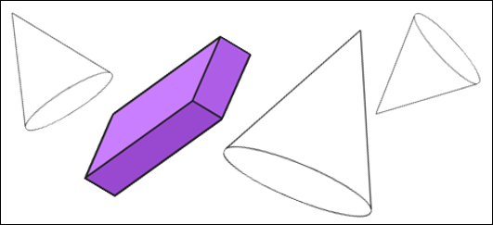
This shape is the odd one out because it is a cuboid. The other shapes are cones.

Slide 13
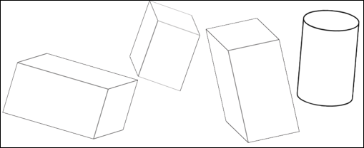

Slide 14
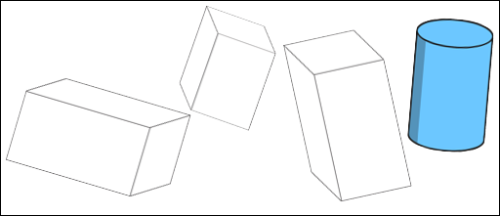
This shape is the odd one out because it is a cylinder. The other shapes are cuboids.

Slide 15
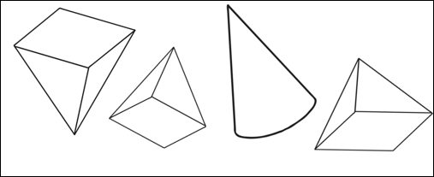

Slide 16
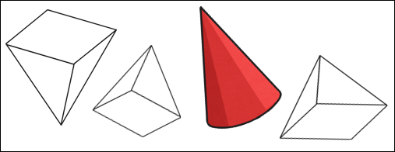
This cone is the odd one out.
The other shapes are all pyramids.

Slide 17
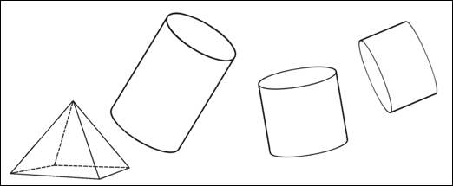

Slide 18
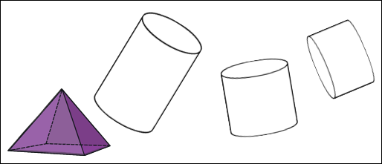
The pyramid is the odd one out because the others are all cylinders.

