Slide 1
Set 2 Sounds
air
Notes:
Lets practise our set 2 sounds, today;’s sound is air

Slide 2
Notes:
What do you think the children are saying to the adult eating all the cake? Yep, they’re saying that’s not fair!

Slide 3
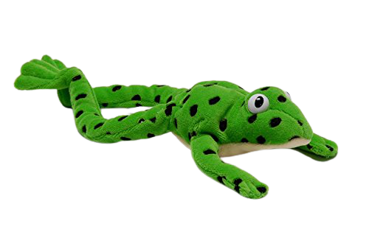
Notes:
Lets fred talk! F-air, fair, ch-air, chair, s-t-air, stair

Slide 4
Notes:
This is our new sound air. It has 3 letters but 1 sound, it’s a special friend

Slide 5
Notes:
Lets practice air. My turn first…..

Slide 6
Notes:
Now it’s your turn, can you practice the sound when it moves on the screen?

Slide 7
fair
__
.
chair
_
__
stair
__
.
.
Notes:
Lets read some green words! First lets use fred talk then read the word

Slide 8
Notes:
Let’s practice writing our sound air

Slide 9
Notes:
Let’s practice writing words with the air sound in them hair lair chair

