Slide 1
LI: to work with number bonds.

Slide 2
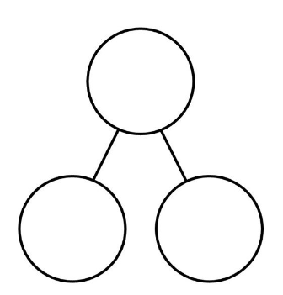
whole
part
part
part + part = whole
whole = part + part

Slide 3
part + part = whole
whole = part + part

Slide 4
10
6
4
6 + 4 = 10
10 = 6 + 4

Slide 5
whole
part
part
part + part = whole
whole = part + part
whole – part = part
whole – part = part

Slide 6
10
6
4
6 + 4 = 10
10 = 6 + 4
10 – 6 = 4
10 – 4 = 6

Slide 7
6
4
10
+
=
10
4
6
10
+
=
10
6
4
6
4
-
=
10
4
=
6
-

Slide 8
2
8
10
+
=
10
8
+
2
=
10
10
2
8
2
8
-
=
10
8
=
2
-

Slide 9
+
=
10
+
=
7
-
=
-
=

Slide 10
+
=
10
+
=
5
-
=
-
=

Slide 11
+
=
10
+
=
9
-
=
-
=

Slide 12
+
=
10
+
=
10
-
=
-
=

