Slide 1
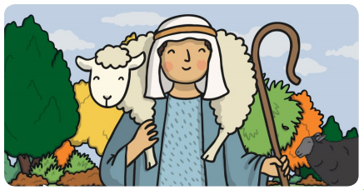
Year 1 RE The lost sheep

Slide 2
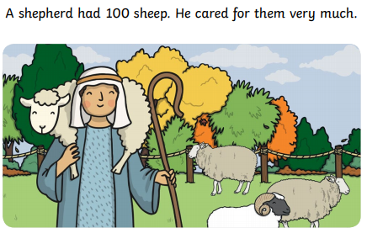

Slide 3
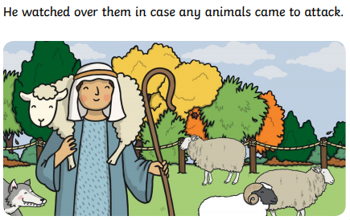

Slide 4
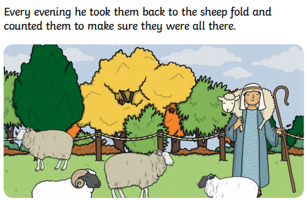

Slide 5
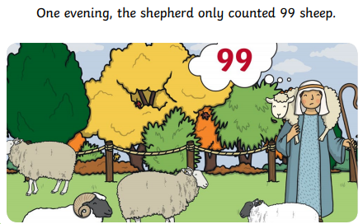

Slide 6
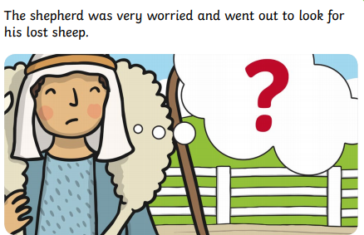

Slide 7
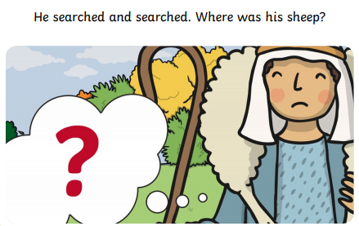

Slide 8
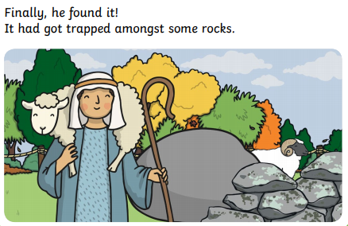

Slide 9
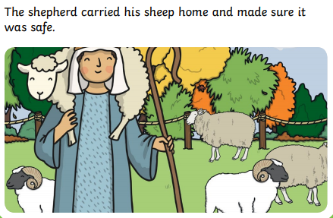

Slide 10
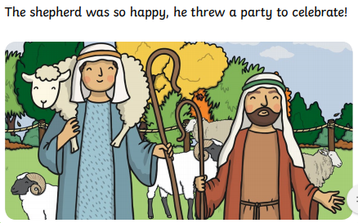

Slide 11
Questions
What happened in the story?
What was special to the shepherd?
How did he feel when he lost one of his sheep?
Do you have anything that is special to you?
How would you feel if you lost something that was special to you?

