Slide 1
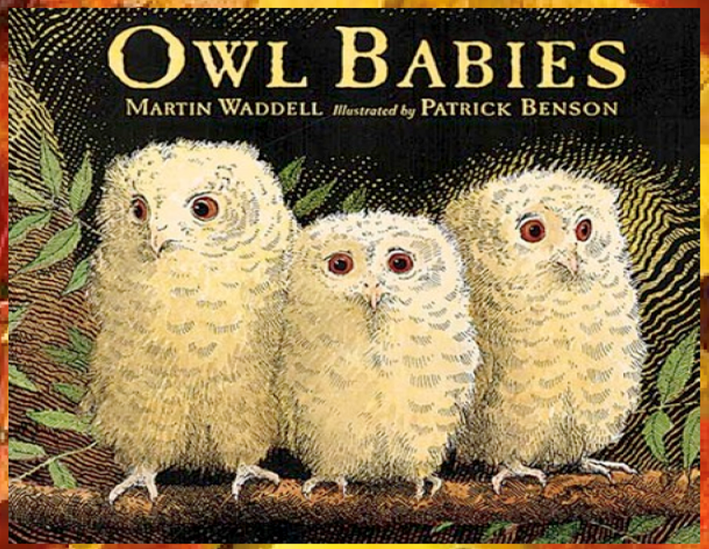
Today we will share the middle of the story.

Slide 2
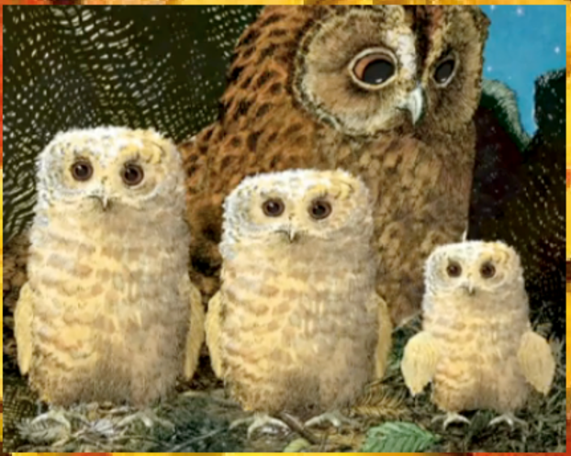
Once there were three owls, Sarah, Percy and Bill. They lived in a whole in the trunk of a tree with their Owl Mother.

Slide 3
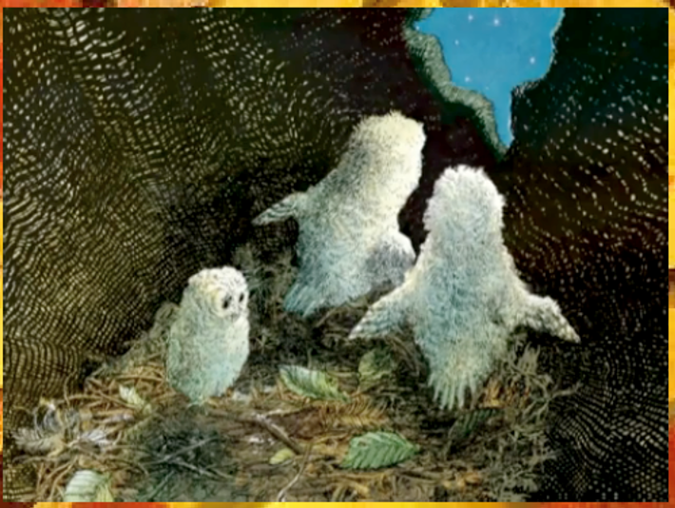
One night they woke up and their Owl Mother was gone!

Slide 4
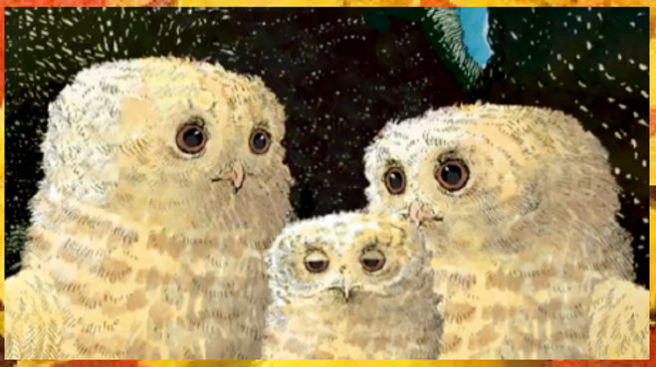
“Where’s Mummy?” asked Sarah. “Oh my goodness!” said Percy. “I want my Mummy!” said Bill. But their Owl Mummy didn’t come . . .

Slide 5
“I think she’s gone hunting,” said Sarah.
“To get us some food,” said Percy.
“I want my mummy,” said Bill.
But their owl mummy did not come…
Can you remember where the owls live?

Slide 6
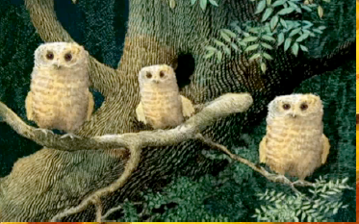
The owl babies came out of their house and waited…
“She’ll be back,” said Sarah.
“She’ll be back soon,” said Percy.
“I want my mummy!” Said Bill.
Why do you think Bill keeps saying that he ‘wants his mummy?’

Slide 7
It was dark in the wood.
They had to be brave.
Things moved all around them.
What things do you think moved around the owls?
Are you frightened of the dark?

