Slide 1
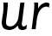

Focus: ur
u – start at the top, come down and curve. Go back up, come back down and flick.
r – start at the top, come down, bounce back up and over.

Slide 2
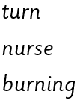
Your turn! Write ur in your book using the lines.
Then try:

