Slide 1
Alternative 2 – To predict a new ending to the story
What could happen next?

Slide 2
Lets read the last page of the story again.

Slide 3
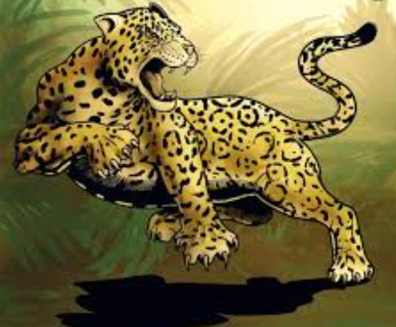
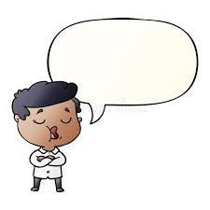
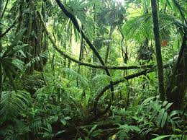

What do you think happened after the man left the rainforest?
Which is of these ideas do you think is the most likely to happen?
Choose which one you think is most likely, draw a picture then explain to someone in your house what is happening in the picture.
All the animals try to attack the man. | 2) The man tells people to look after the rainforest. | 3) The man gets a big saw to chop the tree down.

