Slide 1

Learning intention
Comparing Poems

Slide 2
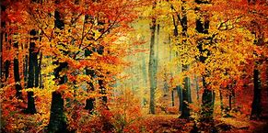
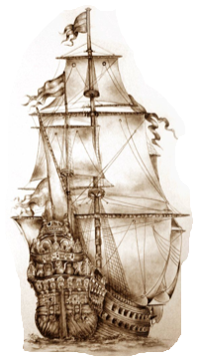
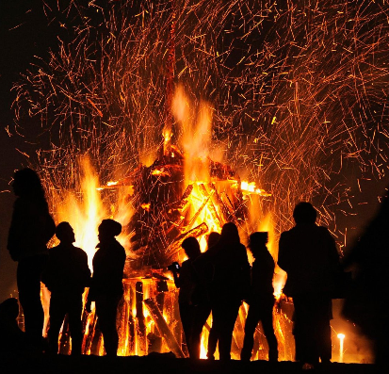
Carefully listen to the poems.
How do they make you feel?
Are they funny?
Are they sad?
Are they exciting?
Are you in a wood?
Can you hear and feel the bonfire?
Are you on the pirate ship?

Slide 3
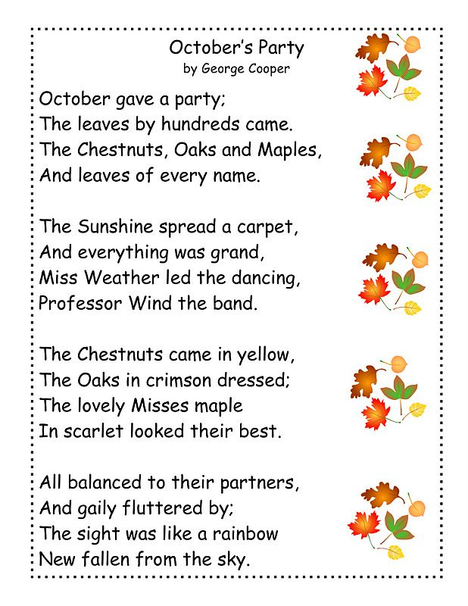
Octobers Party
George Cooper

Slide 4
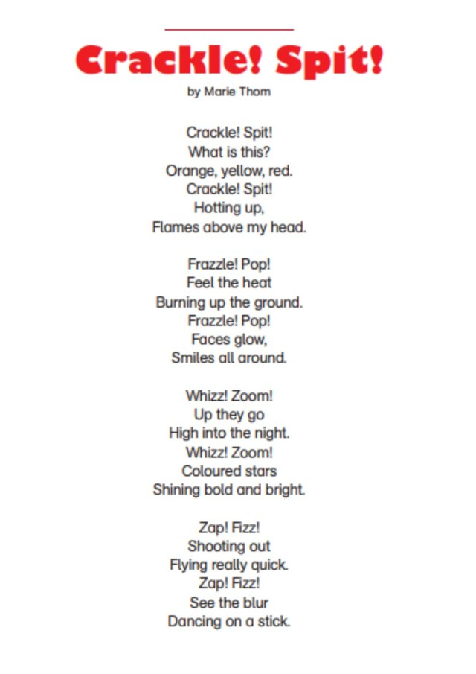
Crackle! Spit!
Marie Thom

Slide 5
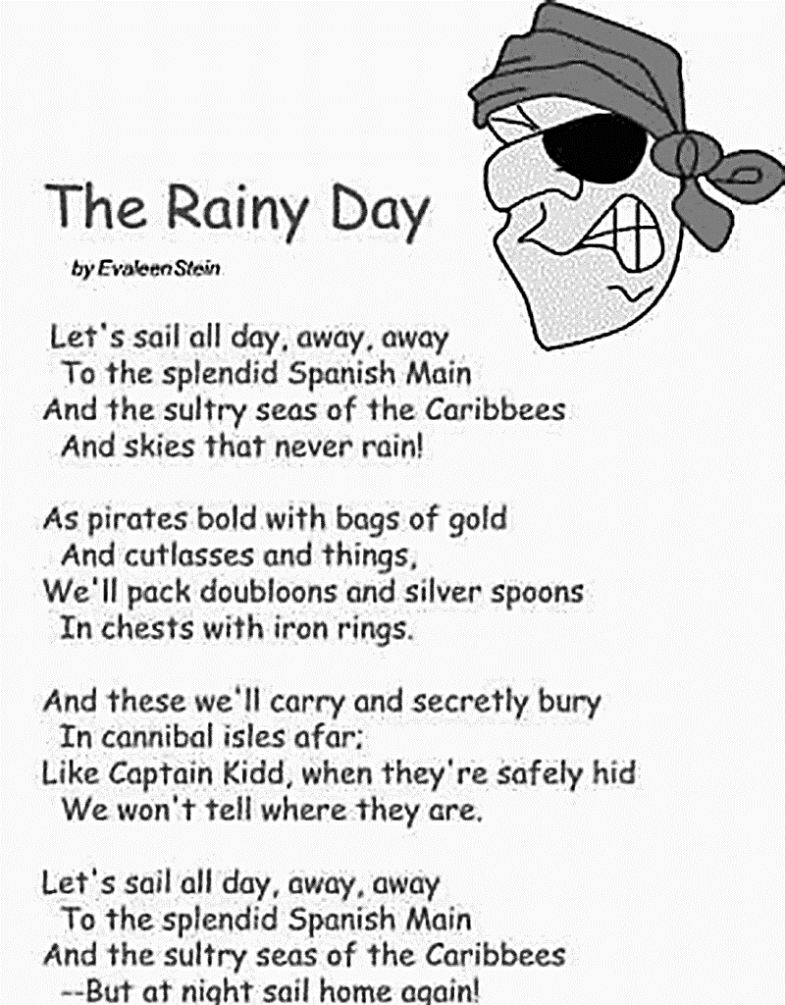

Slide 6
Which words Rhyme?
came
grand
by
red
quick
main
things
head
name
rings
stick
sky
rain
band

