Slide 1
Learning Intention: To explore patterns in numbers (to 100)

Slide 2
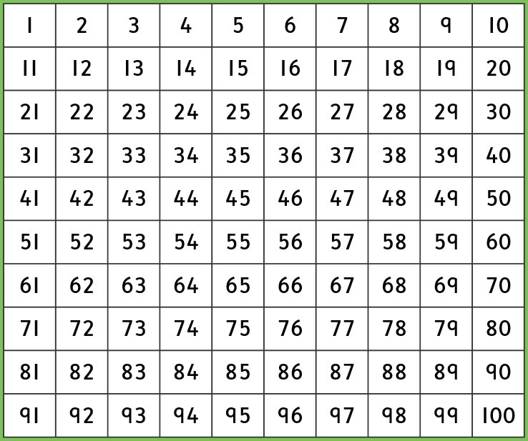
Let’s count forwards to 100

Slide 3
Let’s count backwards from 100

Slide 4
Did you know?
There are patterns to find in the 100 square!
We are going to find these patterns:
Odd numbers
Even numbers
Count in 2s
Count in 5s
Count in 10s

Slide 5
Find the odd numbers

Slide 6
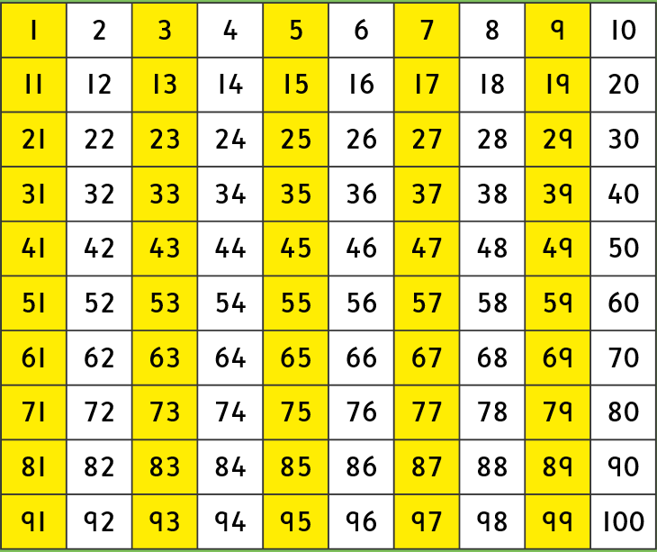
What is the pattern?

Slide 7
Find the even numbers

Slide 8
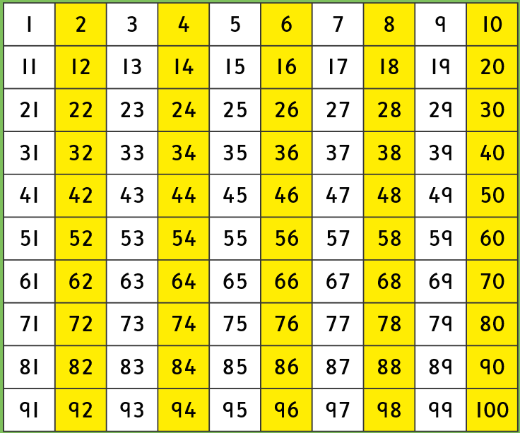
What is the pattern?

Slide 9
Count up in 2s

Slide 10
What is the pattern?
Is it a new pattern?

Slide 11
Count up in 5s

Slide 12
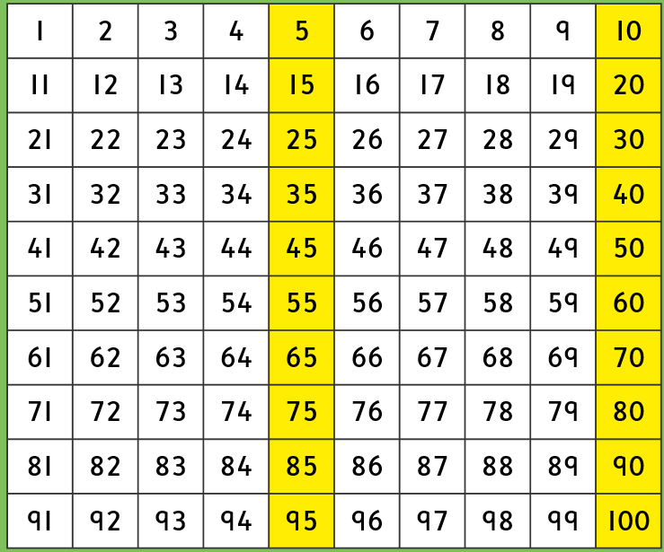
What is the pattern?
Is it a new pattern?

Slide 13
Count up in 10s

Slide 14
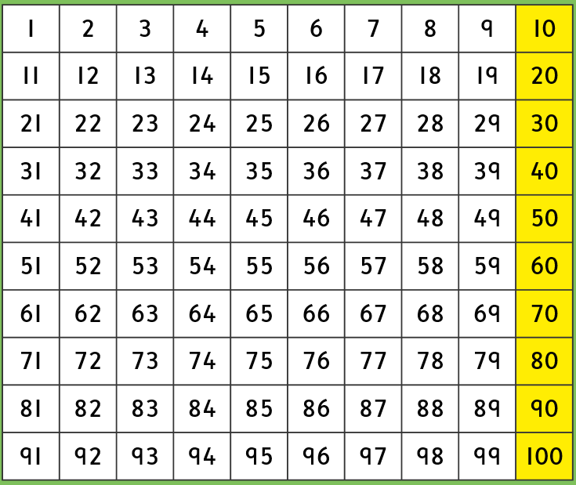
What is the pattern?
Is it a new pattern?

Slide 15
Commentary:
Slide 6: They are in straight lines under each other, and they miss a number each time.
Slide 8: It is the same straight pattern as the odd pattern but it starts on a different number.
Slide 10: It is the same as the even pattern if you start on an even number, so it would be the same as odd if you started on odd. This is because you miss a number each time.
Slide 12: All of the numbers end in 5 or 0.
Slide 14: All of the numbers end in 0.

