Slide 1
Learning Intention: Telling the time

Slide 2
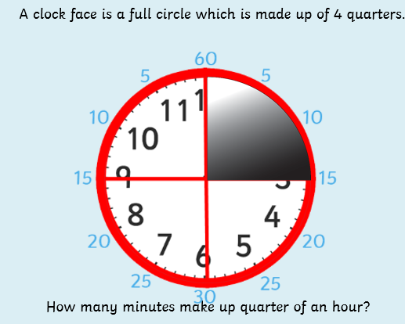

Slide 3
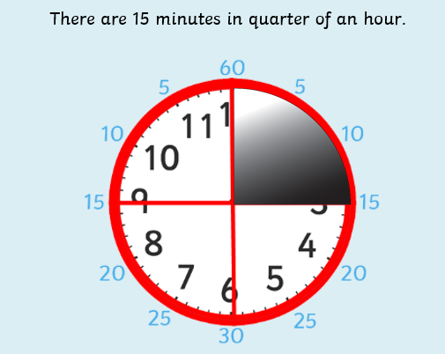

Slide 4
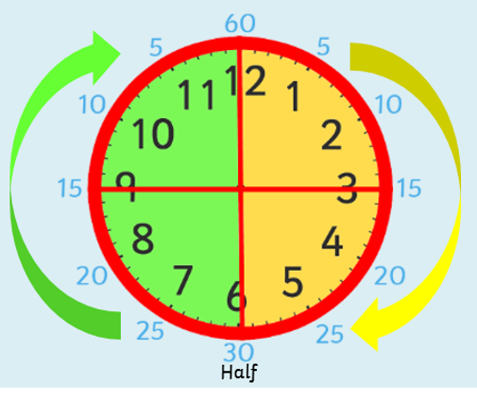
When we tell the time we either say it is ‘past’ the hour or ‘to’ the hour.
.
o’clock
quarter to
quarter past

Slide 5
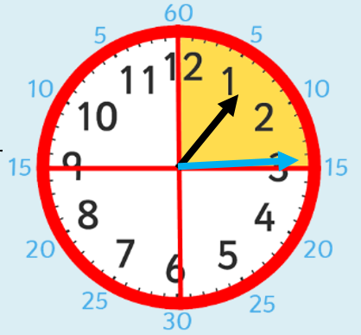
The long hand tells us
how many minutes.
The short hand tells
us the hour.
The short hand is between
1 and 2.
So the time is quarter
past 1.
The long hand is pointing
at the 3 which is a
quarter of the way
around
the clock.

Slide 6
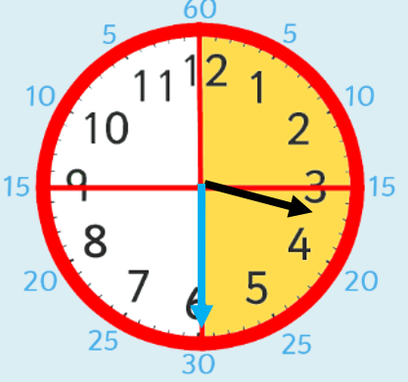
The long hand is pointing to the 6 which is half way around the clock. The small hand is between 3 and 4.
The time is half past 3.

Slide 7
The long hand has moved 3 quarters around the clock. The small hand is pointing between 11 and 12.
The time is quarter to 12.

Slide 8
Which clock is showing quarter past?
Which clock is showing half past?
Which clock is showing quarter to?
Which clock is showing o’clock?

