Slide 1
Today we will read the second story from this book.
You can find it on oxford owl. > ebooks> rwinc> green level
https://www.oxfordowl.co.uk/api/interactives/24760.html

Slide 2
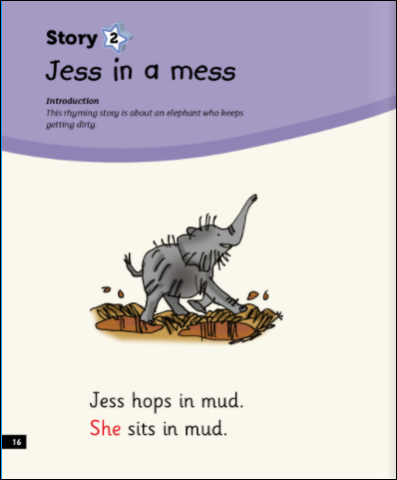

Slide 4
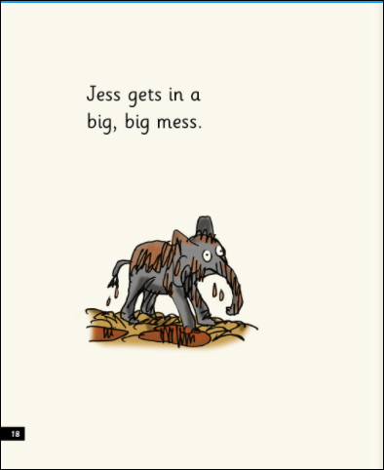

Slide 7
