Slide 1
Learning intention: to explore features of instructions.
Can you remember what these features of instructions are?
Imperative verbs
Numbers or bullet points

Slide 2
Features of instructions
Imperative verbs: bossy verbs. E.g.
Run to the shop. Get a pen.
Numbers or bullet points: instructions can be written in a list with numbers or bullet points. E.g.
Stand up.
Jump up high.

Slide 3
Features of instructions: can you find the imperative verbs as we read the text? Act out what the person in the story is telling you to do.
Imperative verbs

Slide 4
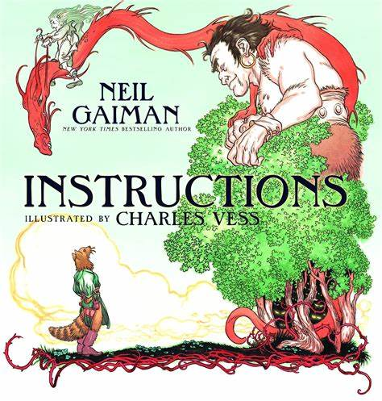

Slide 9
Inside it are three princesses. Do not trust the youngest. Walk on.
In the clearing beyond the castle the twelve months sit, warming their feet, exchanging tales. They may do favours for you, if you are polite. You may pick strawberries in December’s frost.
Trust the wolves, but do not tell them where you are going.

