Slide 1
Science
LO: To describe the life cycle of an insect

Slide 2
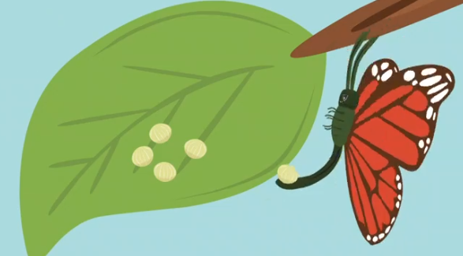
When a male and a female butterfly reproduce, the female lays eggs somewhere safe (usually on a leaf).

Slide 3
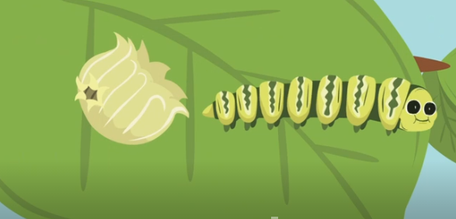
After a few days, the eggs hatch and turn into a caterpillar. This is called the larvae stage and the caterpillar doesn’t really look similar to a butterfly at all yet. When the caterpillar emerges from the egg, it immediately starts munching on plants around it and it grows so much that it has to keep shedding its skin like a snake when the skin becomes too tight.

Slide 4
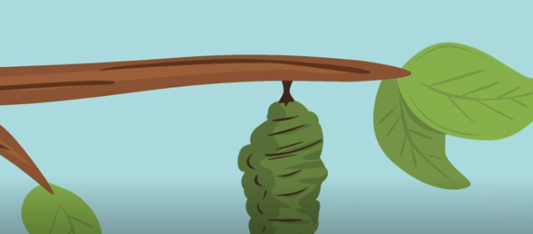
Eventually, the caterpillar makes itself a chrysalis (or pupa), which is a hard case to protect itself from harsh weather or predators while it transforms into the butterfly.

Slide 5
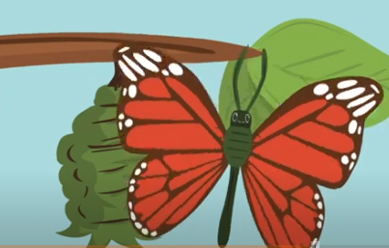
Once the butterfly is ready to emerge, the case around the pupa splits open. At first, the wings are wet, soft and wrinkled so the butterfly waits patiently for its wings to dry and become stronger. When it is ready, the butterfly flies away to find another butterfly to mate with and the cycle starts again.

Slide 6
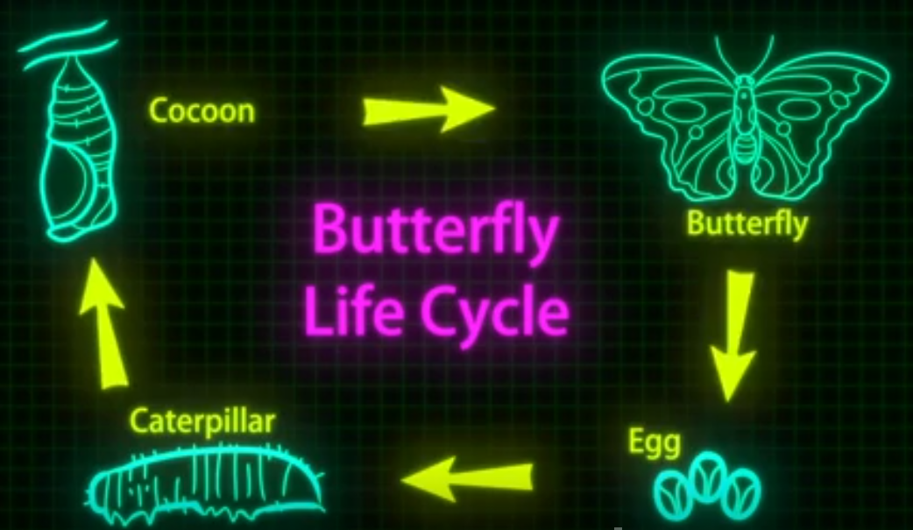
Metamorphosis

