Slide 1

Learning Intention
To understand how our knowledge of the past is made from a range of sources.

Slide 2
Key vocabulary
A Roman A person who lives in or comes from Rome in Italy.
Rome A city in Italy
Legend A story passed down by people about events and people in the past.

Slide 3
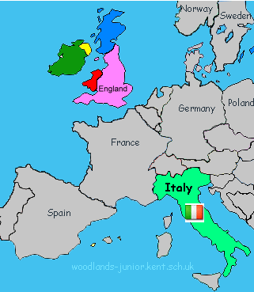
Who were the Romans?
The Romans were one of the greatest and most important people in world history.
It began in the city of Rome in 753 BC and lasted for well over 1000 years.
The Romans lived in Rome, a city in the centre of the country of Italy.

Slide 4
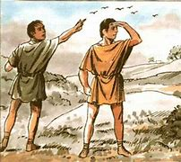
How did Roman start?
Many people believe the legend of the two twins Romulus and Remus and they founded the city of Rome in 750bc.
Let’s read the legend together

Slide 5
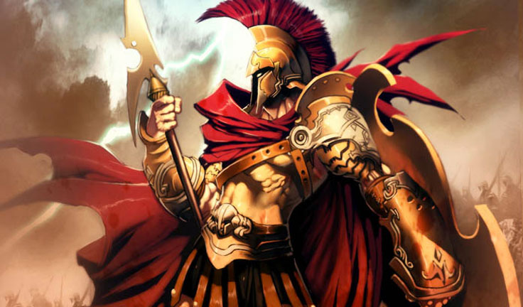
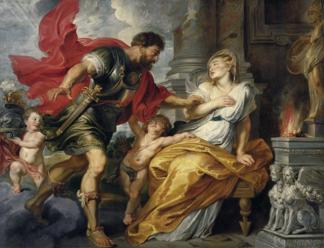
This is the god of Mars. The legend says that he was the father of Romulus and Remus.
.
Rhea Silvia was their mother. She fell in love with Mars. Her uncle, Amulius was king got very angry.
He made her promise that she would never have children, because Amulius did not want anyone else to be king.

Slide 6
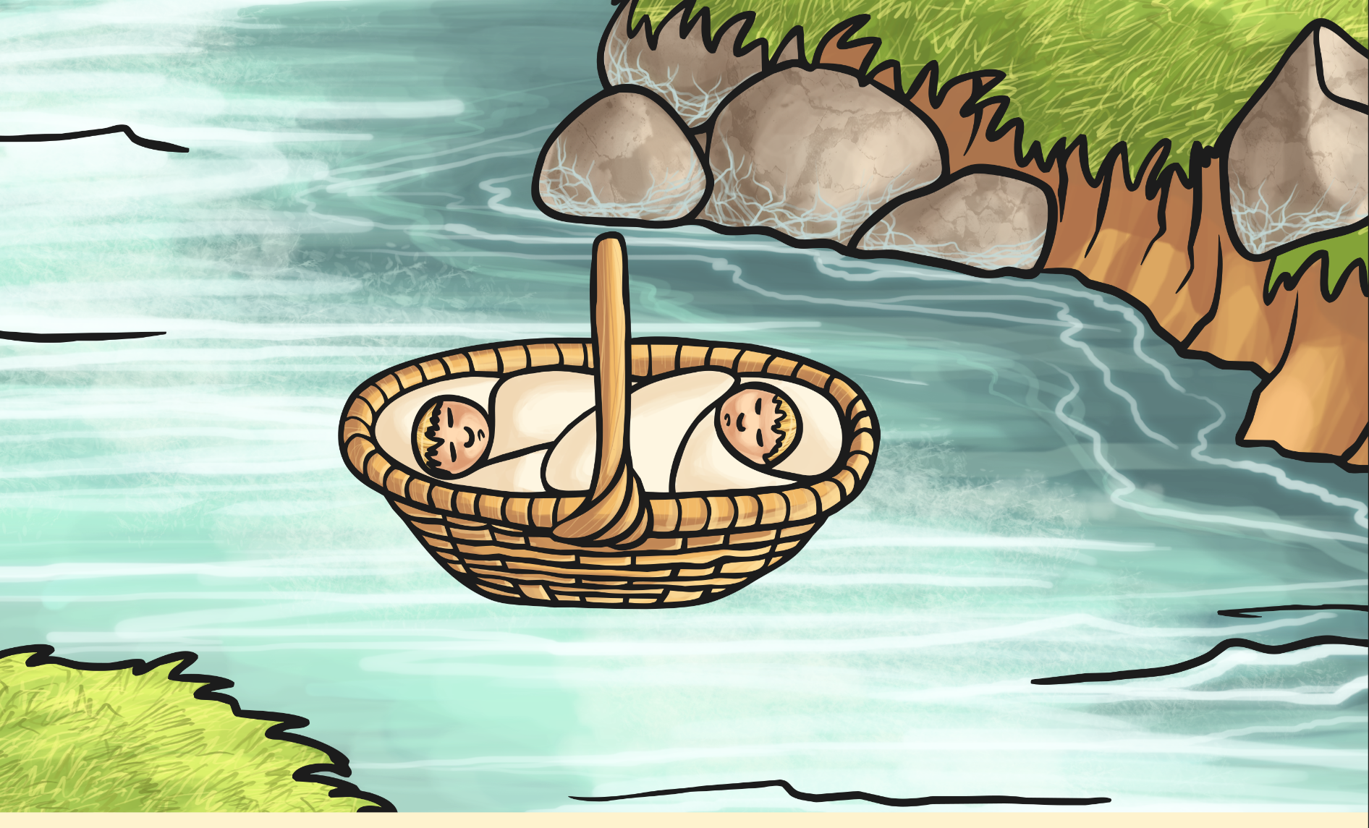
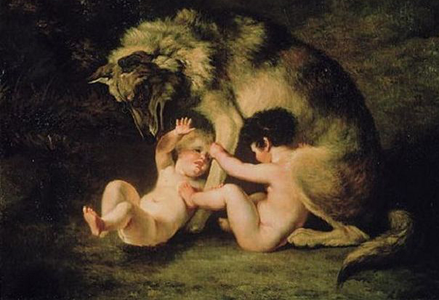
Rhea didn’t listen to her uncle and had twin boys. She was sent to prison and the babies were sent away in a basket on the River Tiber.
They were found by a wolf who took care of them.

Slide 7
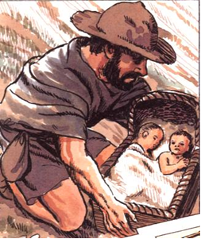
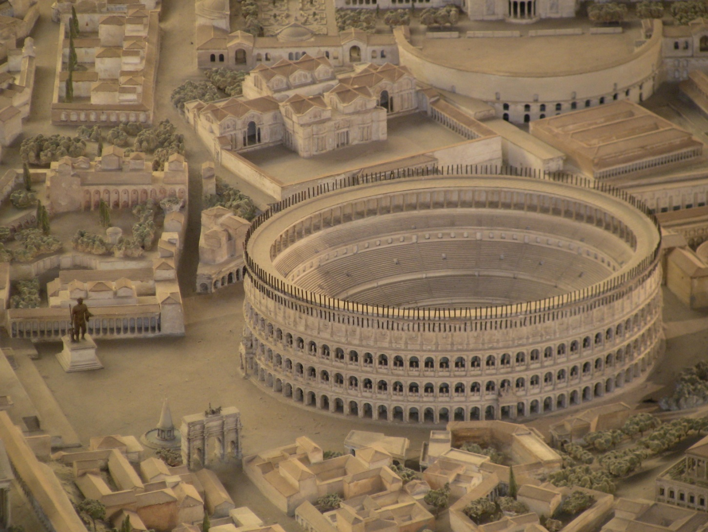
A shepherd found the twins. He and his wife looked after them until they became grown ups.
One day, the boys found out what had happened to them so they killed Amulius. They decided to each build a city.

Slide 8
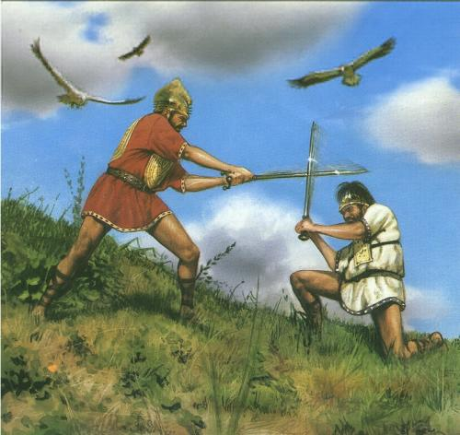
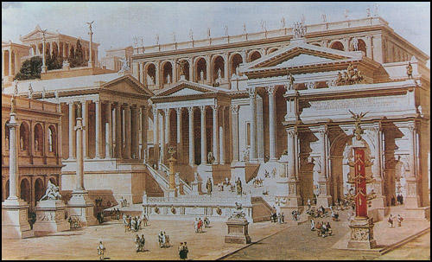
Romulus built his one on the top of the hills and Remus on the bottom.
Remus was jealous of Romulus’s town and they had a fight.
Romulus killed Remus and went to build his city. He named his city Rome, after himself.

Slide 9
Now it’s your turn
After reading and sharing this legend with someone at home you can try to retell by acting it out. Can people at home help you to do this?
Which part will you be? What kind of actions and voices will you use?

