Slide 1

Learning intention: to explore features of instructions.
Can you remember what all these features of instructions are or what they do?
Second person
Imperative verbs
Numbers or bullet points
List

Slide 2
Features of instructions
Imperative verbs: bossy verbs. E.g.
Run to the shop. Get a pen.
Numbers or bullet points: instructions can be written in a list with numbers or bullet points. E.g.
Stand up.
Jump up high.

Slide 3
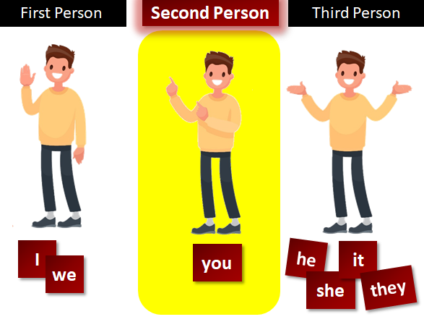
Features of instructions
List: instructions can be written in a list. E.g. Go into the wood, jump over the wall then find the path.
Second person:
instructions are
addressed to the
reader. They talk to
‘you’.

Slide 4
Features of instructions: can you find the features of instructions as we read the text?
Second person
Imperative verbs
Numbers or bullet points
List

Slide 5
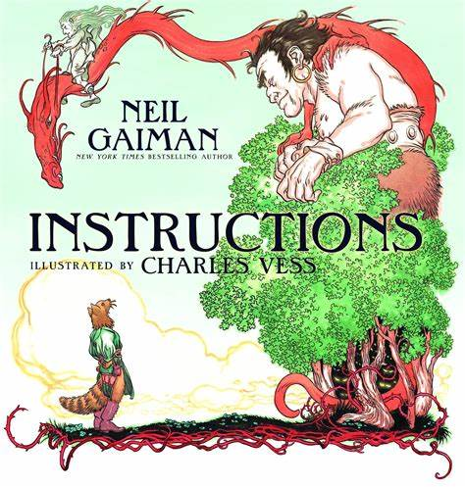

Slide 6
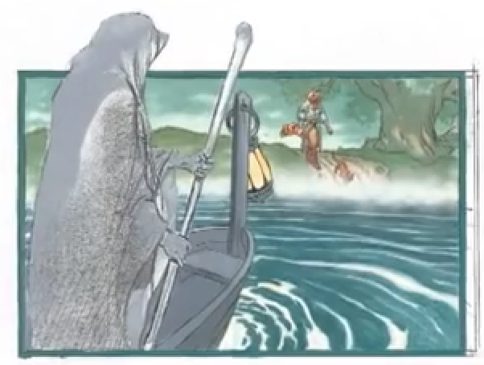
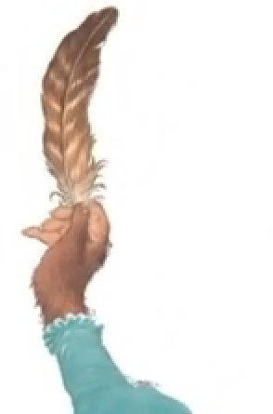
The river can be crossed by the ferry. The ferryman will take you. (The answer to his question is this: if he hands the oar to his passenger, he will be free to leave the boat. Only tell him this from a safe distance.
If an eagle gives you a feather, keep it safe.

Slide 7
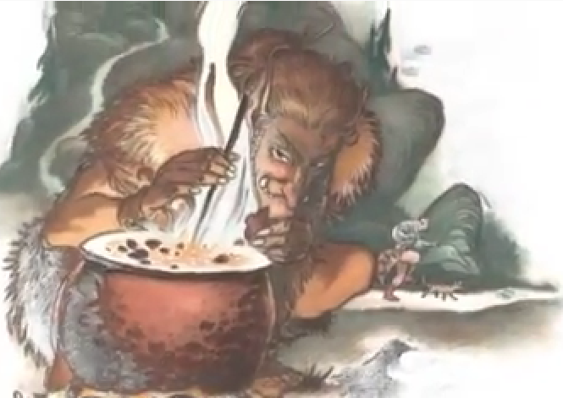
Remember: that giants sleep too soundly; that witches are often betrayed by their appetite; dragons have one soft spot, somewhere, always; hearts can be well hidden, and you betray them with your tongue.

Slide 8
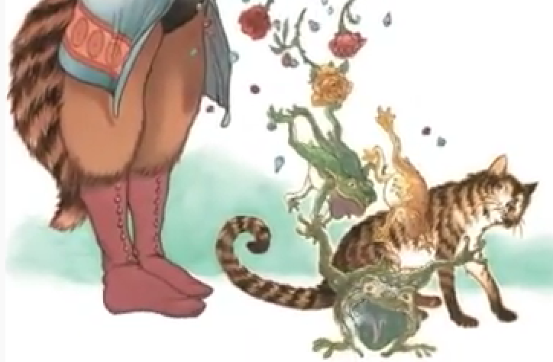
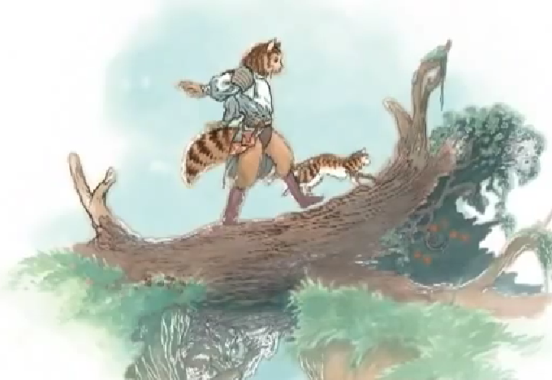
Do not be jealous of your sister: know that diamonds and roses are as uncomfortable when they tumble from your lips as toads and frogs: colder, too, and sharper, and they cut.
Remember your name. Do not lose hope – what you seek will be found.
Trust ghosts. Trust those that you have helped to help you in their turn. Trust dreams. Trust your heart, and trust your story.

Slide 9
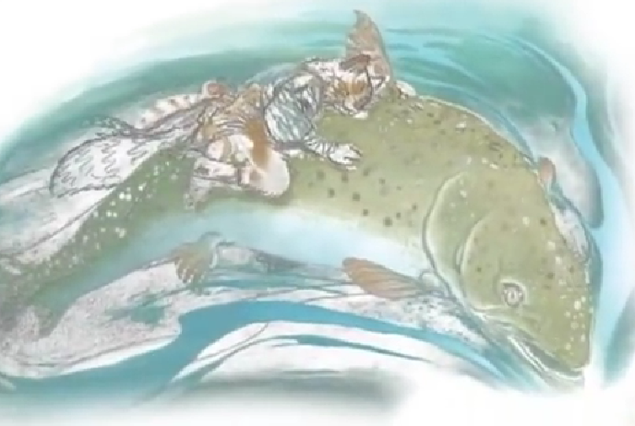
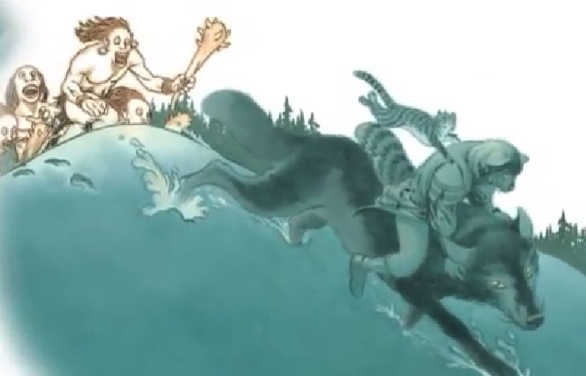
When you come back, return the way you came. Favours will be returned, debts will be repaid. Do not forget your manners. Do not look back.
Ride the wise eagle (you shall not fall). Ride the silver fish (you will not drown). Ride the grey wolf (hold tightly to his fur).

Slide 10
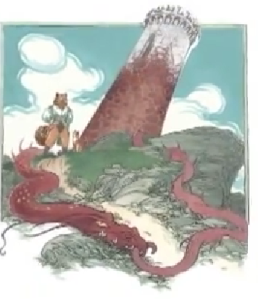
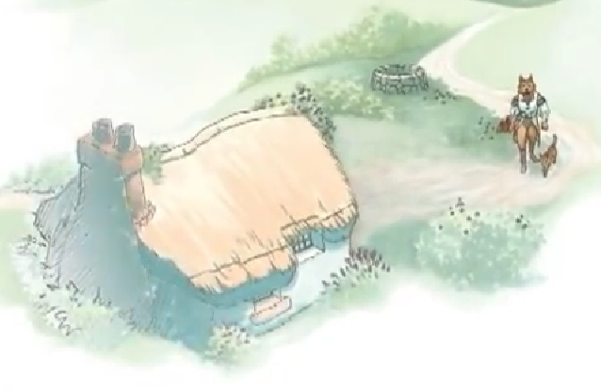
There is a worm at the heart of the tower; that is why it will not stand.
When you reach the little house, the place your journey started, you will recognise it, although it will seem much smaller than you remember. Walk up the path, and through the garden gate you never saw but once.
And then go home. Or make a home. Or rest.

