Slide 1

Hello everyone hope you are all well today?

Slide 2
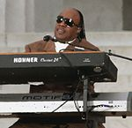
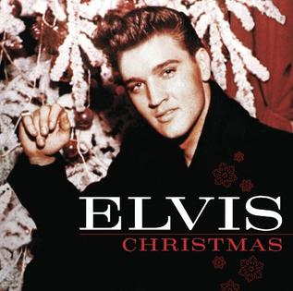
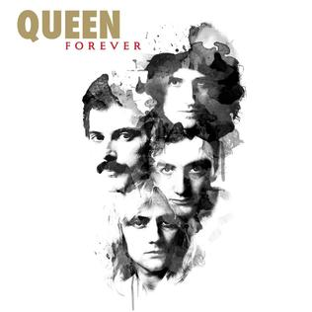
Music History in the 1970s here are some of the different musicians
Stevie Wonder

Slide 3
Today we are going to learn about music history that was recorded and played in the 1970s decade. We will also learn about the different meanings of the musical notes.

Slide 4
In this lesson we will take a trip through history using famous people who made the different styles of music, that are still listened to today by thousands of people all around the world.

Slide 5
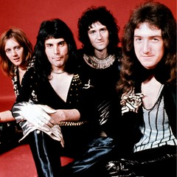

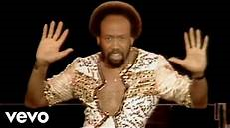
There were many different styles of music in the 1970s here are a few of the different types. Funk, Soul, R&B, Pop, Hard Rock, Soft Rock and Disco. These all had a place in the music world in the 1970s.
Soul Music
Funk Music
Hard Rock Music

Slide 6


Slide 7


Slide 8


Slide 9
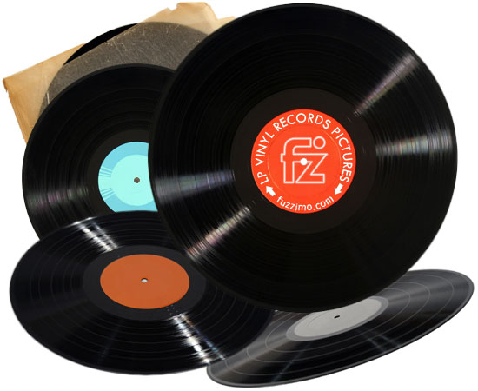
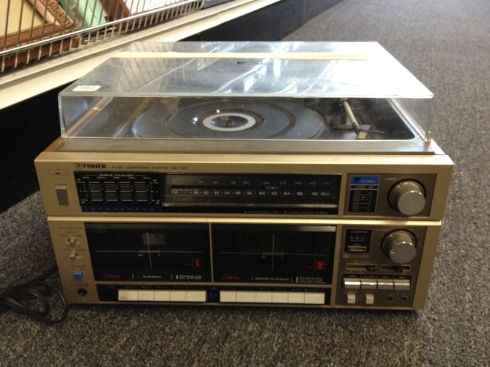
In the 70s there were different ways of listening to music like using the a radio and by playing vinyl records. What is a vinyl record?. This is what they looked like and your played them on a record player This is what a record player looked like at this time.
Vinyl record
Record Player

