Slide 1
History - To learn about the Battle of Dun Nechtain

Slide 2

Key Vocabulary
Loch – a large lake in Scotland
Kingdom – An area you control
Pict – A Scottish warrior
Angle – A English warrior (Anglo-Saxon)
Spearman – a warrior who used a large spear.

Slide 3
What happened in the battle
As well as watching the video I have made some slides for you to show you how the Picts defeated the Anglo-Saxons.

Slide 4

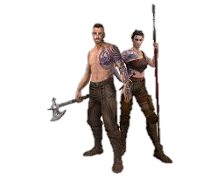
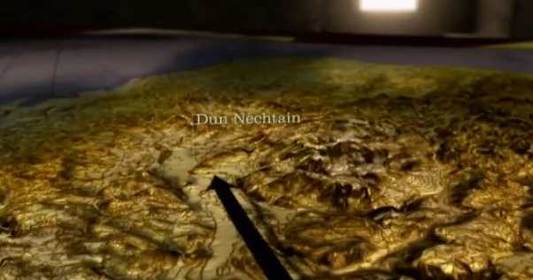
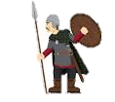
The Picts forced the Angles to come to them.

Slide 5
The two armies fought hard but the Picts we the better soldiers

Slide 6
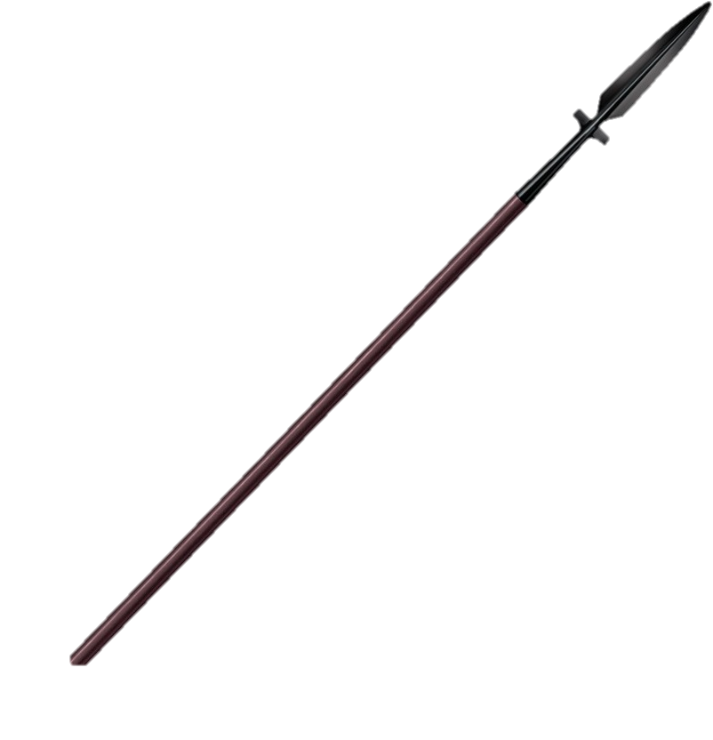
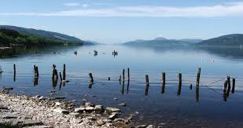
The Pict spearmen forced the Angles into a loch.

Slide 7
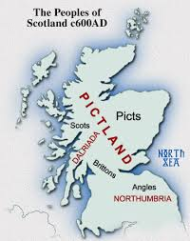
The Picts we relieved and took control of Scotland, this used to be called Pictland.

Slide 8

Can you draw a picture of the battle and label it using the key vocabulary

