Slide 1
Learning Intention - To learn about music from the 1980’s

Slide 2

Music from the 1980’s
Last half term we looked at music from the 1970’s, listening to music from The Beatles, Queen and The Supremes.
This week we are going to move to the next decade and learn about music from the 1980’s.

Slide 3
Structure of the music
While we are listening to the music, I want you to think about the structure of the music.
This is the way the music is ‘built’ and the parts it has.
Is there a chorus?
Are there parts where it is only instruments?
Are there parts where it is only the singer?
Are there parts where instruments and the singer play together?

Slide 4
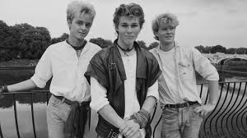
Artist 1 – A-ha
A-ha were a band that were from Norway. They played a type of music called synth-pop which was a type of pop music played with lots of electronic instruments.
Even though they were from Norway, their music was famous all around the world, and they had two number 1 hit songs in the UK.
What do you notice about the structure of their music?

Slide 5

Artist 2 – Wham!
Wham! were a pop music duo featuring George Michael and Andrew Ridgeley. They got together in 1981 and became one of the biggest pop bands of the 1980’s, selling more than 30 million records around the world.
What do you notice about the structure of their music?

Slide 6
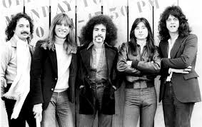
Artist 3 - Journey
The final band we are going to look at are Journey, an American rock band that formed in 1972 however their most successful time was in the 1980’s. One of their most famous songs was called ‘Don’t Stop Believin’’
When it was released in 1981 it only got to 64 in the charts but it later became much more popular and has now sold over 1 million copies.
What do you notice about the structure of the music?

Slide 7
Your opinions
Which was your favourite piece of music?
Why did you like it?
What do the other people in your house think? Do they like the same as you?

