Slide 1
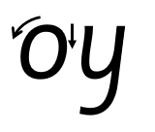
Focus sound: oy
o - Make a curve, go all the way around.
y - Start at the top, come all the way down and curve. Go back up, come all the way down and curve to the left.

Slide 2
Your turn! Write oy in your book using the lines.
Then try:

