Slide 1
Learning Intention: To observe the changing seasons

Slide 2
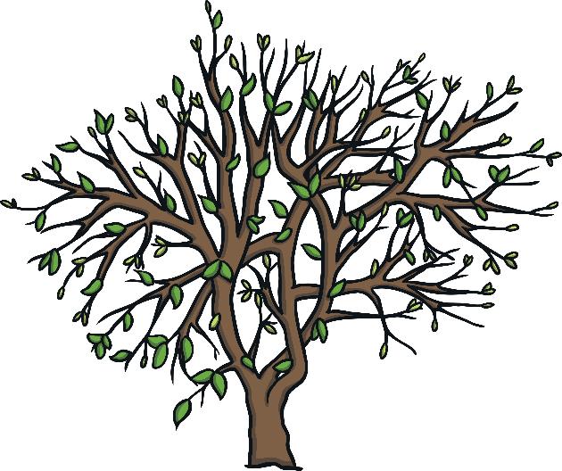
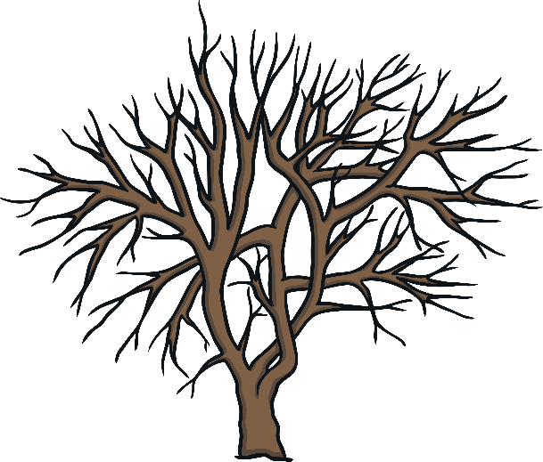
The Seasons:

Slide 3
Months of the year:
January
February
March
April
May
June
July
August
September
October
November
December

Slide 4
The months in the seasons:
Spring:
March
April
May
Summer:
June
July
August
Autumn:
September
October
November
Winter:
December
January
February
Notes:
Each season has 3 months that are in it. Can you spot this month, February? Which season are we in?

Slide 5
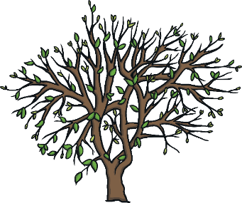
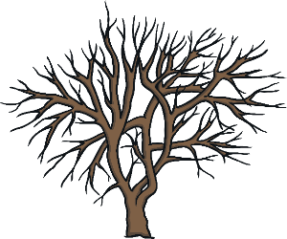
Match the month to the season:
March
October
January
August

Slide 6
We are in Winter, but soon it will be…
February
(Winter)
March
(Spring)
Notes:
Now we are in February, but soon we will be in March. February is Winter but March is Spring!

Slide 7
How can we spot the signs of Spring?
What does Spring look like?

Slide 8
Hours of daylight:
Notes:
Have a look at the hours of daylight we get each season and month. We are in February and Winter now, will we get more sun in Spring? How do you know?

Slide 9
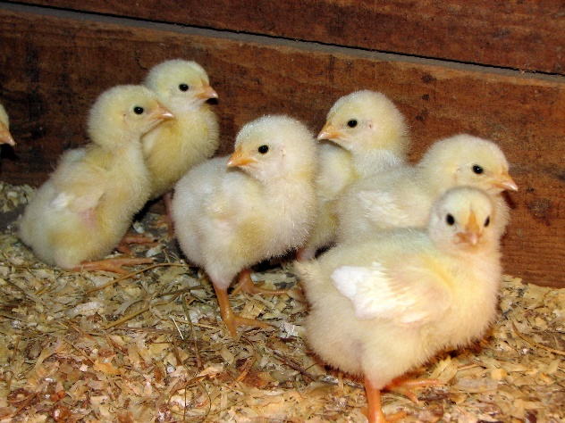
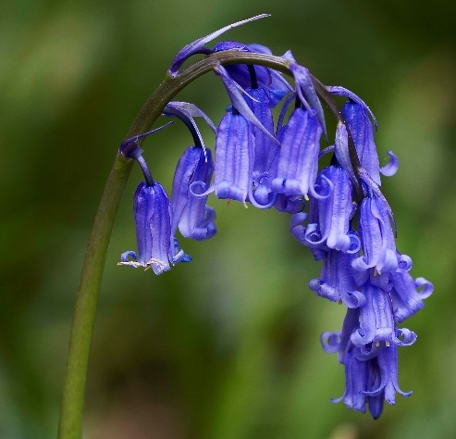
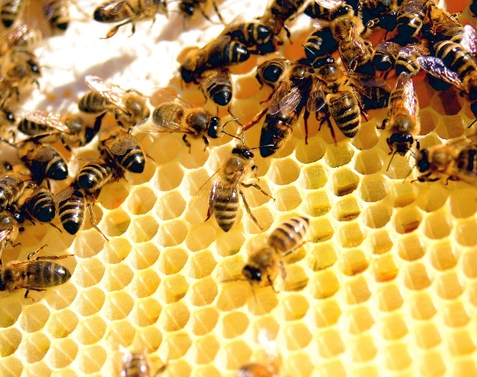
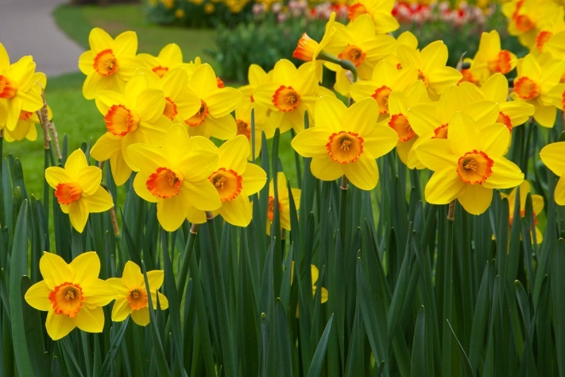
chicks
bluebells
bees
daffodils

Slide 10
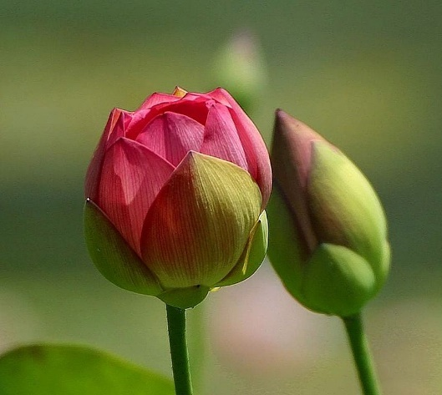
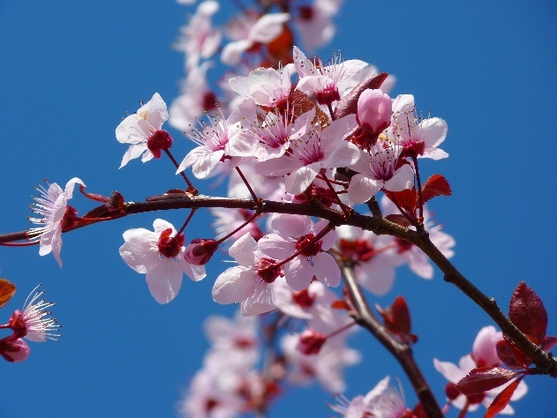
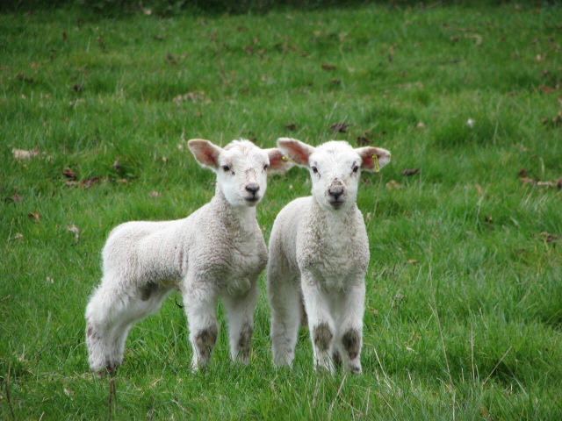
flower buds
blossom
lambs

Slide 11
Your turn:
1) Talk to your grown up. Are there any early signs of Spring outside?
2) Draw the early signs of Spring on your worksheet.

Slide 12
The Seasons - Answers
Spring
Summer
Autumn
Winter

Slide 13
Commentary:
Slide 4: Each season has 3 months that are in it. Can you spot this month, February? Which season are we in?
Slide 6: Now we are in February, but soon we will be in March. February is Winter but March is Spring!
Slide 8: Have a look at the hours of daylight we get each season and month. We are in February and Winter now, will we get more sun in Spring? How do you know?

