Slide 1
Year 1 Maths Alternative 1 Shape Quiz

Slide 2
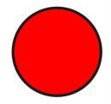
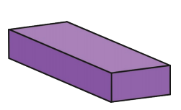
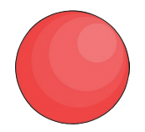
Today in maths we are going to see how much we can remember about 2D and 3D shapes.
2D
3D

Slide 3
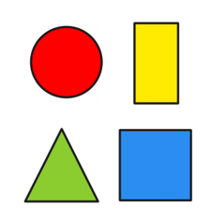
Lets start with 2D shapes. Work out which 2D shape it is from the clues.
I have 4 sides.
2 sides are long and 2 sides are short.
I have 4 corners.
What shape am I?

Slide 4
Work out which 2D shape it is from the clues.
I have 3 sides.
I have 3 corners.
What shape am I?

Slide 5
Work out which 2D shape it is from the clues.
I have 1 side.
I have 0 corners.
What shape am I?

Slide 6
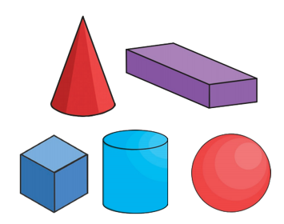
Now lets look at 3D shapes. Work out which 3D shape it is from the clues.
I have 6 faces. All of my faces are the same size.
I have 12 edges.
I have 8 vertices.
What shape am I?

Slide 7
Work out which 3D shape it is from the clues.
I have 1 face.
I have 0 edges.
I have 0 vertices.
What shape am I?

Slide 8
Work out which 3D shape it is from the clues.
I have 2 faces.
I have 1 edge.
I have 1 vertice.
What shape am I?

Slide 9
Answers
Slide 3 – rectangle Slide 6 – cube
Slide 4 - triangle Slide 7 – sphere
Slide 5 – circle Slide 8 – cone

