Slide 1
Learning Intention – To plan my own poem

Slide 2
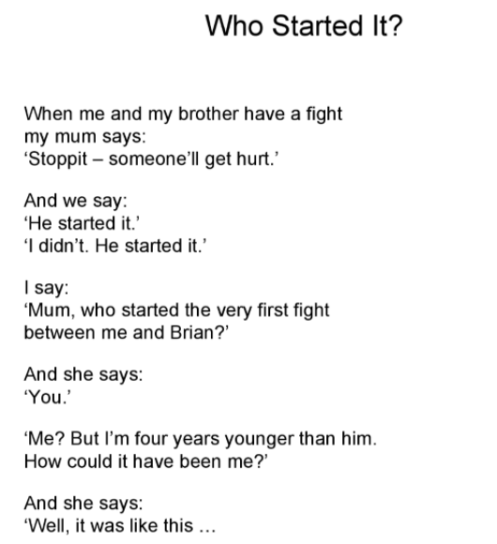
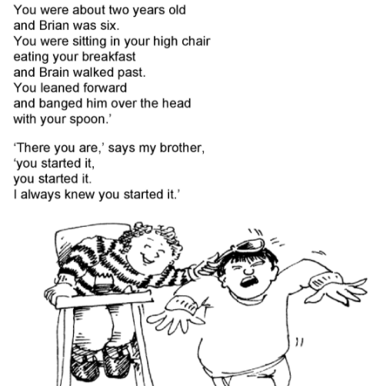

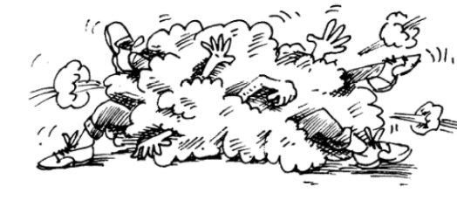
Listen to the poem again, think about the three main characters.

Slide 3
Today’s task
Today you are going to plan your own version of the poem.
Think about an argument you have had with a friend, a brother or a sister. Think about which adult stopped the argument.
You are going to use the planning document I have made for you to help you plan the narrative poem. On the next slide I have completed an example planning document for you to get some ideas from.

Slide 4
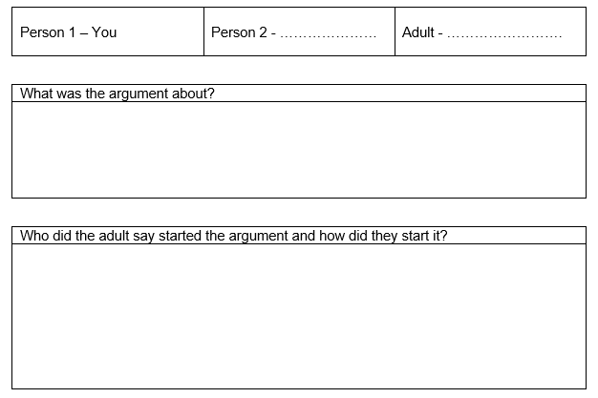
My planning document.
My sister
My mum
My sister and I kept on hitting each other when we were arguing.
My mum told us to stop. She said that my sister started the fight because when she was a baby she bit my foot.

