Slide 1
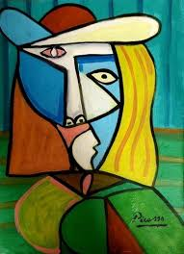
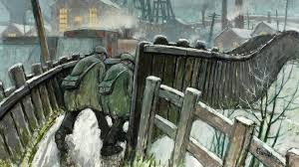
Alternative 1 Art What have I learnt?

Slide 2
Quiz time!
Go through the next slides answering the quiz questions all about Pablo Picasso and Norman Cornish.
Discuss them with someone at home.

Slide 3
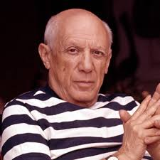
Who is this man?

Slide 4
Pablo Picasso
2. What type of art did he create?
Choose which one you think below.
Paintings sculptures drawings

Slide 5
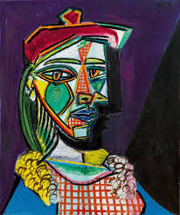
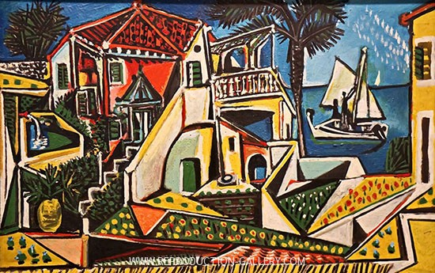
Pablo Picasso
3. Which painting is a portrait?

Slide 6
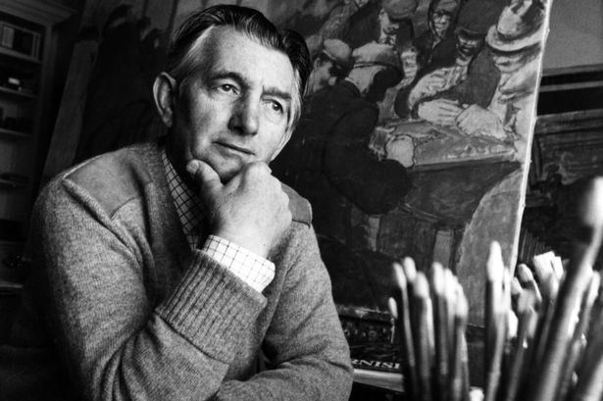
Norman Cornish
4. Who was Norman Cornish?

Slide 7
Norman Cornish
5. What type of art did Norman Cornish create?
Paintings sculptures drawings

Slide 8
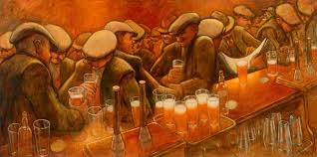
Norman Cornish
6. What colours can you see in this painting?

Slide 9
Norman Cornish
7. What was his job before he was an artist?
miner policeman teacher

Slide 10
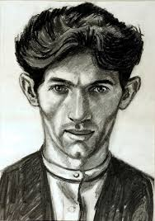
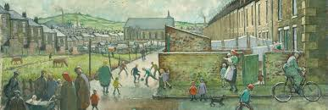
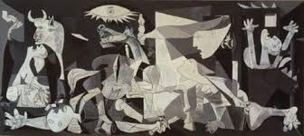
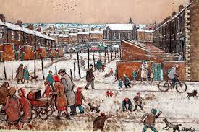
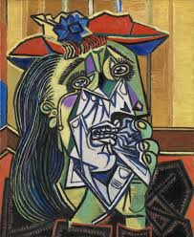
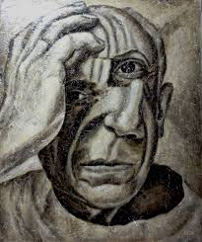
8. Who painted each painting, Norman Cornish or Pablo Picasso?

Slide 11
9. Name one thing that is the same about these paintings and one thing that is different about them.

Slide 12
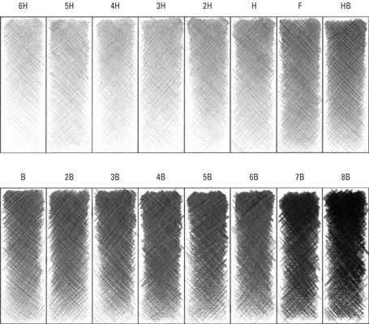
10. What is it called when you create different tones using a pencil?
Colouring shading

Slide 13
Answers
Pablo Picasso.
Paintings
This one is a portrait- It is of a face.
An English artist.
Paintings
Orange, white, red
Miner
9. Same: Both of faces.
Different: One is colorful, the other is black and white.
10. Shading

Slide 14
8. Picasso Norman Cornish

