Slide 1
Learning intention – classifying animals

Slide 2
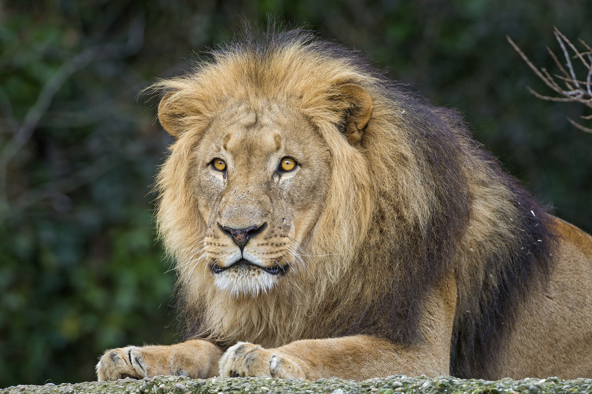
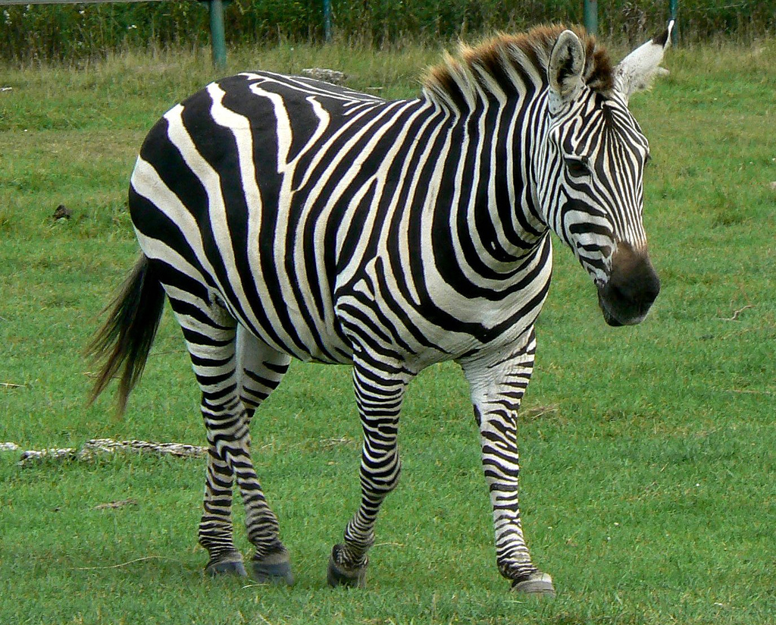
Mammals
lion
Mammals usually have hair or fur.
Mammal babies are born alive.
The mothers feed their babies milk.
We are mammals. They have a backbone, this means that are vertebrates.
zebra

Slide 3
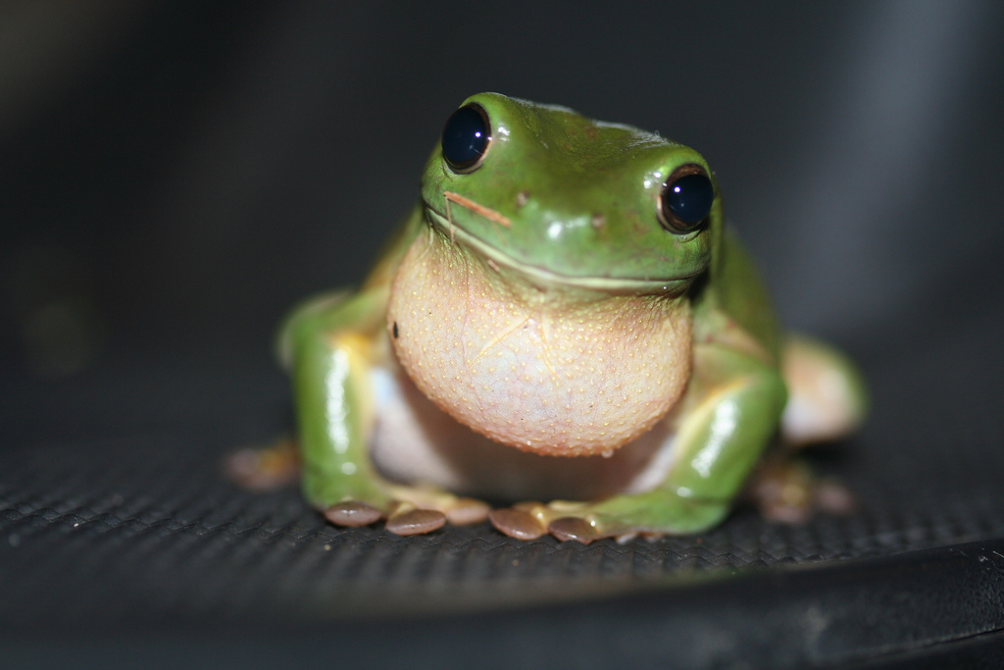
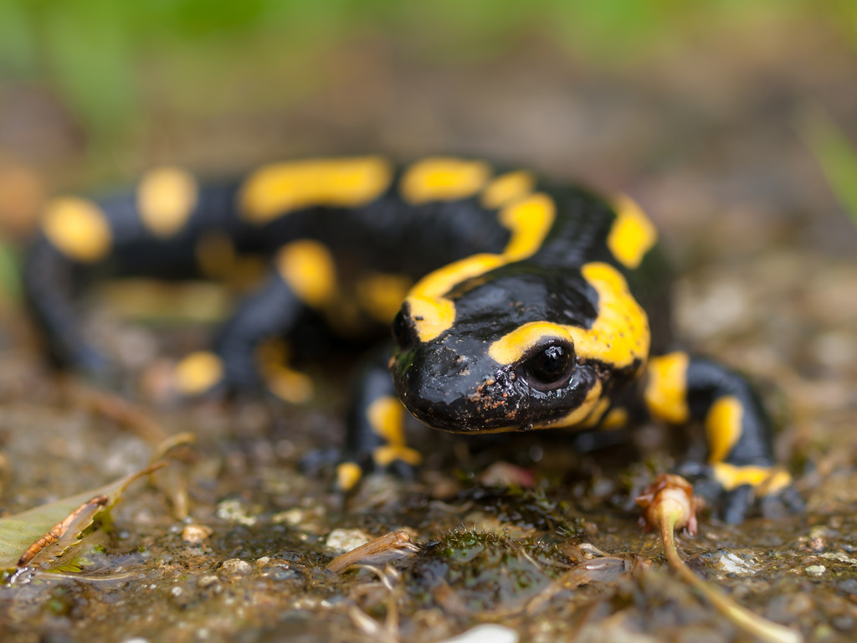
Amphibians
frog
Amphibians live on land and in water. They lay their eggs in water. They have backbones.
salamander

Slide 4
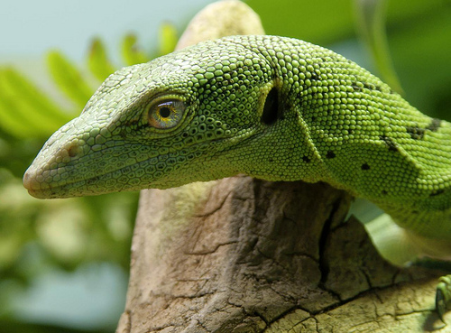
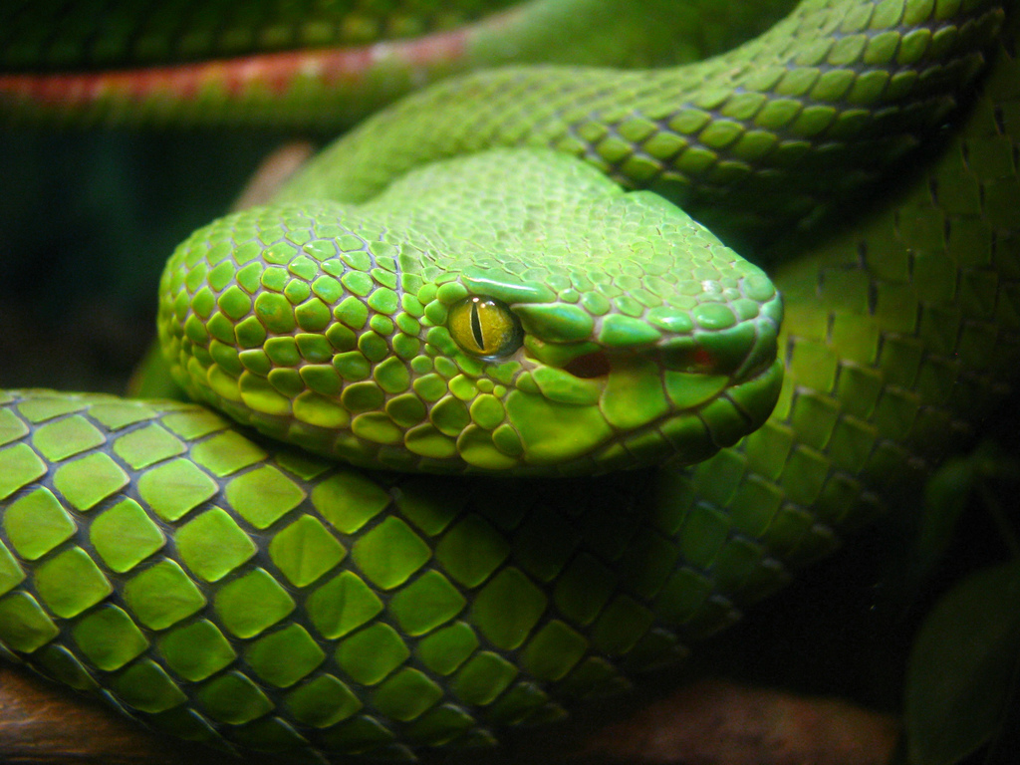
Reptiles
lizard
Reptiles live in water and on land.
They have scales and are cold blooded. This means that they cannot keep warm by themselves and need to be in a warm place.
They lay their eggs on land. They have backbones.
snake

Slide 5
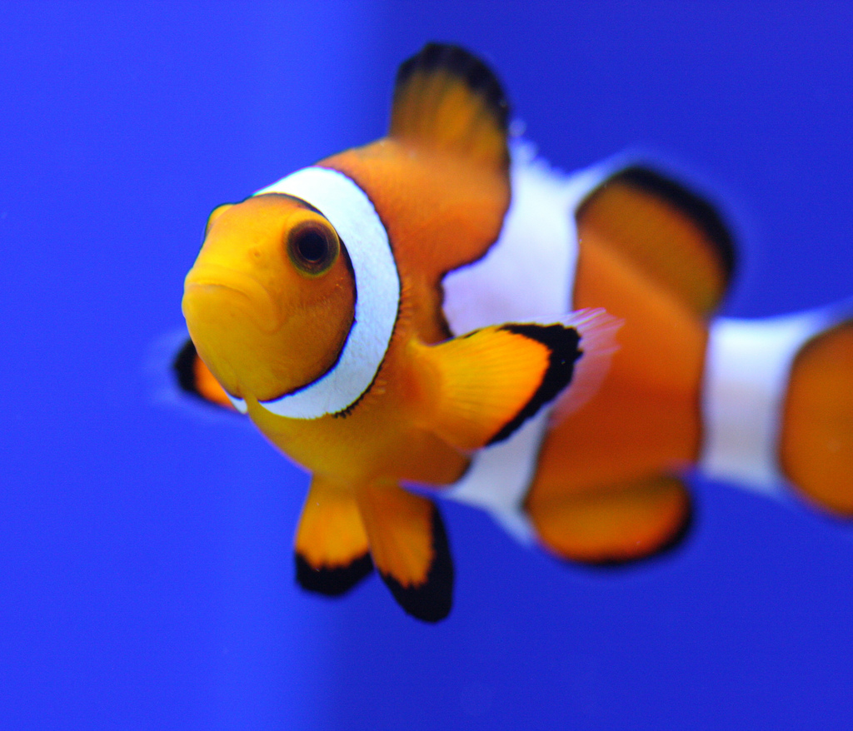
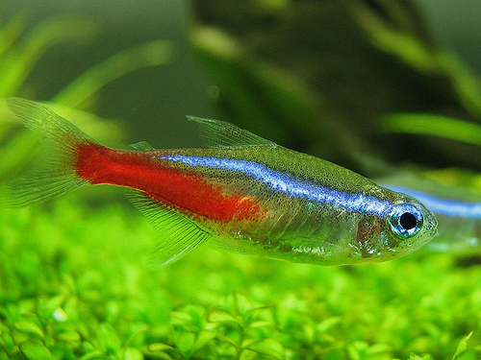
Fish
Clown Fish
Fish live in water.
They have fins instead of legs and gills instead of lungs. They lay their eggs in water. They have backbones.
Neon Tetra

Slide 6
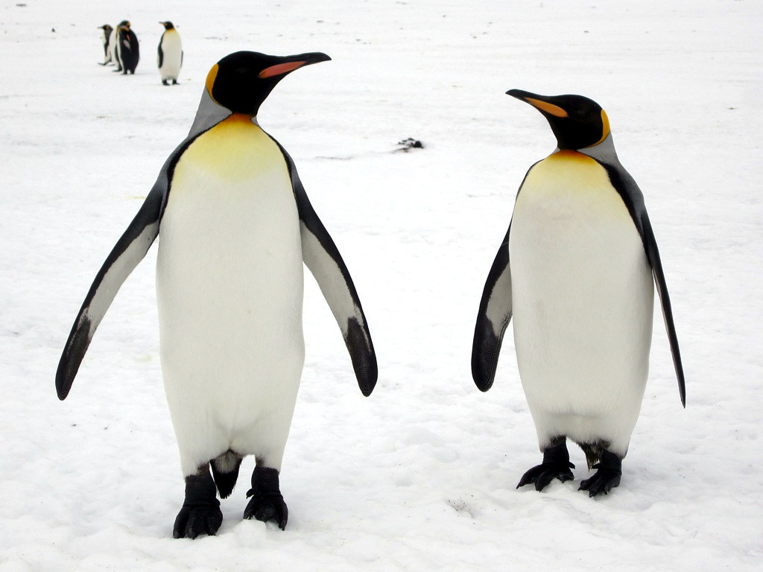
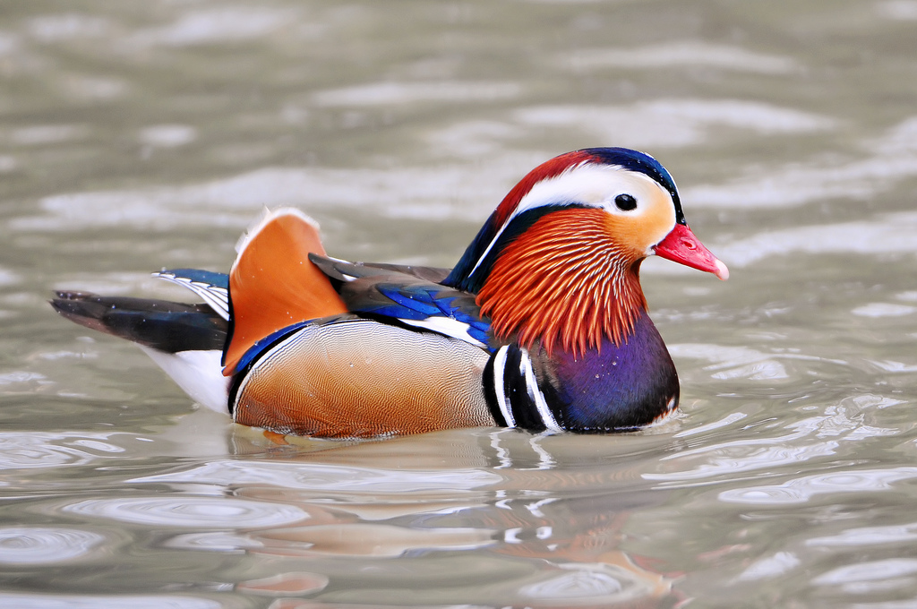
Birds
penguins
Birds have a beak, wings, feathers and 2 legs. They lay eggs. They have backbones.
Mandarin Duck

Slide 7
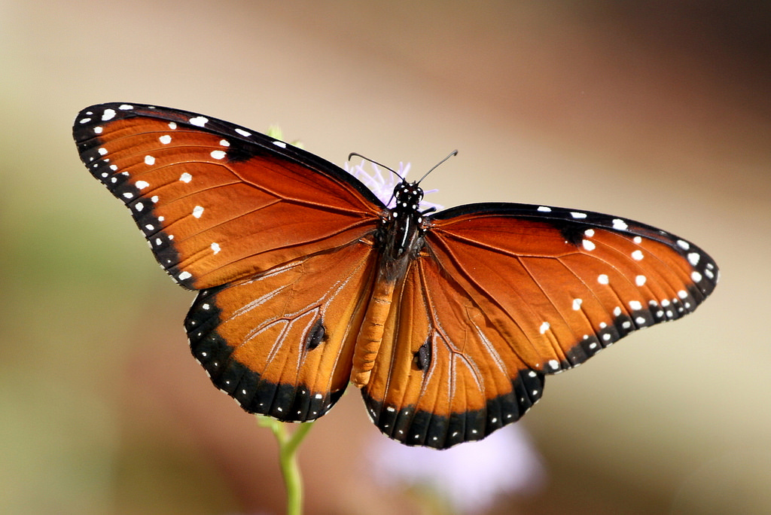
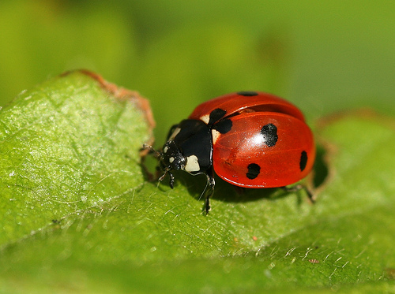
Insects
butterfly
Insects have 6 legs.
Their bodies are made up of 3 parts. Some have wings.
They lay eggs.
They are invertebrates. They have no back bone.
ladybird

