Slide 1
Learning intention: To solve multiplication problems

Slide 2
Class 6 are going on a trip.
The teacher wants the class to get into groups of 5, so there is an adult with each group.
There are 7 adults.
How many children are going on the trip?
How can you work this out?

Slide 3
How did you work it out?
You could represent your thinking in different ways.
Draw a picture.
Write a number sentence.
7 × 5 = 35
5 + 5 + 5 + 5 + 5 + 5 + 5 = 35

Slide 4
Draw a bar model.
35
5 | 5 | 5 | 5 | 5 | 5 | 5
Draw jumps on a number line.

Slide 5
Draw an array.
Use equipment.

Slide 6
7 × 5 = 35
5 + 5 + 5 + 5 + 5 + 5 + 5 = 35
35
5 | 5 | 5 | 5 | 5 | 5 | 5
+5
+5
+5
+5
+5
+5
+5
0
5
10
15
20
25
30
35

Slide 7
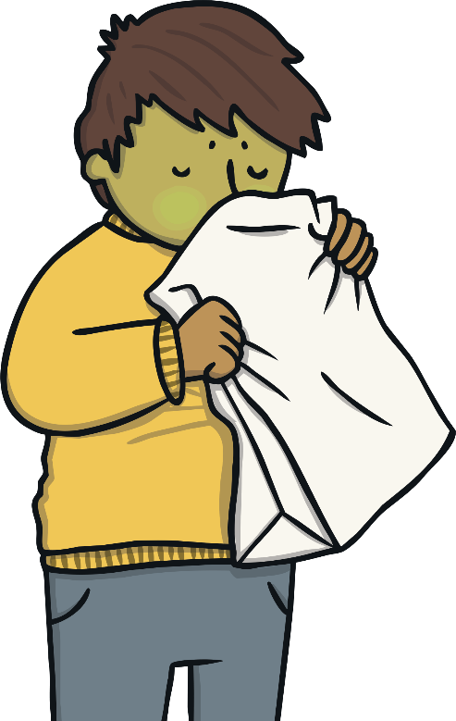
I always get sick on the coach.
I think we should pack 2 sick bags for each group.
There are 7 groups.
How many sick bags do they need to pack?
Represent this in as many ways as you can.

Slide 8
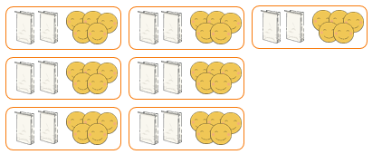
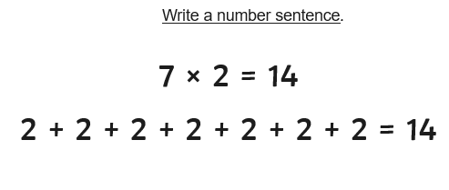
I can draw a picture.

Slide 9
