Slide 1
Can you help Peter the polar bear count his fish.

Slide 2
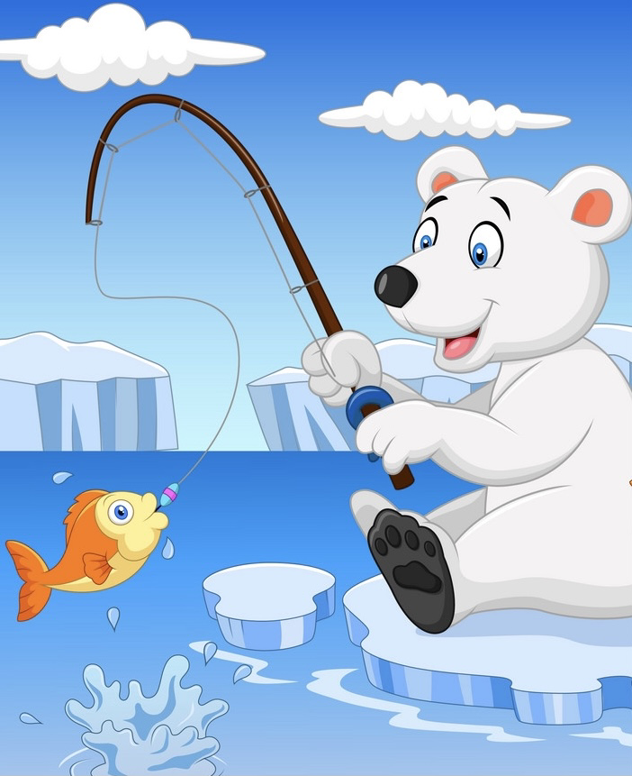
2
4
3
5

Slide 3
1 2 3
2
4
3
5

Slide 4
5
4
1
3

Slide 5
1 2 3 4 5
5
4
1
3

Slide 6
2
1

Slide 7
1 2
2
1

Slide 8
5
2

Slide 9
1 2 3 4
5
2

Slide 10
1
5

Slide 11
1
1
5

