Slide 1


Learning intention: to know different word types including verbs
A verb is a type of word.
Verbs are something you do.
Which word is a verb?
red run dog

Slide 2
Run is a verb because it is something we can do.
✓
red run dog

Slide 3
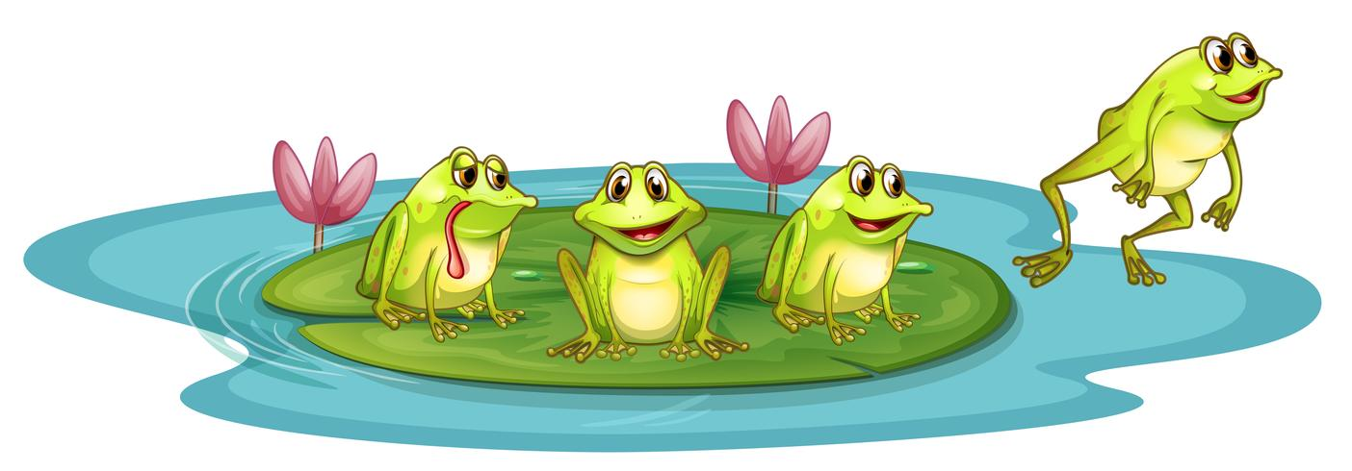
Which word is a verb in this sentence?
The frog can jump off.

Slide 4
Which word is a verb in this sentence?
✓
The frog can jump off.
Jump is the verb because that is what the frog is doing.

Slide 5
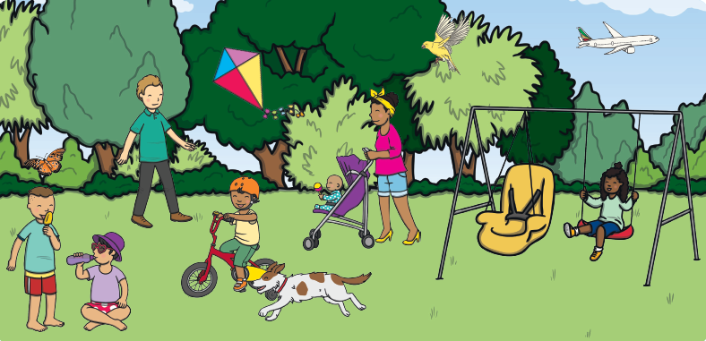
What verbs can you think of to go with this picture?

Slide 6
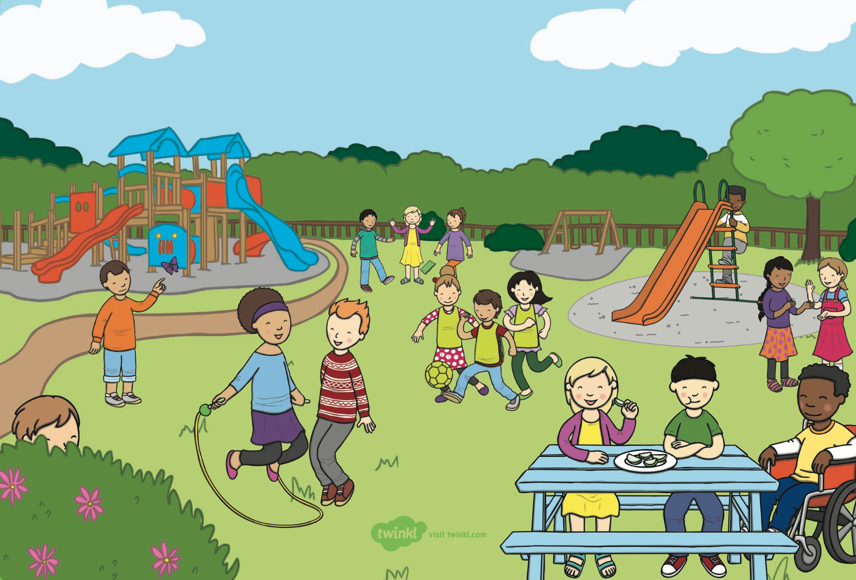
What verbs can you think of to go with this picture?

