Slide 1
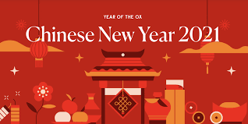
Chinese New Year marks the start of a new lunar year and falls in January / February. In 2021 Chinese New Year begins on 12th February.
Kung Hei Fat Choy!
(That is how you say “Happy New Year!” in Chinese)

Slide 2
Chinese New Year is also known as the Spring Festival. It is the biggest and most important festival in China and it is celebrated in Chinese communities all over the world.
It is celebrated with gifts, fireworks and dragon and lion dances. The celebration culminates on the 15th day with a lantern festival. It is thought to be largest annual human migration as Chinese people return home to spend time with their families.
The 15-day festival begins with spring cleaning: everyone joins in with cleaning the home ready for the New Year. The festival is celebrated with:
New clothes
Gifts of money
Special food
Parades - including dragon and lion dances
Fireworks and beautiful lantern displays on the final day

Slide 3
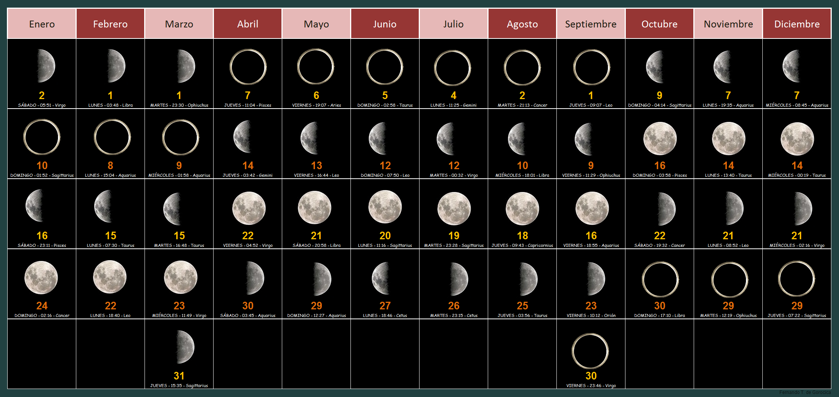
The date of Chinese New Year is based on the lunar calendar, so it changes each year. However, the celebrations always take place between 21st January and 20th February.

Slide 4
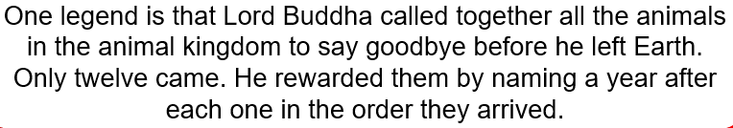
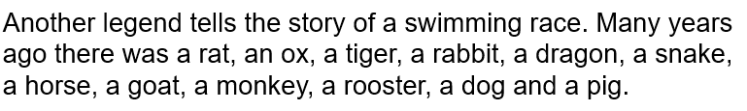
There are many legends about how the Chinese New Year came about.
The animals argued about who should be first in the cycle of years. The gods decided that there should be a swimming race and the animal that won would be the first animal in the cycle. The rest of the animals would be in the order that they finished. The order that they finished the race was rat, ox, tiger, rabbit, dragon, snake, horse, goat, monkey, rooster, dog then pig.

Slide 5
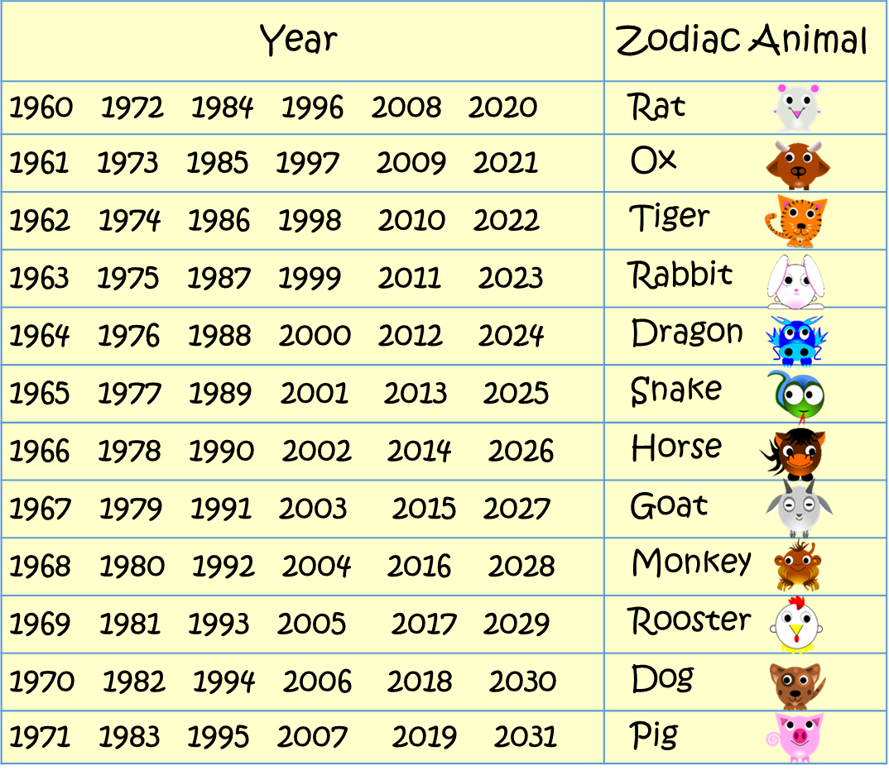
What is your zodiac animal? Find the year you were born in the chart.
What year will 2021 be?

Slide 6
How is Chinese New Year celebrated?
The first day of the Lunar New Year is "the welcoming of the gods of the heavens and earth."
On day two, the Chinese pray to their ancestors as well as to all the gods.
The third and fourth days are for the sons-in-laws to pay respect to their parents-in-law.
The fifth day is called Po Woo. On that day people stay home to welcome the God of Wealth.
On the sixth to the 10th day, the Chinese visit their relatives and friends.
The seventh day of the New Year is the day for farmers to display their produce.
On the eighth day people have another family reunion dinner, and at midnight they pray to Tian Gong, the God of Heaven.
The ninth day is to make offerings to the Jade Emperor.
Days ten, eleven and twelve are the days on which friends and relatives are invited for dinner.
After so much rich food, on the 13th day most people have simple rice congee and mustard greens (choi sum) to cleanse the system.
The 14th day is for preparations to celebrate the Lantern Festival which is to be held on the 15th night.
In this video, a young member of the Chinese community in the UK tells us about the festival of Chinese New Year and why she enjoys it so much...

Slide 7
Chinese New Year quiz:
What is another name for Chinese New Year?
What day do the Chinese New Year celebrations begin on in 2021?
Where is Chinese New Year celebrated?
How long do the celebrations last?
5) Why does the date of Chinese New Year change each year?
6) In the legend of the swimming race, which animal came first? Which animal came last?
7) What is your zodiac animal?
8) On which day of the celebrations do farmers display their produce?
On which day are the offerings to the Jade emperor made?
10) Why are simple rice and vegetable dishes eaten on the 13th day of the celebrations?

