Slide 1
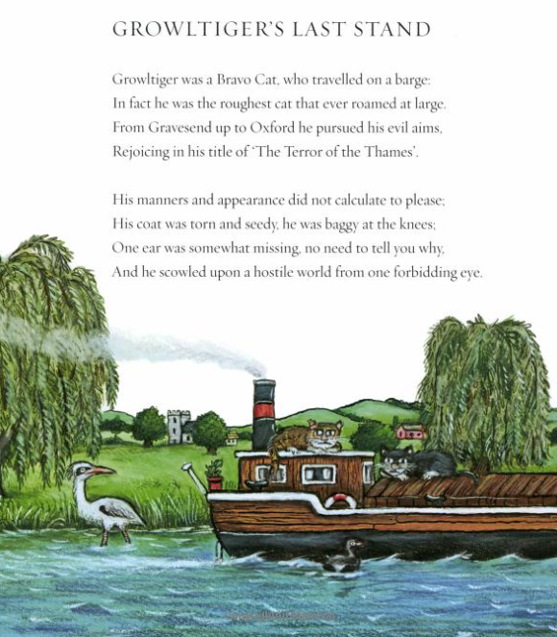

Slide 2
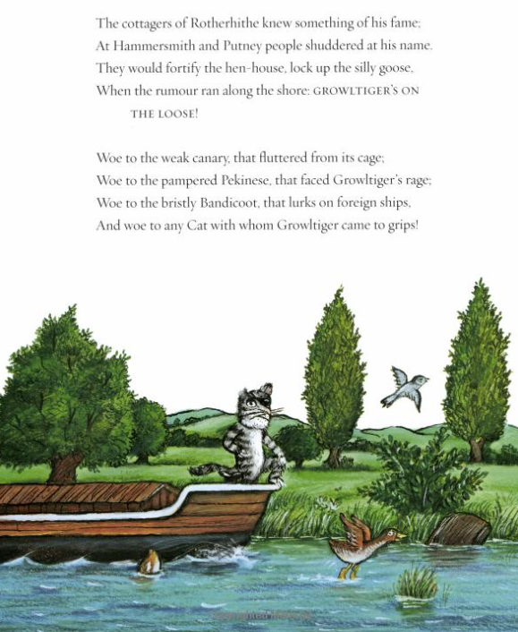

Slide 3
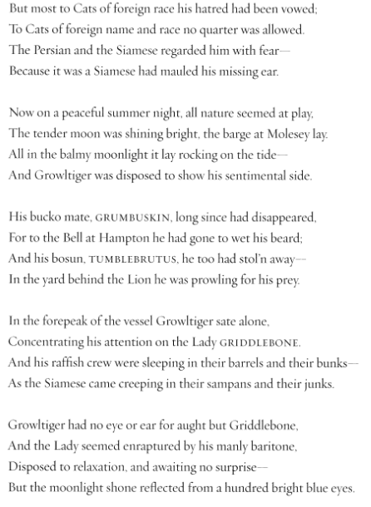

Slide 4
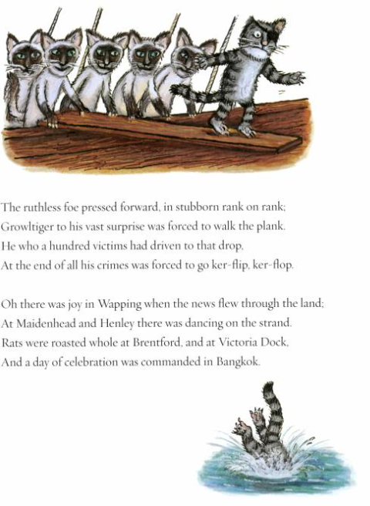

Slide 5
Growltiger was a cat who travelled on a barge.

Slide 6
He pursued his evil aims,
rejoicing in his title ‘The Terror of the Thames’.

Slide 7
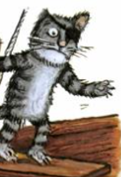
One ear was somewhat missing.

Slide 8
At Hammersmith people shuddered at his name.

Slide 9
Woe to the cats that faced Growltiger’s rage.

Slide 10
The ruthless foe pressed forward in stubborn rank on rank.

Slide 11
Growltiger to his surprise was forced to walk the plank.

Slide 12
Oh there was joy when the news flew through the land.

