Slide 1
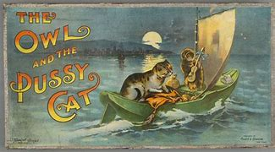

Learning Intention
To discuss and respond to themes in a poem

Slide 2
What is a narrative poem?
The Owl and the Pussy Cat is a narrative poem.
Narrative means story so these poems are ones that tell a story.

Slide 3
Poem 1: The Owl and the Pussycat by Edward Lear
The Owl and the Pussy-Cat went to sea
In a beautiful pea-green boat,
They took some honey, and plenty of money,
Wrapped up in a five pound-note.
The Owl looked up to the stars above,
And sang to a small guitar,
'O lovely Pussy! O Pussy, my love,
What a beautiful Pussy you are,
You are,
You are!
What a beautiful Pussy you are.'
Pussy said to the Owl, 'You elegant fowl,
How charmingly sweet you sing.
O let us be married, too long have we tarried,
But what shall we do for a ring?'
They sailed away for a year and a day,
To the land where the Bong-tree grows,
And there in the wood a Piggy-wig stood,
With a ring in the end of his nose,
His nose,
His nose!
'Dear Pig, are you willing, to sell for one shilling
Your ring?' Said the Piggy, 'I will.'
So they took it away, and were married next day,
By the Turkey who lives on the hill.
They dined on mince, and slices of quince,
Which they ate with a runcible spoon;
And hand in hand, on the edge of the sand,
They danced by the light of the moon,
The moon,
The moon!
They danced by the light of the moon

Slide 4
What are the features of narrative poems?
Powerful verbs and exciting adjectives
A verb is a word used to describe an action, state, or event.
Powerful verbs are more descriptive verbs.
e.g.
Exciting adjectives would be miserable instead of unhappy
Introduction - some lines or a verse
Characters
Rhyme
This means words that sound the same or similar in their endings. Poems and popular song lyrics often use rhyme.
e.g.
.
Repetition
This means words that sound the same or similar in their endings.
This is when a word or phrases is used over and over again in a poem.
e.g.
Dialogue
This is speech in the poem between the characters
e.g.

Slide 5
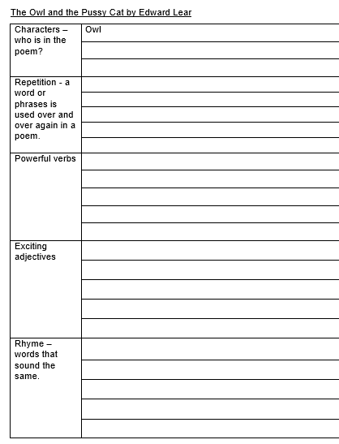
Now it’s your turn
Using what we have learnt about today in this PowerPoint, we have created a table like the one you see below and using The Owl and the Pussy Cat poem. Collect as many features as you can identify from the poem.

