Slide 1
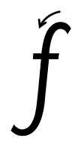
Focus sound: f
f -Make a curve, come all the way down, curve to the left. Lift and cross

Slide 2
Your turn! Write f in your book using the lines.
Then try:
fox
fun
fit

