Slide 1

Learning intention: To order and arrange combinations of mathematical objects in patterns and sequences.

Slide 2
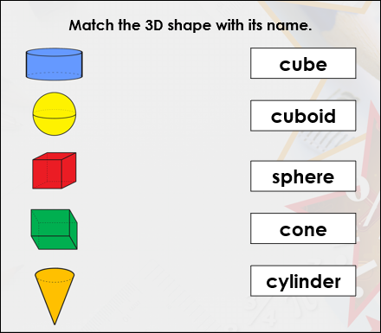

Slide 3
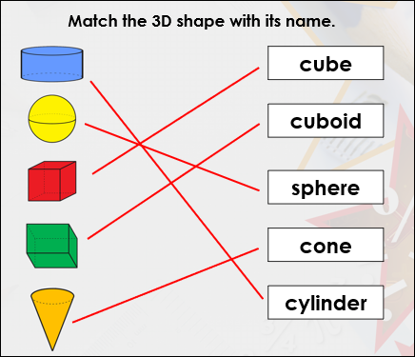

Slide 4
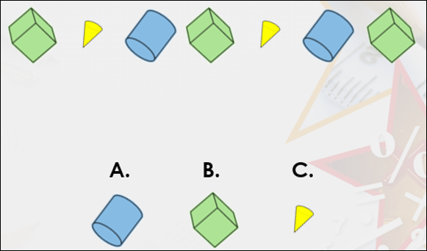
Which shape will come next in the pattern?

Slide 5
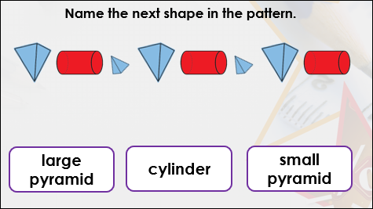

Slide 6
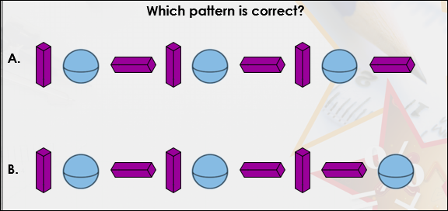
A is correct.

Slide 7
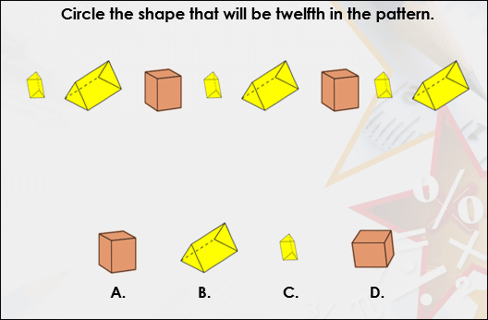

Slide 8
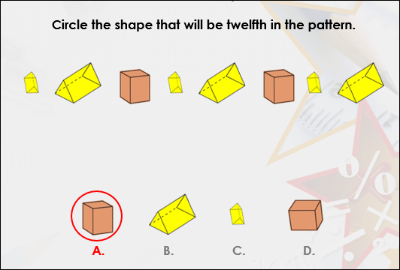

Slide 9
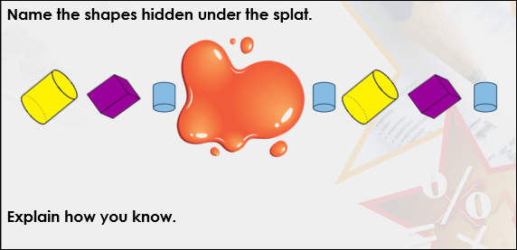

Slide 10
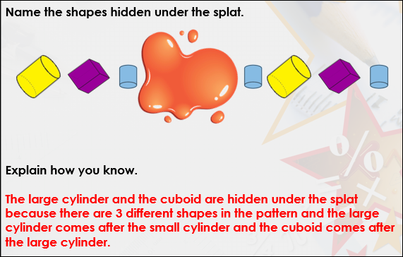

Slide 11
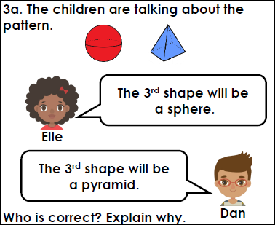
Elle is correct because there are 2 different shapes in the pattern and the first shape is a sphere, so the third shape will also be a sphere.

Slide 12
