Slide 1
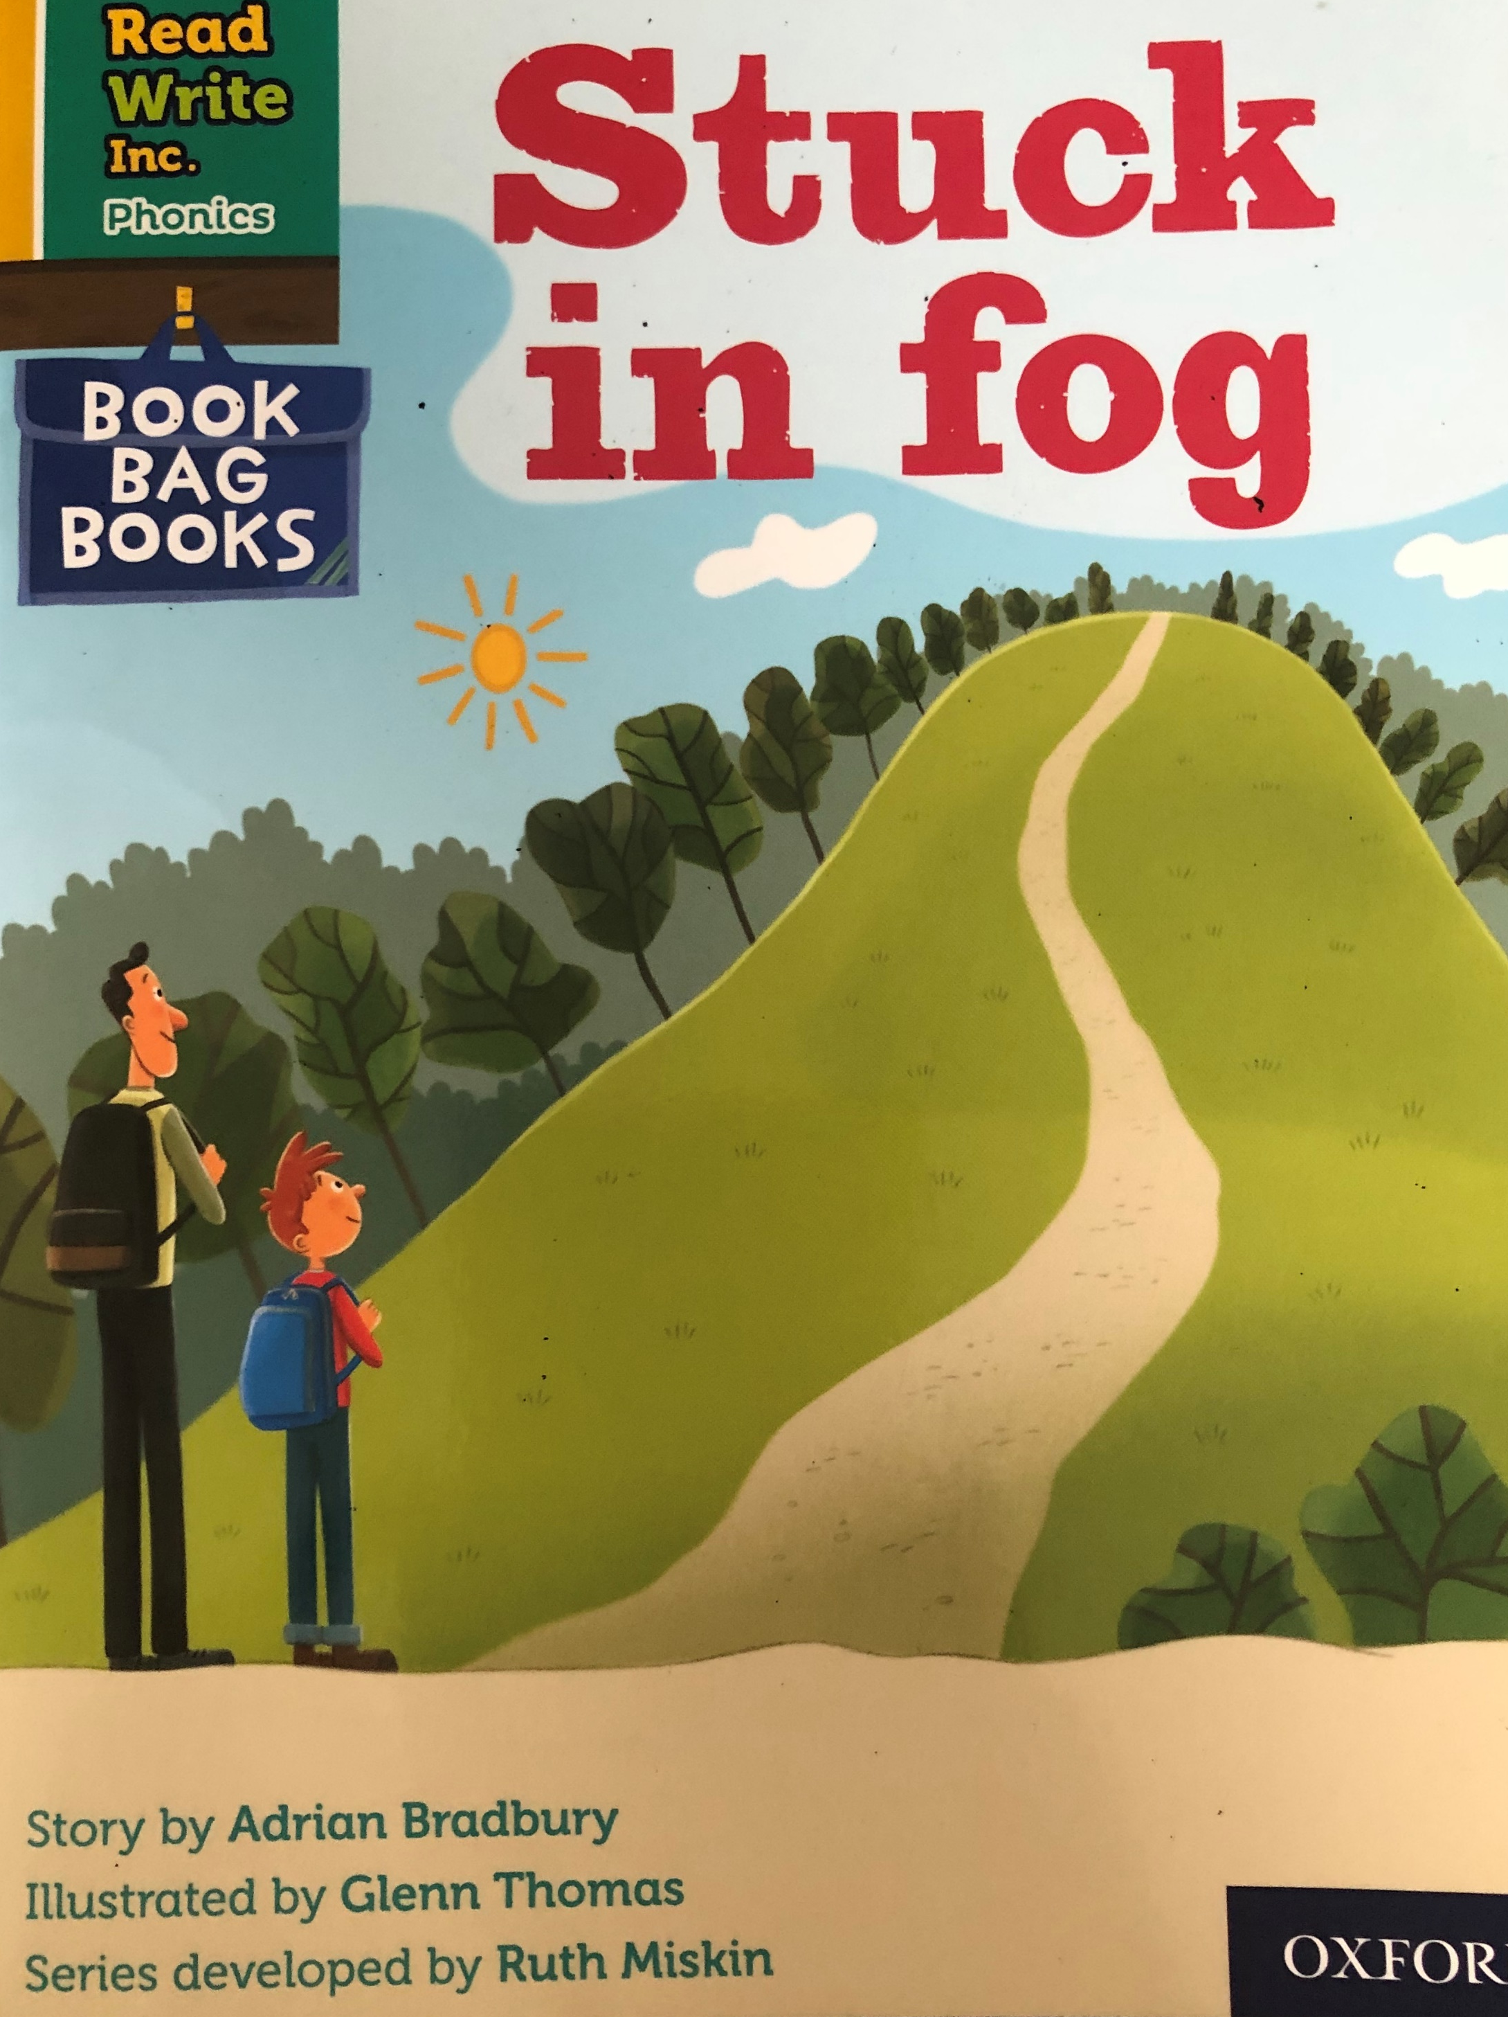
You are going to read the story ‘Stuck in Fog’.
In this story you will hear words with the sounds:
a
e
i
o
u
Look at the picture. What can you see? What will happen in the story?

Slide 2
Let’s read these words together. These are words you will come across in the story.
Green Words
backpack
jacket
silly
sipped
yelled
Red Words
was
put
all
fall

Slide 3
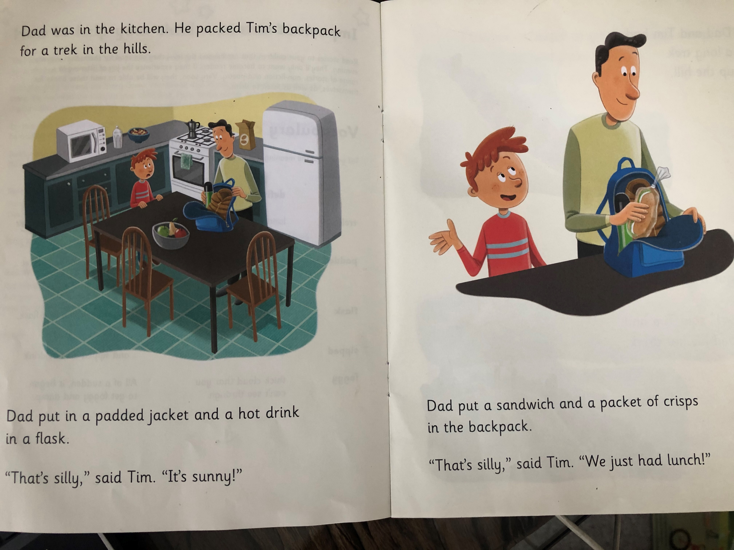
Why did Dad pack Tim’s backpack?
What did dad put in first?
Why did Tim think it was silly that dad put a sandwich and crisps in the backpack?

Slide 4
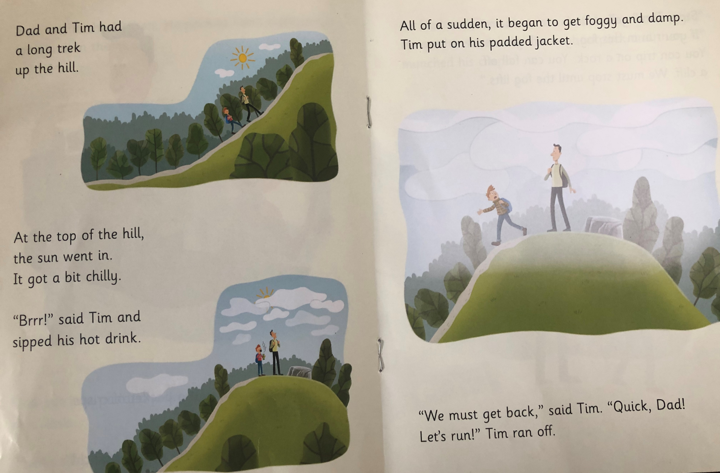
What happened at the top of the hill?
What did Tim do at the top?
Why did Tim run back?

Slide 5
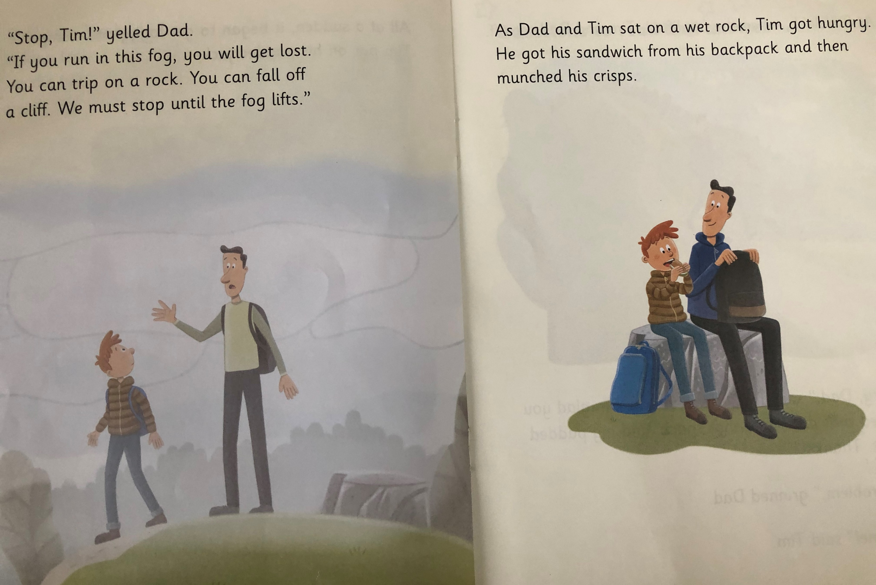
Why Did dad stop Tim?
Where did Tim and Dad sit?
What did they do while they sat?

Slide 6
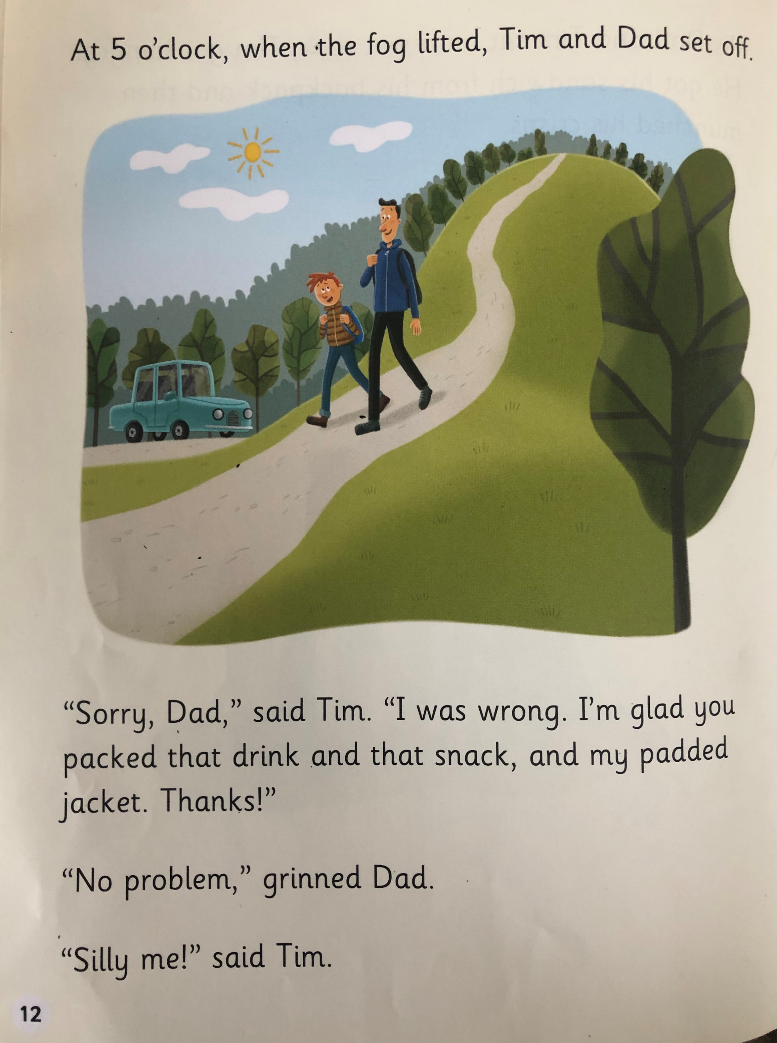
What time did the fog lift?
Why did Tim say sorry to Dad?
Who was silly in the end?

Slide 7
Recap questions
What did Dad pack in Tim’s backpack?
When did Tim sip his hot drink?
When did Tim put on his padded jacket?
What did Dad yell when Tim ran off?
When did Dad and Tim set off?

