Slide 1

Name the Animal Quiz

Slide 2

This animal has a small pointy nose.
It has prickles on its body.

Slide 3
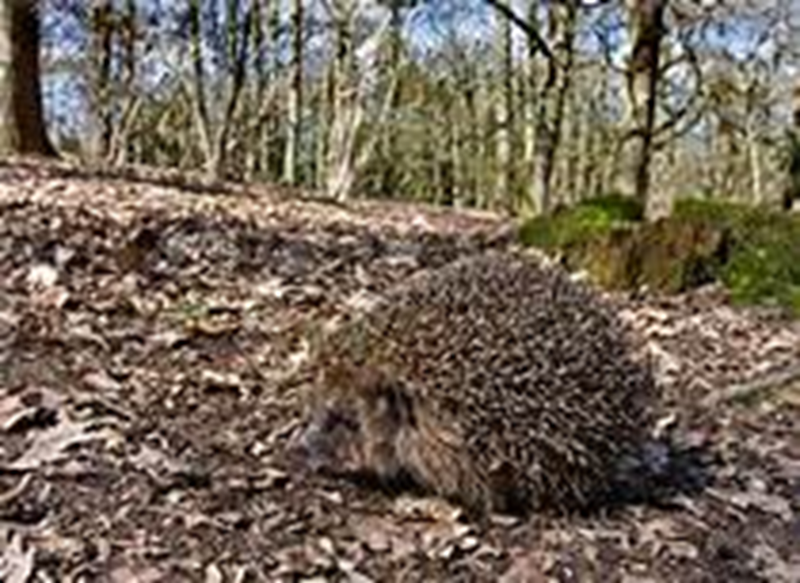
A hedgehog

Slide 4

In the story After the Storm, Percy had to give this animal a handkerchief to blow its nose.
This animal has a bushy tail.

Slide 5
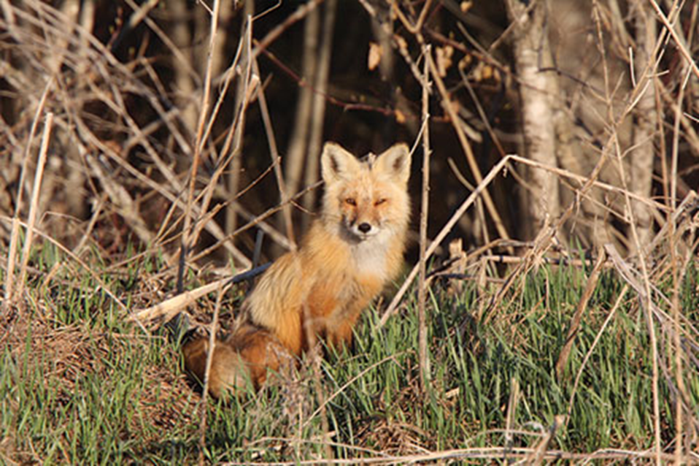
A Red Fox

Slide 6
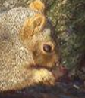
You have watched a class clip about this animal collecting nuts.
This animal can be red in colour, or grey in colour. The red one is hard to find in the outdoors.
In the first story about Percy the Park Keeper, this animal was the first animal to seek shelter.

Slide 7
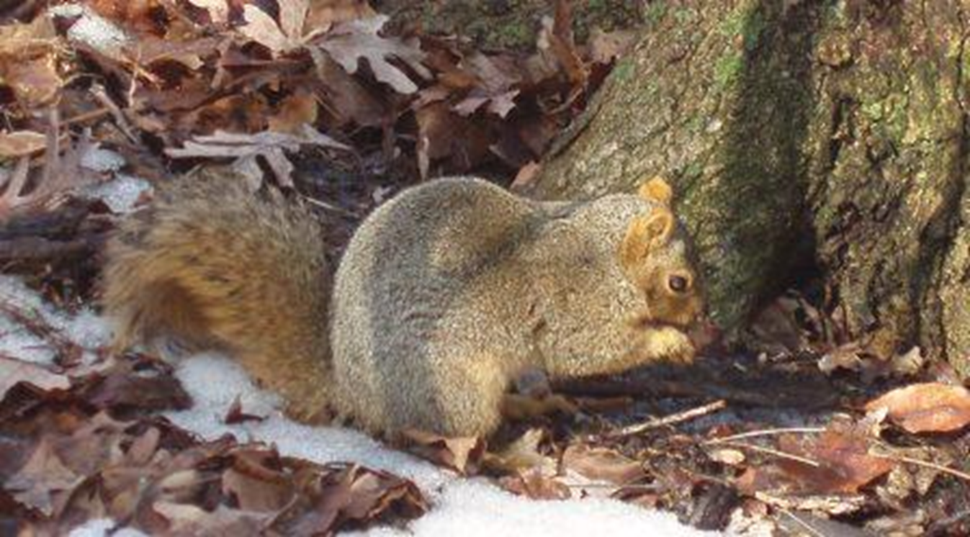
A Squirrel

Slide 8

This animal has pointy ears.
It can be either brown, grey, black or white.
In the story about Percy the Park Keeper, there were two of these.

Slide 9
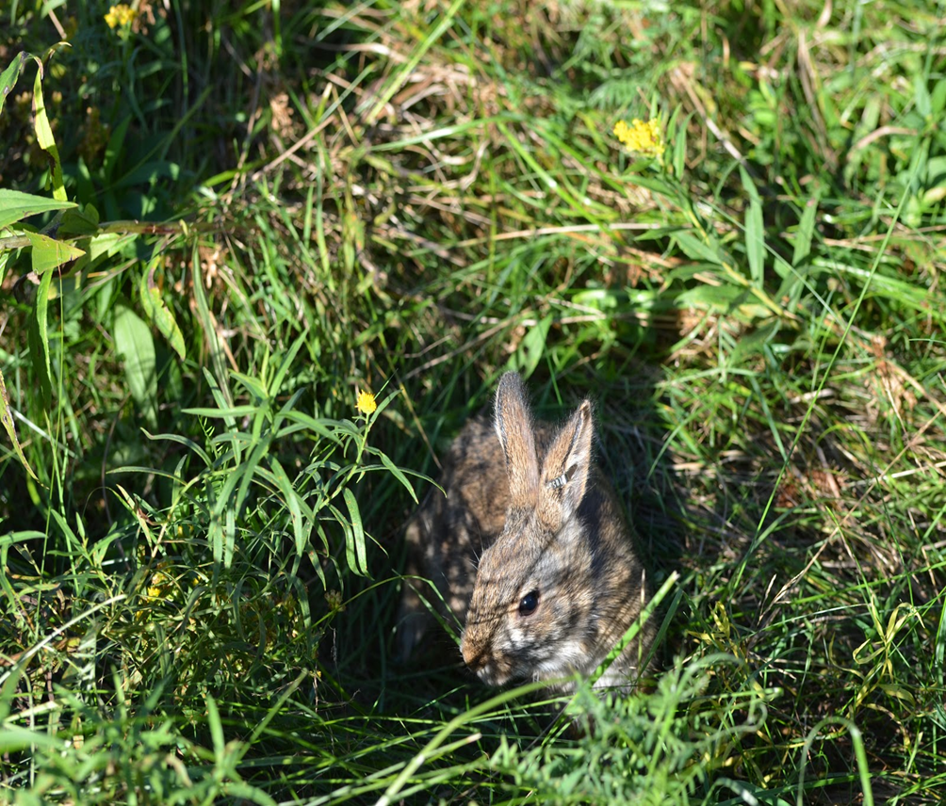
Rabbits

Slide 10

It lives under the ground.
This animal lives in a sett.
It makes tunnels under the ground.

Slide 11
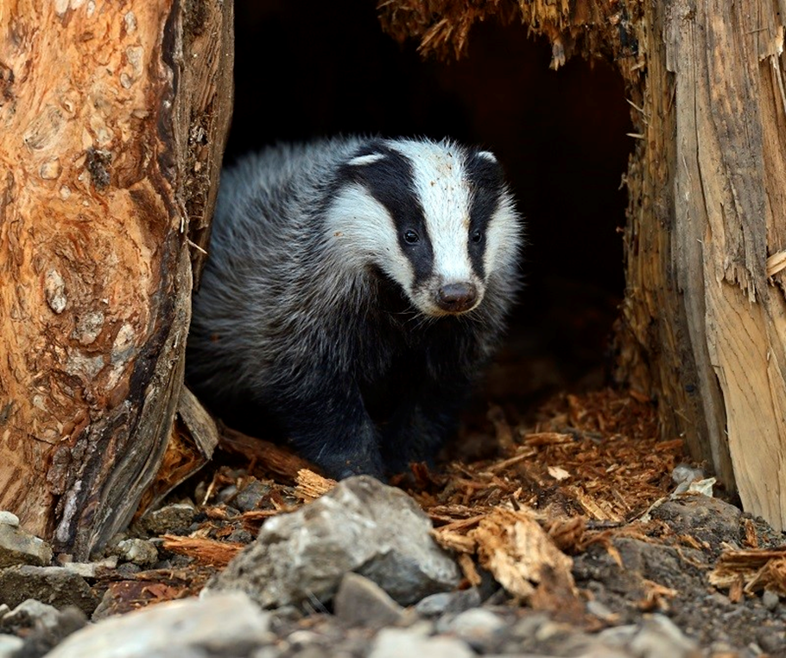
Badger

Slide 12

This animal was the last animal in the story about Percy the Park Keeper. It came up through the floorboards.
It uses its paws to dig the ground.
It lives underground.

Slide 13
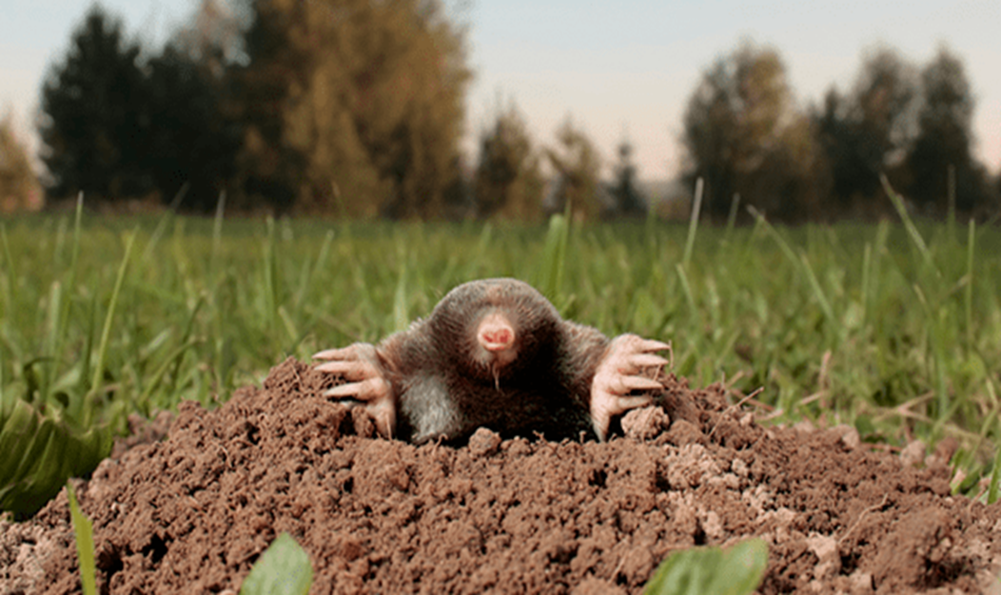
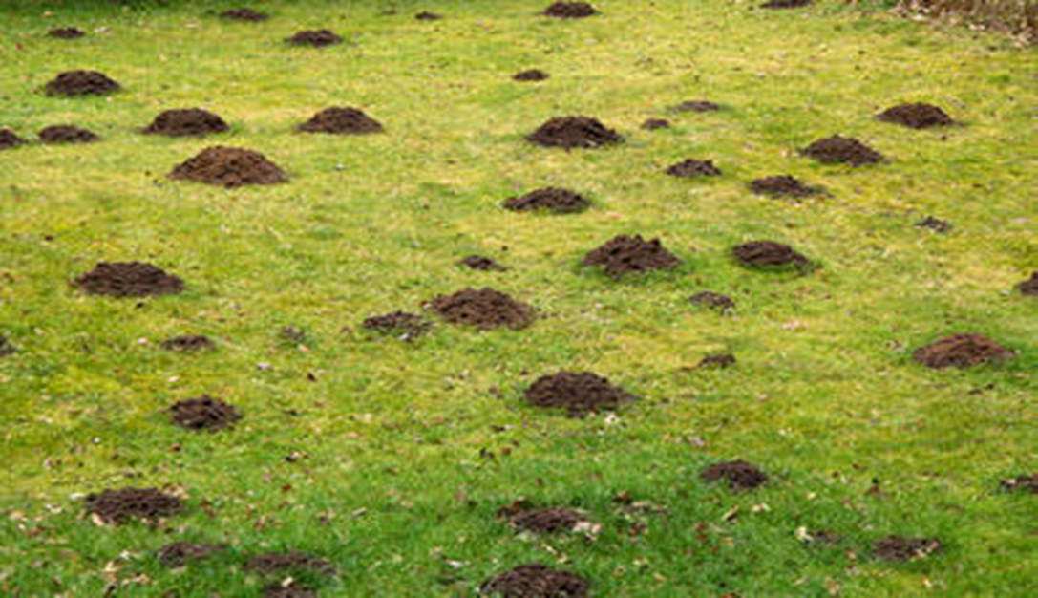
Mole and Mole Hills

