Slide 1
Set 1 Sounds l

Slide 3
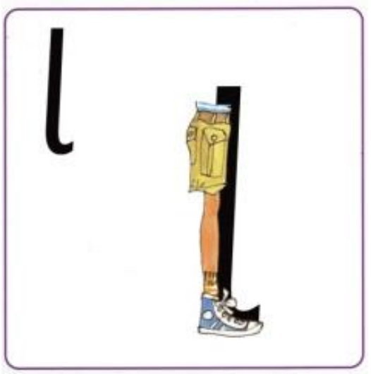

Slide 6
