Slide 1
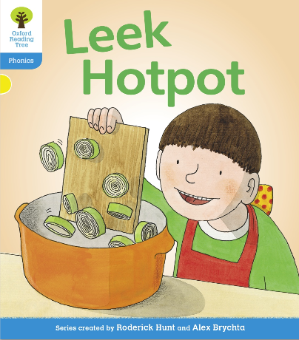

You are going to read the story ‘Leek Hotpot’.
In this story you will hear words with the sounds:
ee
oo
The ee sound is in the words:
see
tree
three
The oo sound is in the words:
book
look
cook

Slide 2
Can you write two words with the oo sound in and two words with the ee sound? Ask an adult to check your spellings.
Look at the picture. What is Biff doing? What will happen in the story?

Slide 3
Let’s read the words together to practice the sounds we are learning.
see
leek
peel
need
deep
beep
feed
been
cookbook
took
good
look

Slide 4
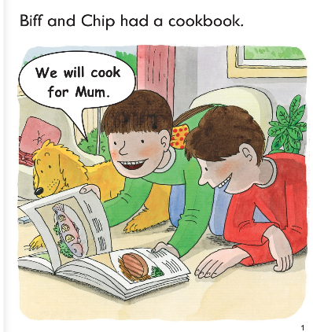
Write down all of the words you can see with the oo sound we are learning today.
What were Biff and Chip going to do?
What did they have?

Slide 5
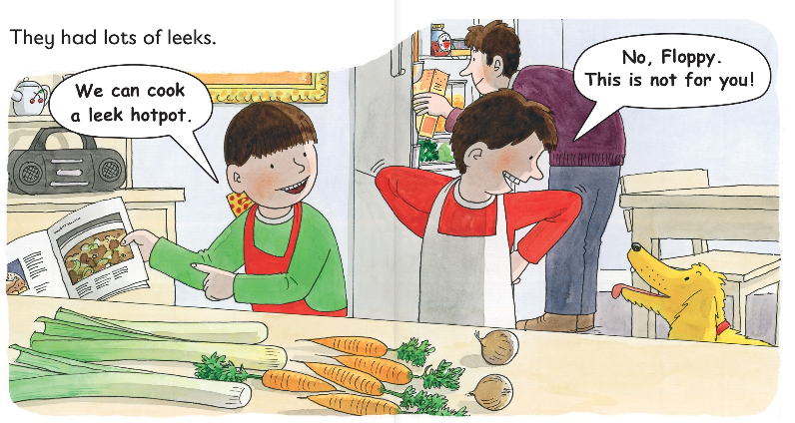
What were the children going to make?
What did they have lots of?

Slide 6
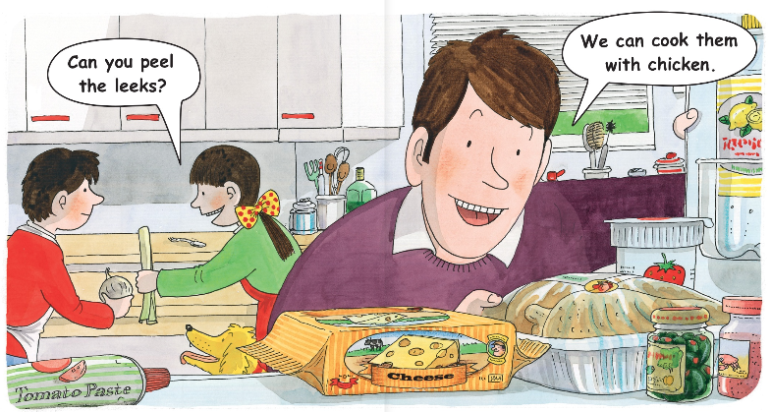
What does Biff want Chip to do?
What does dad think they could cook with the leeks?

Slide 7
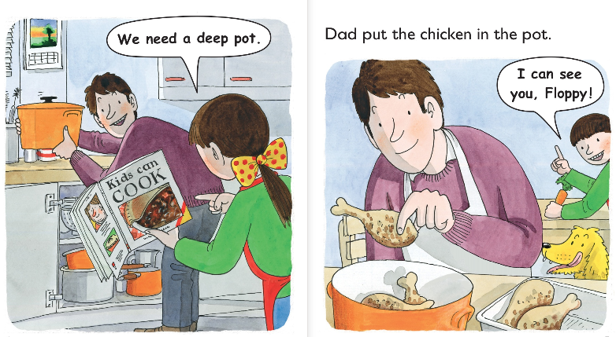
What do the children need?
What is Floppy doing?

Slide 8
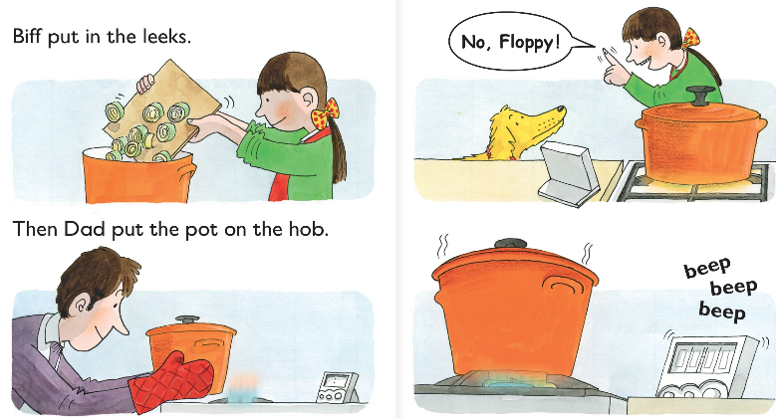
Who put the leeks in the pot?
What did dad do?

Slide 9
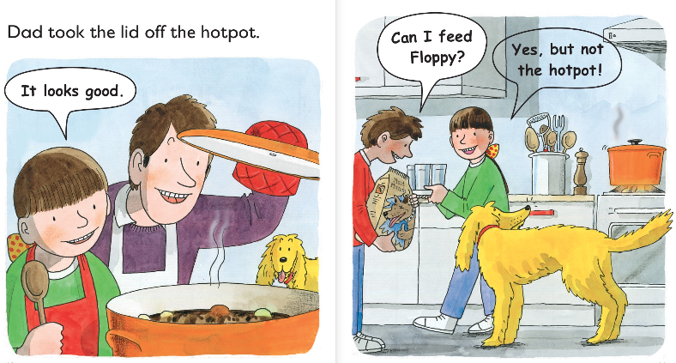
What does Chip give Floppy to eat?
What does Floppy really want?

Slide 10
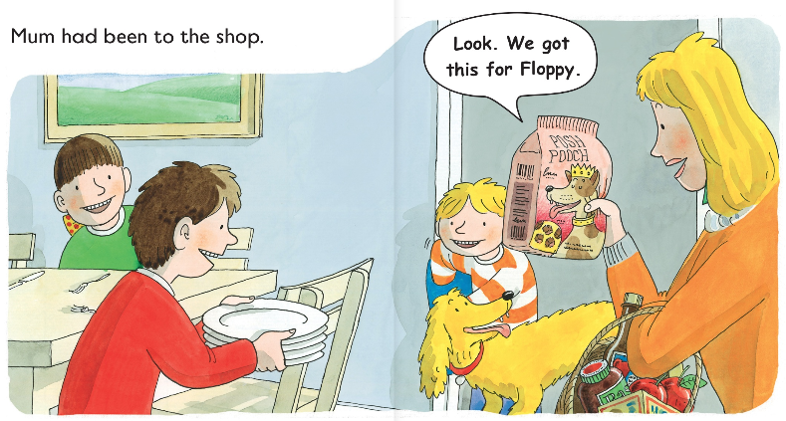
Where had mum been?
What had mum got floppy?

Slide 11
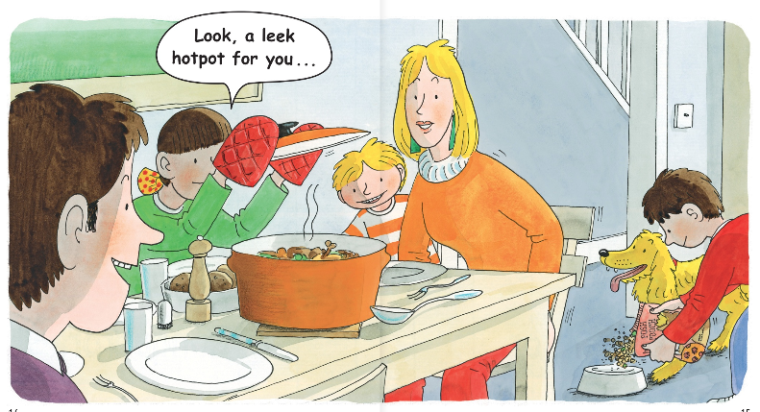
What had the children made for mum?

Slide 12
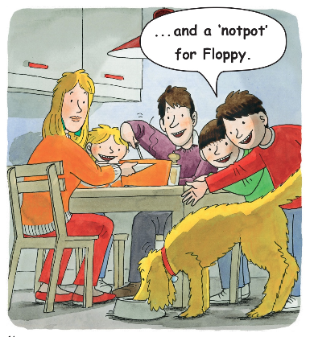
What did Floppy have for dinner?
How do you think the family thought of the hotpot? Why do you think this?

Slide 13
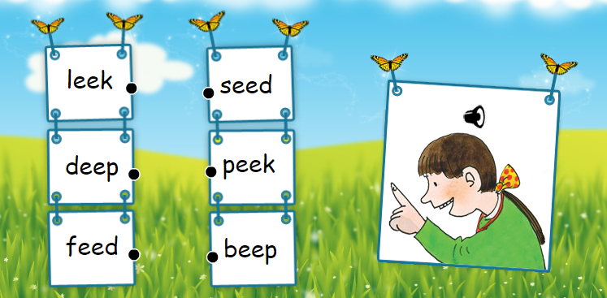
Read each word below. Can you match up the rhyming words?

