Slide 1
PSHE
Learning intention: To embrace

Slide 2
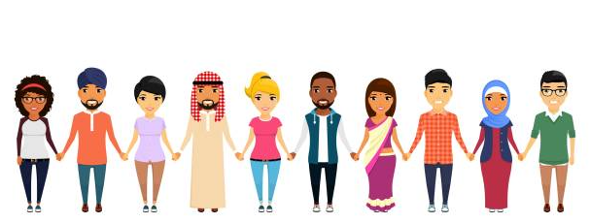
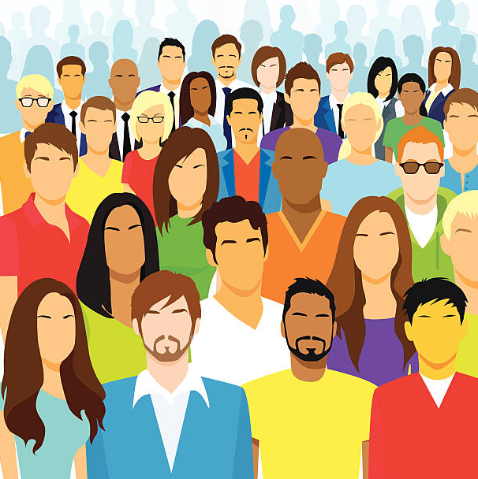
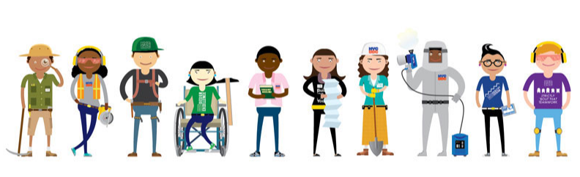

What makes us special?
Everyone is unique.

Slide 3
What makes us special?
Everyone is unique.
hair colour
height
language
type of family
talents
beliefs

Slide 4
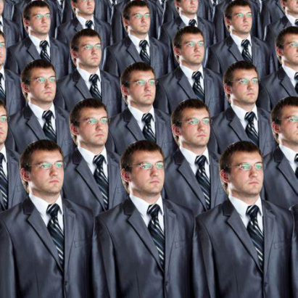
Why is it good that everyone is different?
It’s not boring.
We need different people’s talents for different jobs.

Slide 5
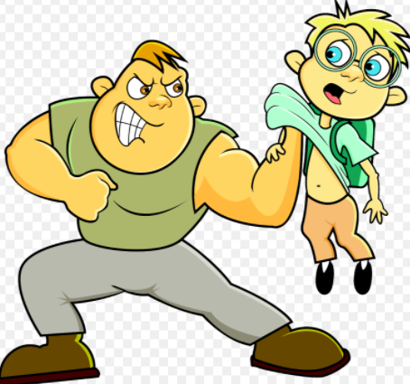
Respecting Differences
Discrimination is where somebody is treated unfairly because of their differences.
What do you think you should do if you think someone is being discriminated against?

