Slide 1

Learning Intention Identify angles Right angles

Slide 2
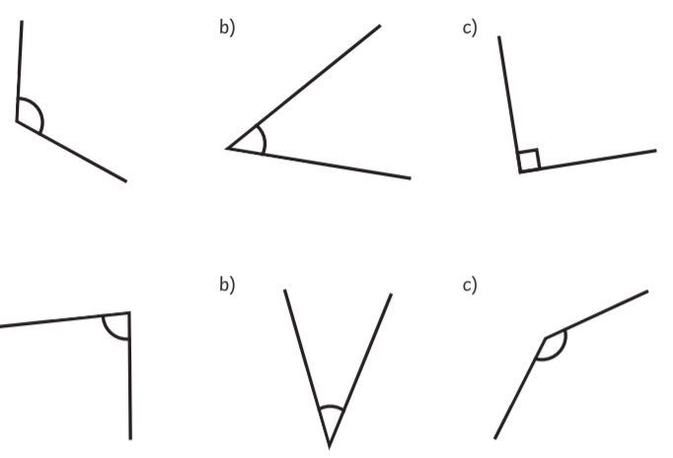
What is an angle?
An angle is where two lines meet. These are all angles.

Slide 3

Different types of angles have different names.
These are ‘right angles’.
2 lines meet each other and form
a perpendicular join.

Slide 4
Not all angles are right angles.
These are not all right angles. Can you see the difference.
Right angle

Slide 5
Right angles are often shown like this with a square corner.
This shows you the angle is a right angle.
All other angles have round corners.
square round

Slide 6
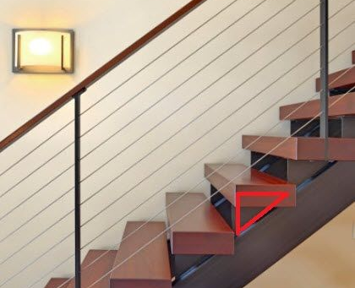
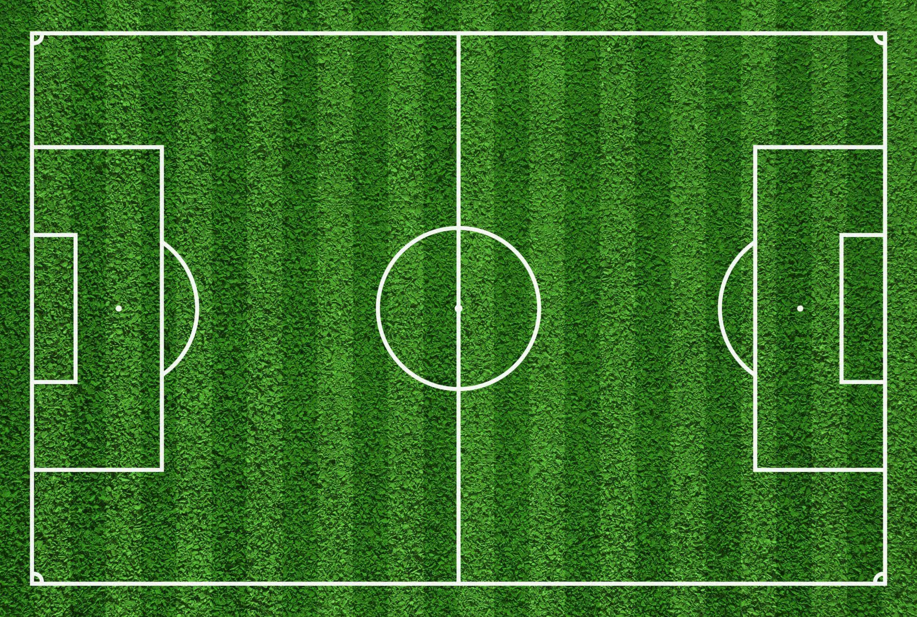
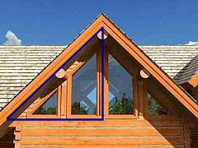

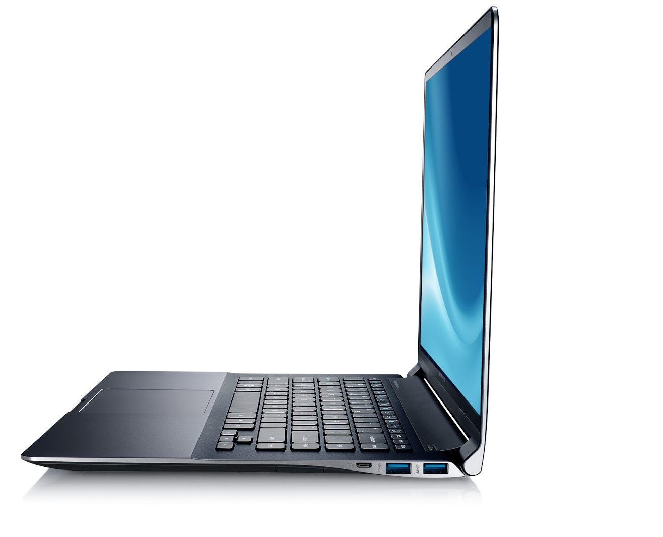
We see right angles everywhere!

Slide 7


How many can you find?
Use the corner of a normal piece of paper or a book to help you. They are all right angles!
right angles

Slide 8
Now complete the sheet Maths Alternative 2.
Find the right angles.

